Slide 1
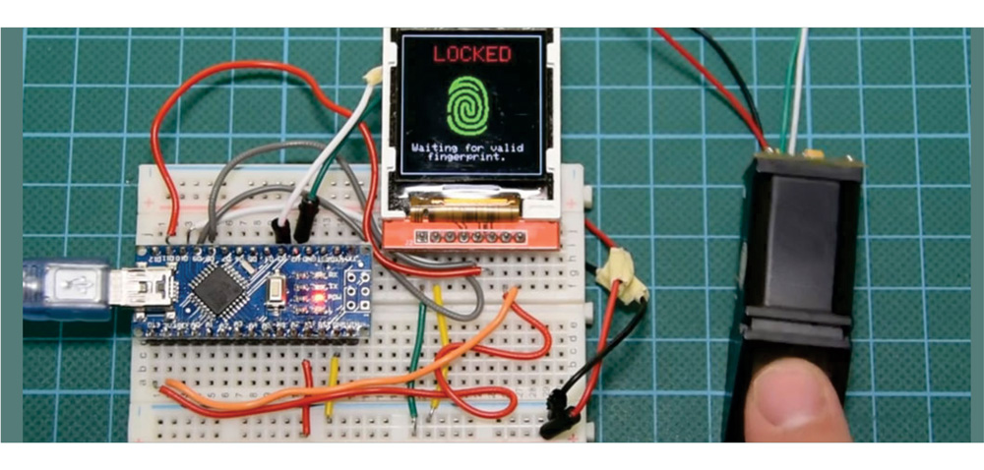
Embedded System Development
Adam Hoover

Slide 2
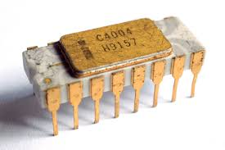
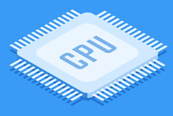
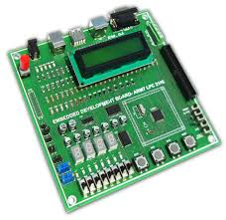
Outline
History of embedded computing
Design levels
Design methods and tools

Slide 3
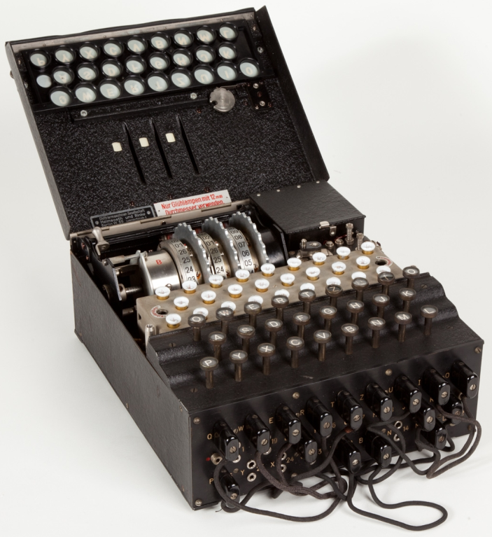
History
Enigma machine used by
Germany in WW2
From the film “The Imitation Game”, Alan Turing’s
Bombe computer designed to crack Enigma codes

Slide 4
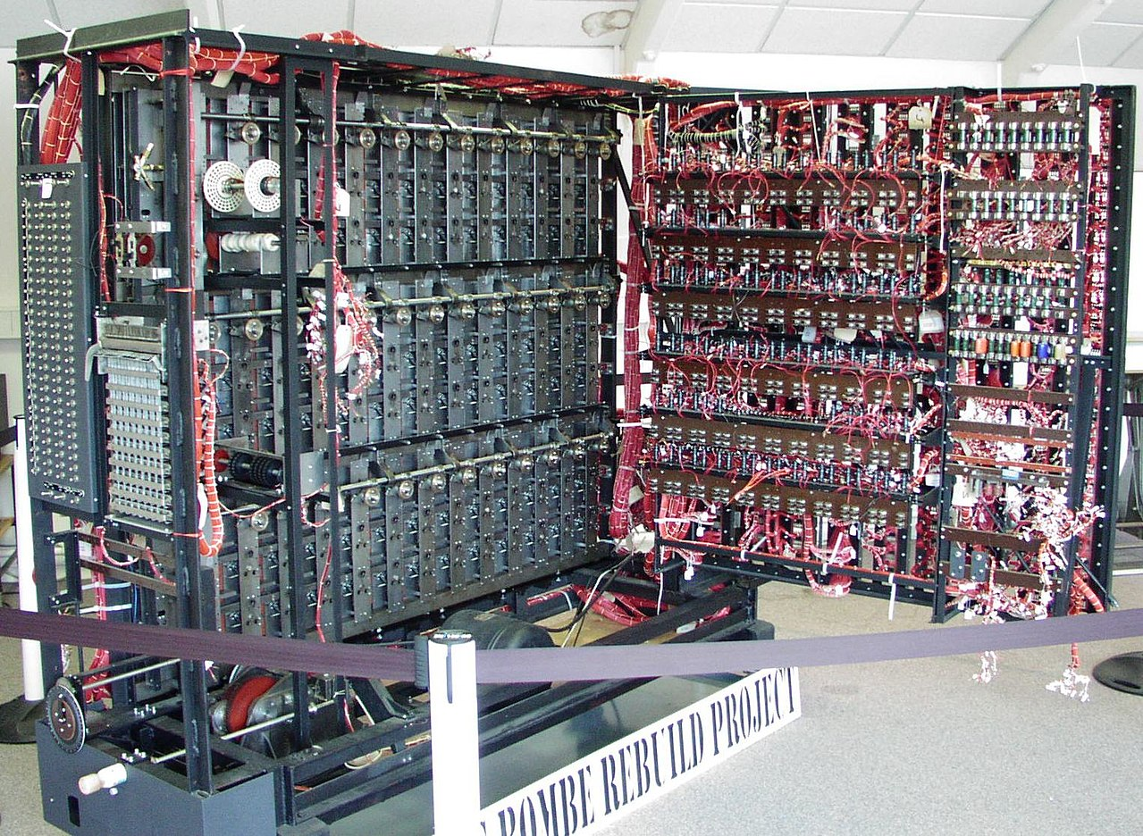
History
Modern replica from the Bombe rebuild project

Slide 5
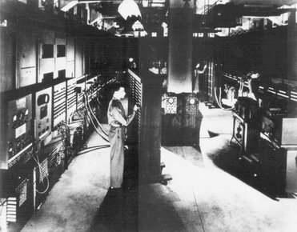
History
ENIAC computer, circa 1945, US Army used for artillery calculations

Slide 6
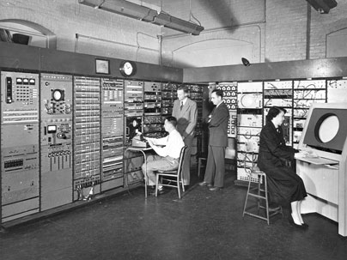
History
Whirlwind computer at MIT, circa 1950, used for flight simulator
First example of “embedded” – computer part of larger machine

Slide 7
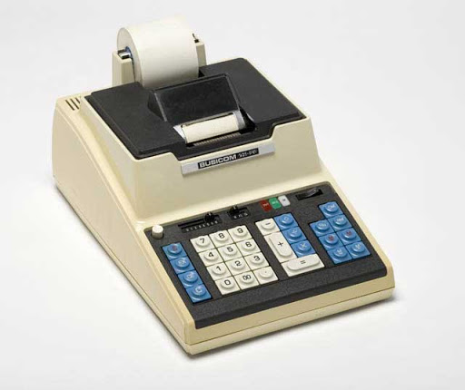
History: microcontroller
Intel 4004, circa 1970,
first microcontroller
Busicom calculator
microcontrollers in automobiles, circa 1975
partly in response to oil crisis of 1970’s

Slide 8
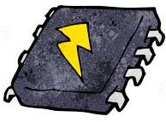
Why embed a processor?
mechanical, analog
processor, digital
Digital designs tend to be:
faster (response time)
cheaper (part quantity and cost)
more reliable (less physical wear, more predictable)
programmable (easy to change)

Slide 9
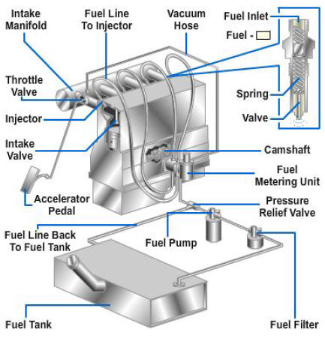
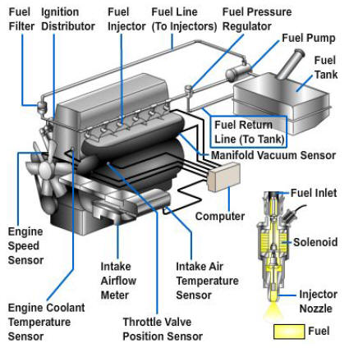
Automobiles
mechanical-timed injection
electronic fuel injection
[click for reference]

Slide 10
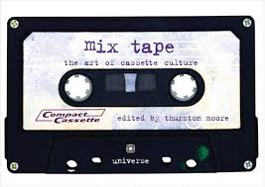
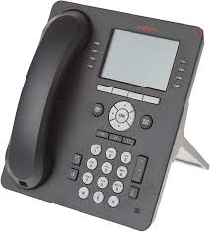
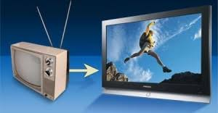
History: DSP
AT&T DSP1, 1980
transition from analog to digital music
analog to digital telephony
analog to digital television

Slide 11
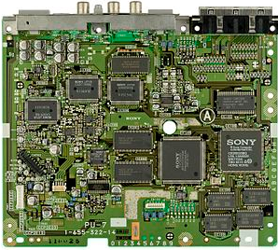
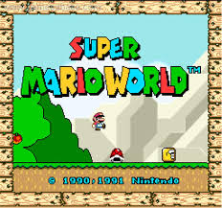
History: GPU
Nvidia GeForce 256
circa 1999, first GPU chip
Sony “GPU” board, circa 1994, in PlayStation
Video games transitioned from 2D to 3D

Slide 12
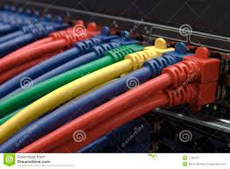
History: Network processor
Intel IXP, circa 2002
Backbone routers and switches
Transitioned from ASICs to NPs
Speeding up packet routing (the internet)

Slide 13
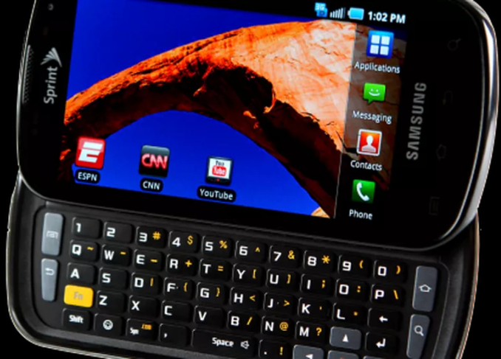
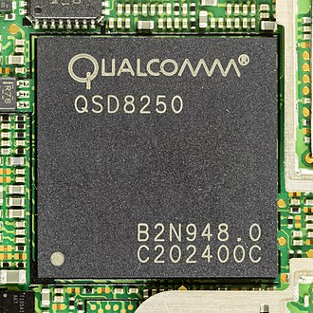
History: System on Chip
Qualcomm Snapdragon, circa 2009
Samsung smartphone, circa 2010
transition from simple phones to smartphones

Slide 14
History…and future?
1970’s microcontroller automobiles
1980’s DSP telephony, television, audio
1990’s GPU video games
2000’s network processor internet
2010’s SoC (system on chip) smartphones
2020’s AI/ML chips driverless cars
future ? ?

Slide 15
Outline
History of embedded computing
Design levels
Design methods and tools

Slide 16
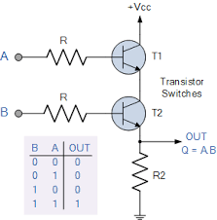
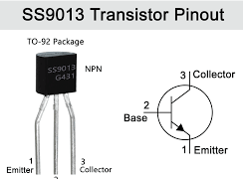
Transistor level design
application specific
Integrated circuit
transistor
transistors -> gates
Common tools include SPICE, Synopsys, Cadence

Slide 17
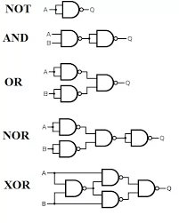
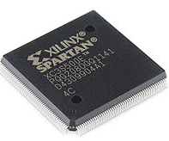
Logic level design
field programmable
gate array (FPGA)
hardware description
language (e.g. Verilog)
gates
Common tools include VHDL, Verilog

Slide 18
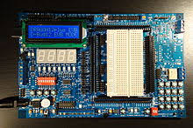
Processor level design
processor
coding
dev board
Common tools include IAR Embedded Workbench, gnu gcc,
or manufacturer-specific (e.g. Texas Instrument’s Code Composer Studio)

Slide 19
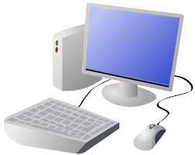
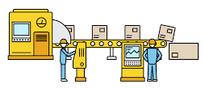
Computer level design
OTS computer
high level coding
factory deployed
Common tools include desktop IDEs (Visual Studio, Eclipse) and
GUI-based block design tools (LabVIEW, Simulink)

Slide 20
Comparison
Development cycle:
Programming quicker than circuit design
Debugging code easier than debugging circuit
Code reuse easier than circuit reuse
Product family based on processor family
Execution speed:
ASIC has no fetch/decode overhead
Processors use instruction level parallelism, e.g. pipelining
Fabrication:
ASIC requires significant overhead (setup)
Processors use state-of-the-art fab equipment
Processors produced in bulk = lower cost

Slide 21
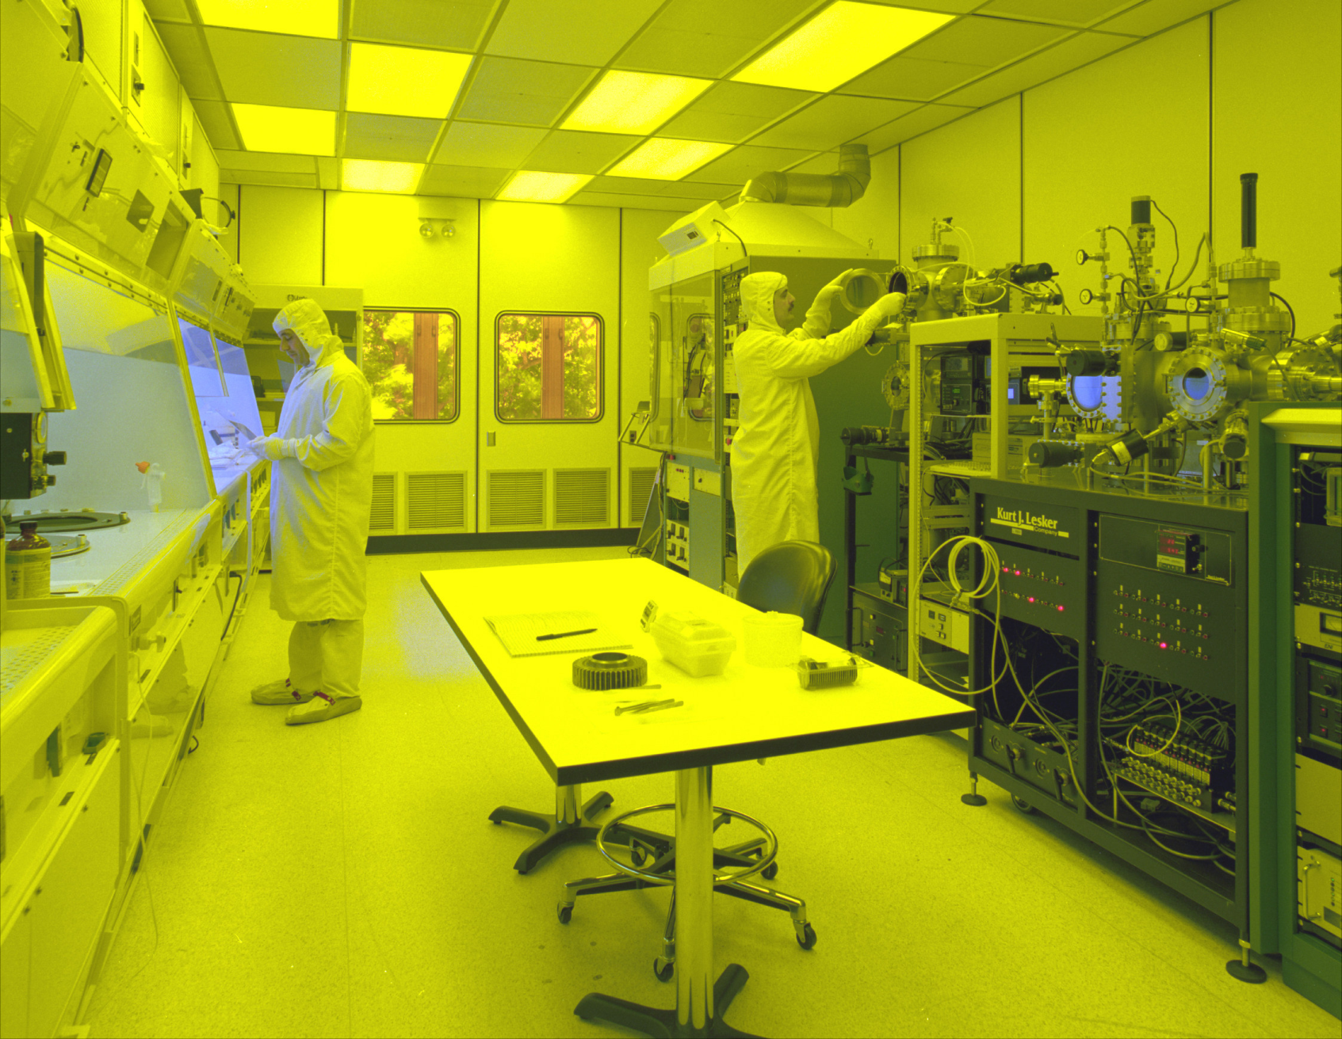
Fabrication facility

Slide 22
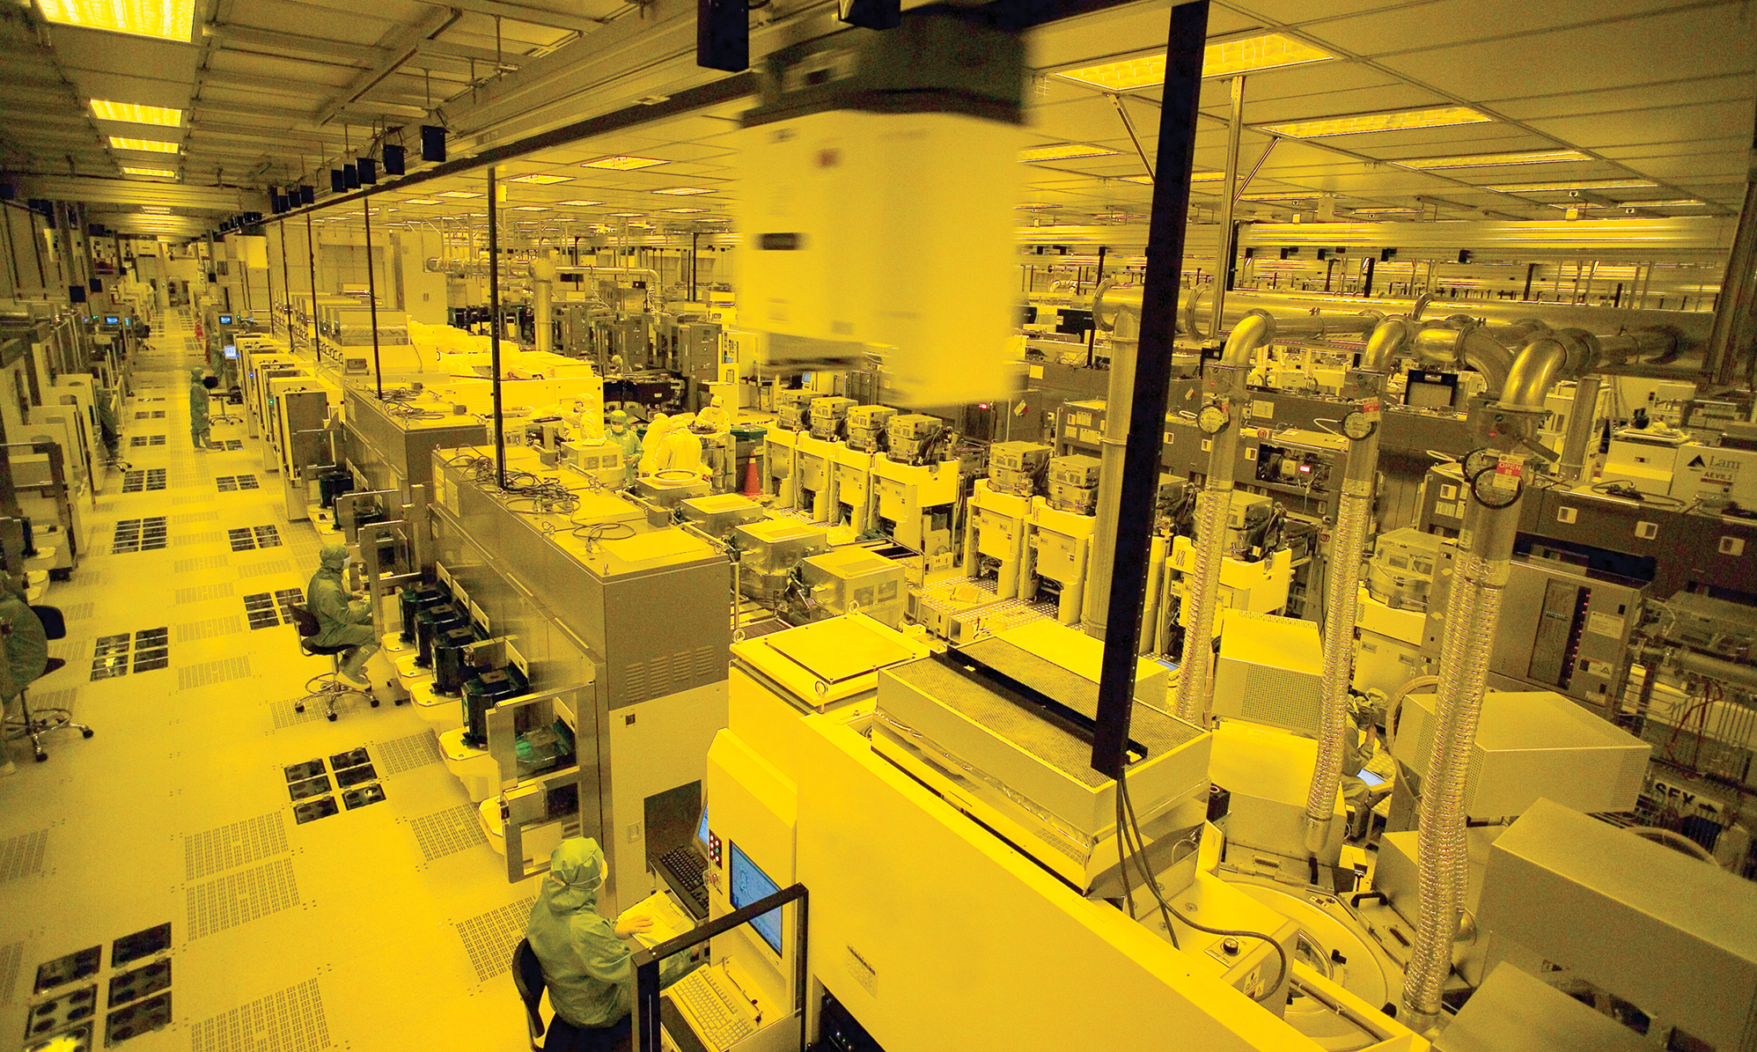
Big fabrication facility

Slide 23
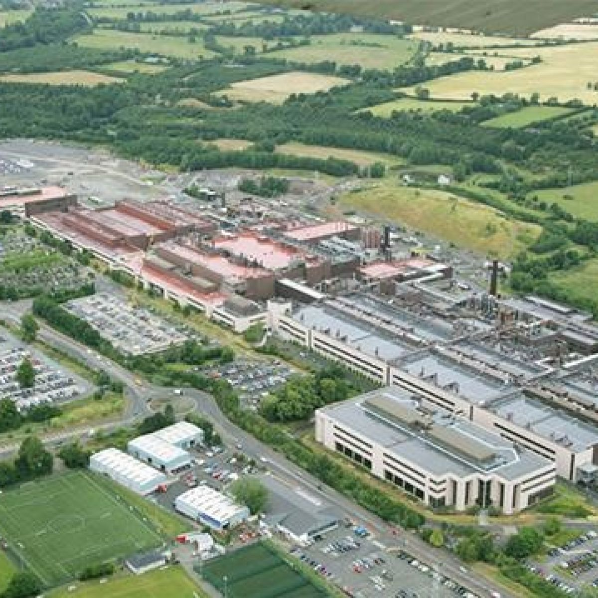
Intel’s Ireland fabrication facility
Cost: $8B
[click for reference]

Slide 24
Comparison
Most embedded products use processor-level design
due to cost and speed of design cycle
When volume gets high enough, advantages of ASICs
take over (e.g. smartphones, video game consoles)
FPGAs and OTS computer level design commonly used
in factories and where engineers work
(reconfiguration, programming, hardware re-use)

Slide 25
Outline
History of embedded computing
Design levels
Design methods and tools

Slide 26
Development board
Main purpose is to “break out” all processor pins for breadboard work
Often includes essential analog circuits for interfacing
Typical cost $10-20

Slide 27
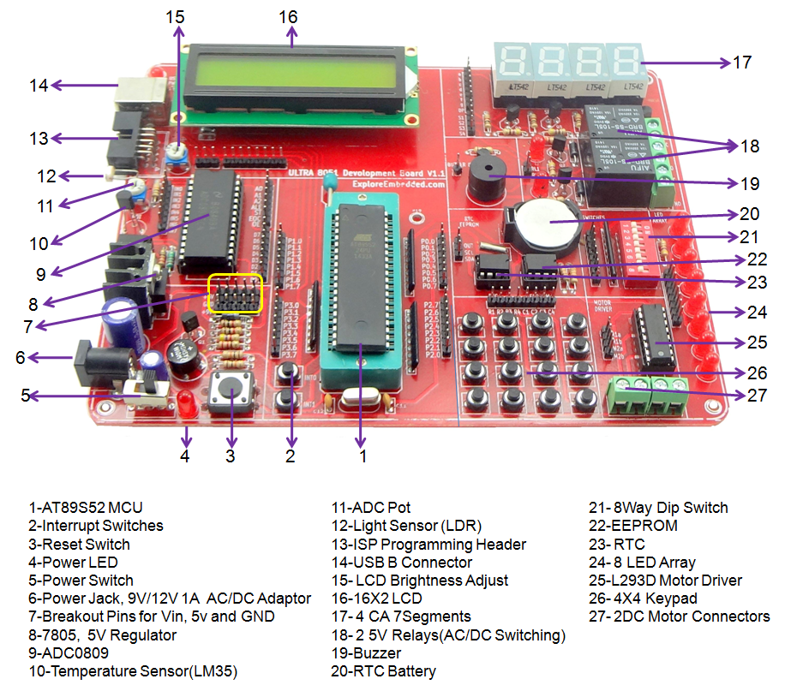
Development board
More sophisticated boards include support items like buttons, displays, ports

Slide 28
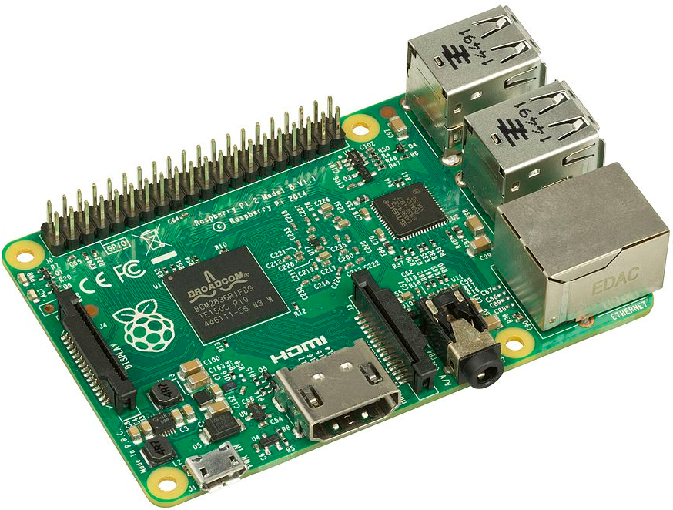
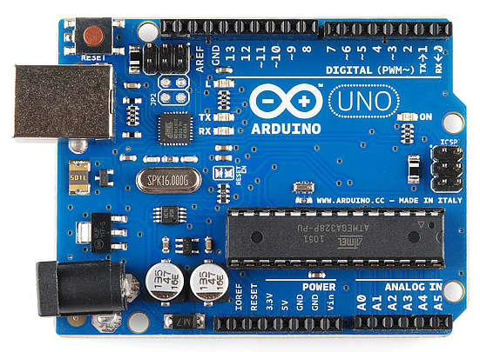
Single-board computer
Raspberry Pi
Arduino
Typically has all components needed to operate on single board
Dev board becomes the product
Used when product appearance does not matter (e.g. factories, hobbyists)

Slide 29
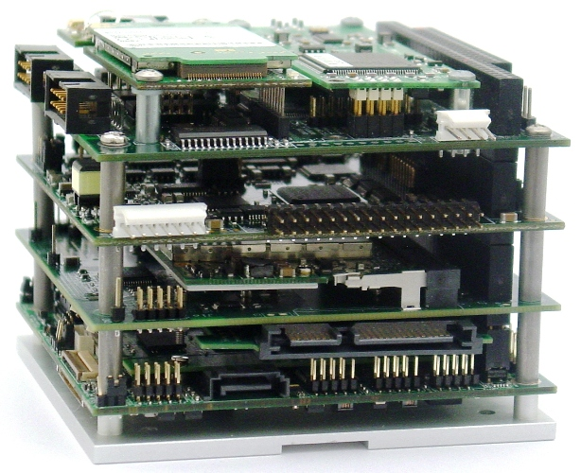
PC/104
Design using layered boards (rugged backplane)
Each layer provides different component (CPU, display, I/O, whatever is needed)
Uses standard PC bus architectures to simplify development

Slide 30
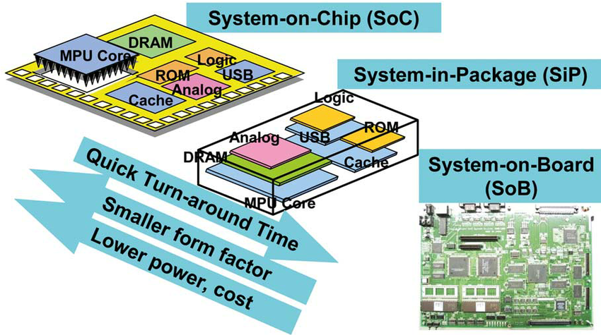
SoC, SiP, SoB
Basically a continuum between one chip, a set of chips, and a dev board
As more can be packed into a single chip, technology progresses towards top-left

Slide 31
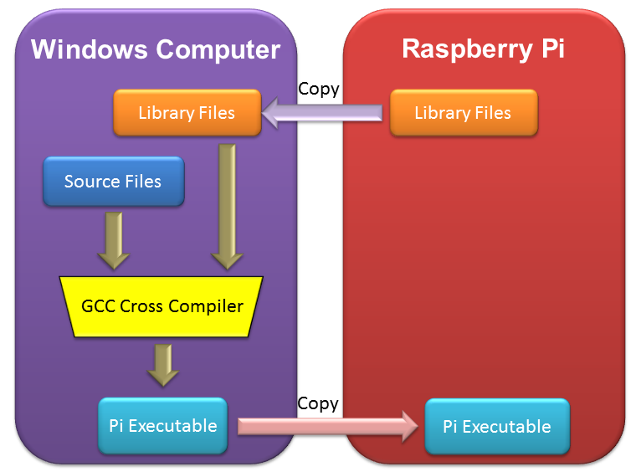
Cross compiler
Allows development to take place on hardware different from target hardware
Common for smartphone app development (e.g. Android Studio)
Generate multiple targets simultaneously (e.g. Windows -> MacO/S and Android)

Slide 32
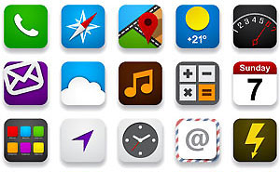
Hardware/software co-development
Group #1 working on hardware
Group #2 working on software (e.g. O/S)
Co-design toolset
Group #3 working on integration, testing, via simulation
Common for complex systems or when time-to-market is critical

