Slide 1
Intro to Deep Learning
Adam Hoover

Slide 2
Outline
Motivation
Similarity to template matching
Gradient ascent (or descent)
Live demo #1
Layers
Live demo #2
Images
Live demo #3
Classifier designs
Hardware
Programming languages
The hype

Slide 3
Template Selection
Suppose we want to recognize the numbers “0” and “1” in handwriting
We start by taking an example of each to use as templates for matching

Slide 4
Template Matching
match
score
match
score
We run it on some data and find they match some good, some bad

Slide 5
Template Selection
match
score
match
score
Now we (somehow) pick a second template for each class to start building a filter bank

Slide 6
Filter Bank
How do we pick templates?
How many templates do we need?
As number of classes grows, template selection becomes tedious and error prone.

Slide 7
Deep Learning Concept
Automatically learn a “filter bank” of templates from large labeled data set

Slide 8
Example
Y
X
data
Suppose we want to classify 1D data having upward vs downward slopes
-1
0
1
1
0
-1
desired template for class 0 (“up”)
desired template for class 1 (“down”)

Slide 9
Example Classification
Y
X
data
-1
0
1
(-2 x -1) + (0 x 0) + (3 x 1) = 5
class 0 template
-2
0
3
input data
1
0
-1
(-2 x 1) + (0 x 0) + (3 x -1) = -5
class 1 template
Highest score = recognized class (this input data trends “up”)

Slide 10
Template Learning
initialize templates
0
0
0
0
0
0
class 0 template
class 1 template
randomly adjust weights
0
2
1
1
-1
0
classify training data
-2
0
3
(-2 x 0) + (0 x 2) + (3 x 1) = 3
(-2 x 1) + (0 x -1) + (3 x 0) = -2
(reward correct class, penalize incorrect class)
evaluate classifier
label is class 0
(3 x 1) + (-2 x -1) = 5
pick weight adjustments that improve total classifier score

Slide 11
Multiple Data
randomly adjust weights
0
2
1
1
-1
0
loop through all training data
classify training data #1
-2
0
3
(-2 x 0) + (0 x 2) + (3 x 1) = 3
(-2 x 1) + (0 x -1) + (3 x 0) = -2
label is class 0
classify training data #2
4
(4 x 0) + (1 x 2) + (-2 x 1) = 0
(4 x 1) + (1 x -1) + (-2 x 0) = 3
1
-2
label is class 1
classify training data #3
-3
(-3 x 0) + (1 x 2) + (2 x 1) = 4
(-3 x 1) + (1 x -1) + (2 x 0) = -4
1
2
label is class 0
all training data contribute to total classifier score
(3 x 1) + (-2 x -1) + (0 x -1) + (3 x 1) + (4 x 1) + (-4 x -1) = 16

Slide 12
Iterate Learning
initialize templates
0
0
0
0
0
0
class 0 template
class 1 template
randomly adjust weights
… (pass through all data once)
0
2
1
1
-1
0
0
1
1
2
-1
0
… (pass through all data once)
-1
1
1
3
0
1
… (pass through all data once)
-1
1
2
2
0
-1
Each iteration through the data is called an “epoch”

Slide 13
Gradient Ascent (or Descent)
classifier score
epochs
final
value
initial
value
weights
(template values)
Learning parameters include:
Number of epochs (more may learn better but takes longer)
Learning rate (amount to change weights per epoch)
Initial value (better starting point needs less epochs)

Slide 14
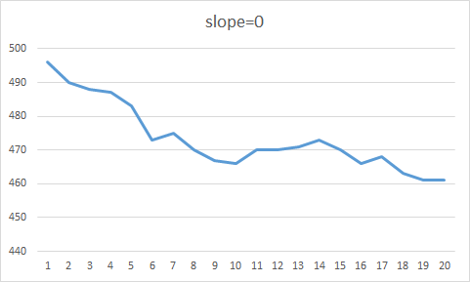
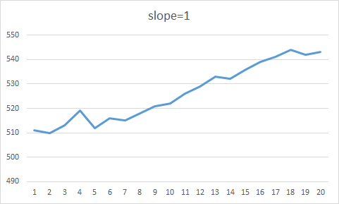
Live Demo #1
“simslope” (http://cecas.clemson.edu/~ahoover/deep-learning/)
1000 “samples” (500 down trends, 500 up trends)
simslope0.py learns weights and prints templates to screen
increase #epochs to learn better templates
saves weights into classifier “model file”
simslope1.py reads model file and uses it to classify data
reports final classifier scores for each sample

Slide 15
Layers
0
2
1
0
1
1
1
-1
0
-1
1
1
2
-1
0
3
0
1
input data
0
1
7
5
-1
2
3
4
0
layer 1
-6
3
4
layer 2
5
layer 3
Classifier can have multiple layers of weights
Early layers learn low-level features, deeper layers learn feature patterns
Classifier design depends on problem

Slide 16
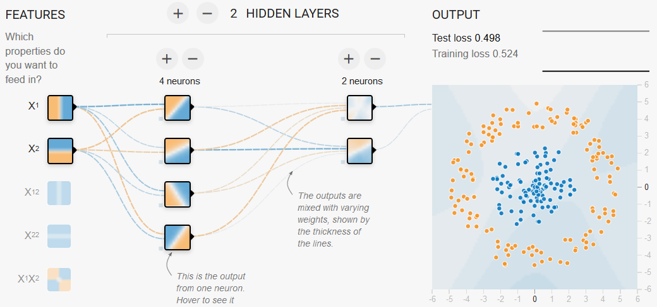
Live Demo #2
“playground” (http://playground.tensorflow.org/)
two classes (orange, blue), two features (x, y)
two layers (4 weights, 2 weights)

Slide 17
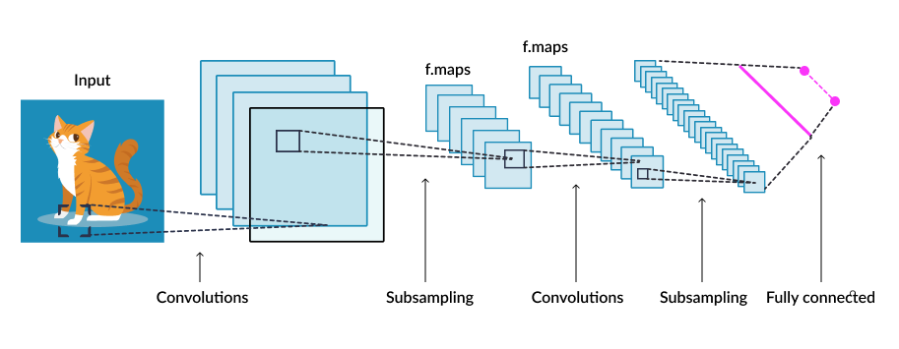
Images
Image analysis uses 2D filters of different sizes in multiple layers

Slide 18
Live Demo #3
“MNIST” (https://www.tensorflow.org/datasets/keras_example)
The “hello world” problem for deep learning
60,000 training images; 10,000 test images; 28x28 pixels per image
Takes appx 10 minutes to train (average computer)

Slide 19
Layer Types
Different types of layers provide different calculations:
Fully connected = all input feeds to output
Convolution = local window feeds to output
Recurrent = input + previous output feeds to next output
Many other types

Slide 20
Example Classifiers
Deep learning classifiers can have complex series of layers and connections depending upon the specific problem

Slide 21
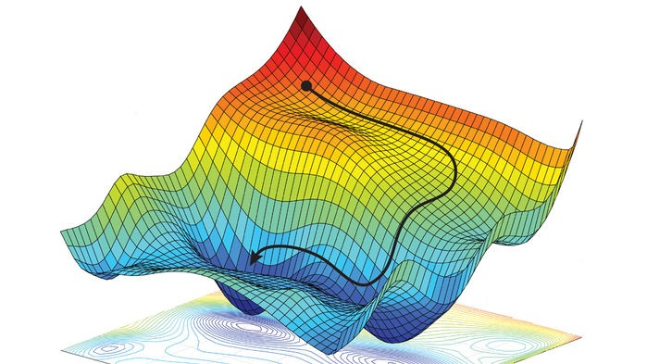
Multidimensional Search
Classifiers learn lots of weights simultaneously
Number of weights = “model parameters” of classifier
Search can be complex including multiple local minima/maxima
Training can take days or longer …

Slide 22
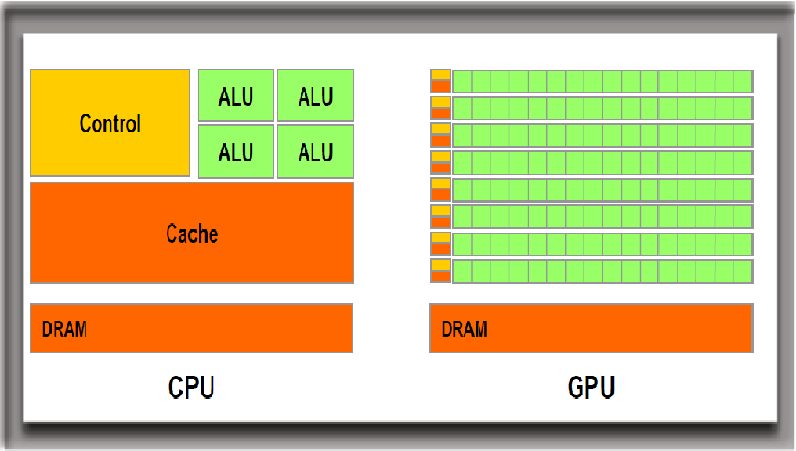
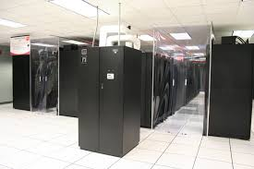
Hardware
GPUs are ideal for deep learning
Highly parallelizable matrix math
Cluster computing is common for deep learning
Clemson’s Palmetto cluster

Slide 23
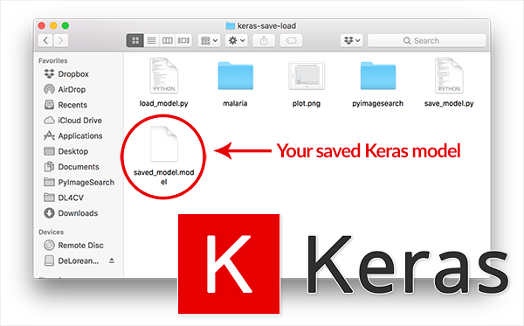
Programming Language
Classifier training done using Python programming
Classifier models (saved weights) can be loaded from a file into any program and used for new classifications (C, Python, Android, …)

Slide 24
Software Packages
TensorFlow (Google) most popular
Keras simplifies TensorFlow
PyTorch most popular with experts (scientists)
Comparison of packages

Slide 25
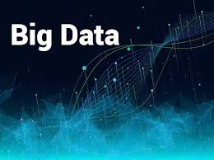
When to use?
Deep learning is just another tool
Don’t use it for every problem!
Good when features/patterns are complex
Don’t use for simpler problems!
Requires “big data” (lots of labeled samples)
If you don’t have data, forget it

Slide 26
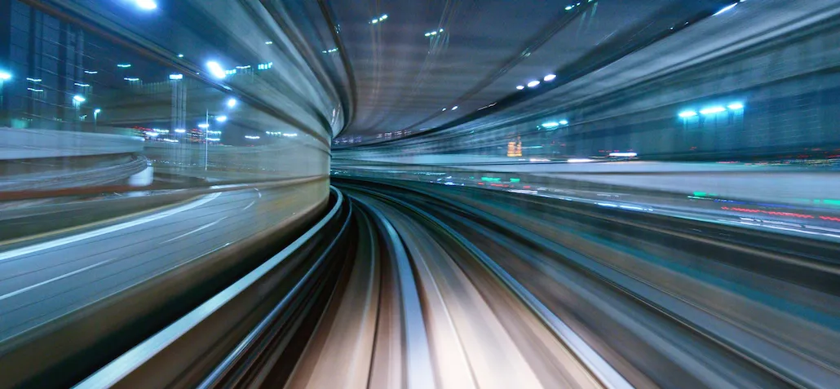
Learn More
Evolving at warp speed
My group’s deep learning website
Lots of other material on the internet

