Slide 1
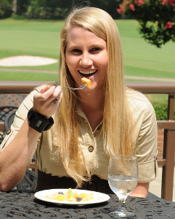

Tracking Wrist Motion to Measure Energy Intake
Adam Hoover
Electrical & Computer Engineering Department

Slide 2
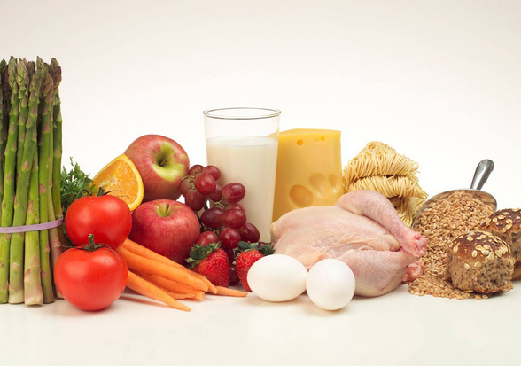
Outline
Motivation, related work
Tracking wrist motion to count bites
Relating bites to calories
Using bite counting for weight loss
Research opportunities

Slide 3
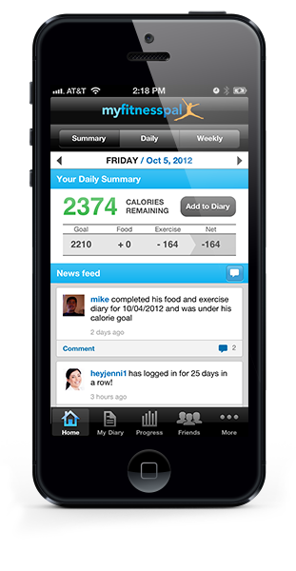

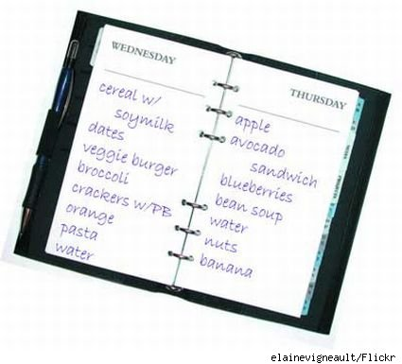
Classic tool problems
food diary, manual counting, database-assisted logs
Problem #1: Compliance (not easy to use for long period of time)
Problem #2: Underestimation/underreporting bias (dozens of studies have found it ranges 10-50%, evaluated using doubly labeled water)

Slide 4
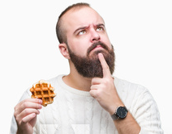
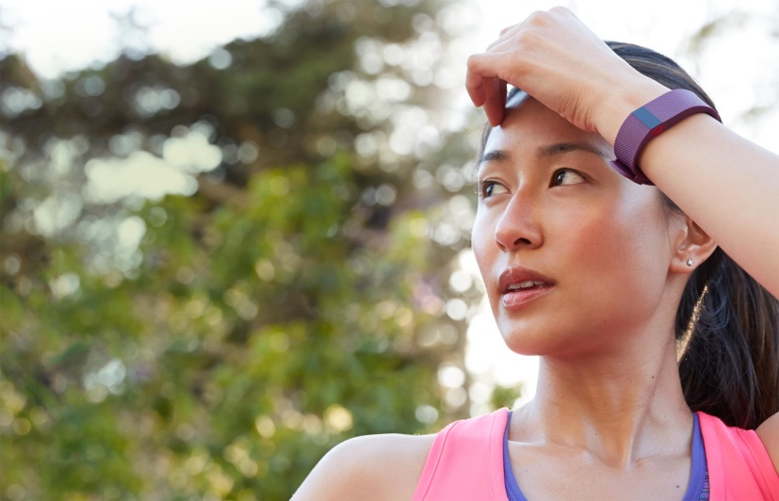
Challenge:
Wearable for Measuring Eating
Something like the FitBit

Slide 5

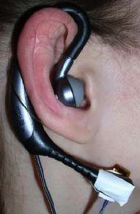
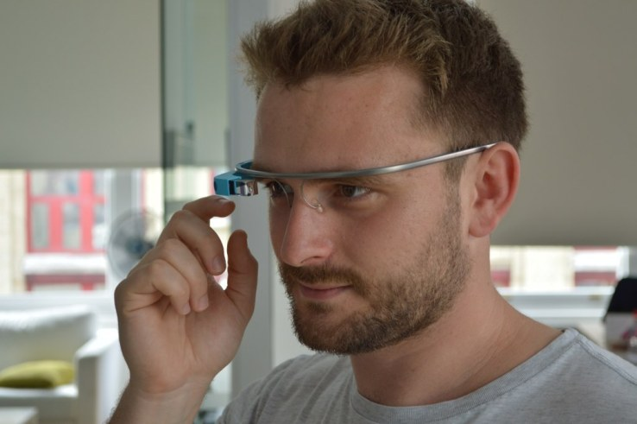
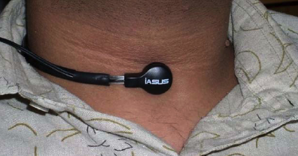
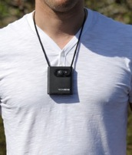
Related Work
  Throat and ear
Detect swallows, chewing sounds
  Glasses
Detect chewing motions
  Lanyard camera
  Video record eating activities
Challenge: Will you wear it every day for 6 months?

Slide 6
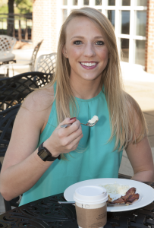
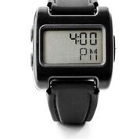
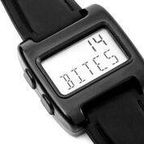
Our concept: Bite Counter
Audible alarms to queue behaviors such as slowing eating or portion control
Worn like a watch
Tracks wrist motion to detect eating activities and count bites (hand-to-mouth gestures)

Slide 7
Outline
Motivation, related work
Tracking wrist motion to count bites
Relating bites to calories
Using bite counting for weight loss
Research opportunities

Slide 8
Wrist Roll Motion
Wrist rolls to get food from table to mouth
Roll is independent of other axes of motion

Slide 9
Algorithm
The wrist undergoes a characteristic roll motion during the taking of a bite of food that can be tracked using a gyroscope
Biologically, this can be related to the necessary orientations for (1) picking food up, and (2) placing food into the mouth

Slide 10
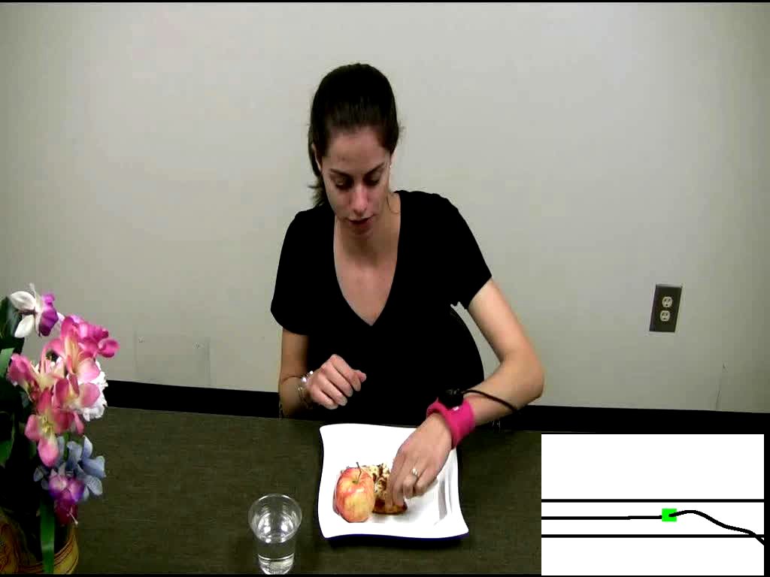
Demo of Bite Counting
Early test: 49 meals (47 participants), 1675 bites
86% bites detected, 81% positive predictive value
Talking and other actions between 67% of bites
Y. Dong, A. Hoover, J. Scisco and E. Muth, "A New Method for Measuring Meal Intake in Humans via Automated Wrist Motion Tracking", in Applied Psychophysiology and Biofeedback, vol 37, no 3, 2012, pp 205-215.

Slide 11
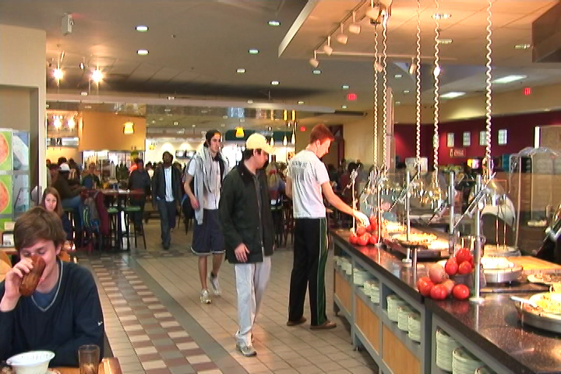
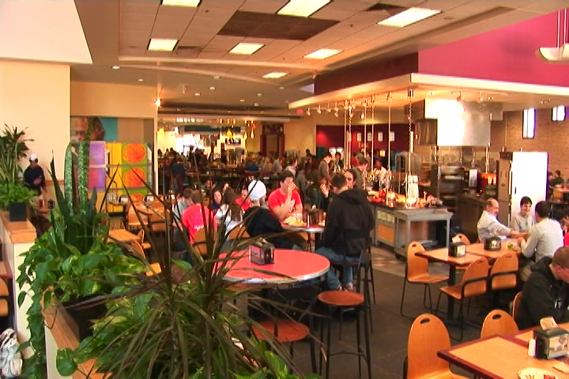
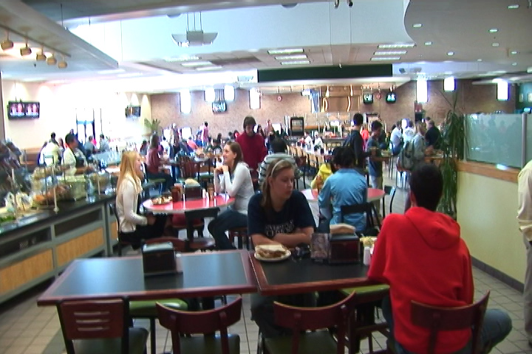
Cafeteria Experiment
Main food service for Clemson University
Seats ~800 people
Huge variety of foods and beverages

Slide 12
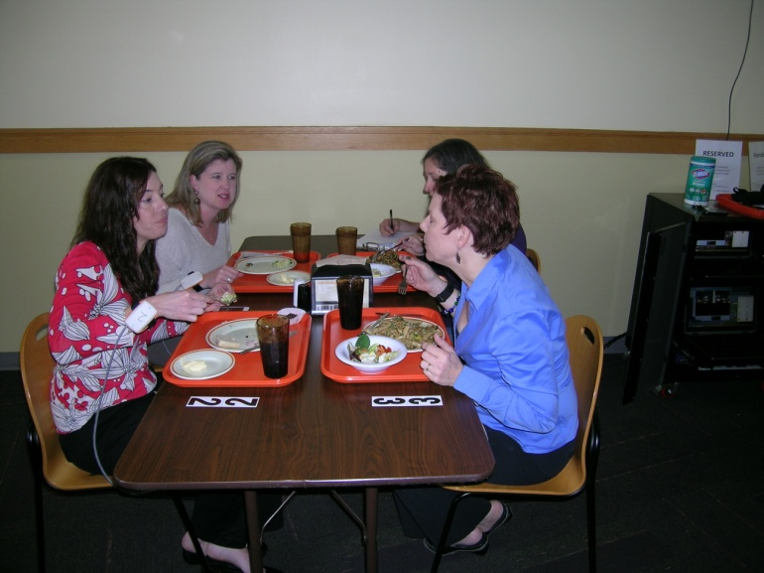
Cafeteria Experiment
276 participants (1 meal each)
374 different foods and beverages consumed
24,088 total bites
81% bites detected, 83% positive predictive value
Y. Shen, J. Salley, E. Muth and A. Hoover, "Assessing the Accuracy of a Wrist Motion Tracking Method for Counting Bites across Demographic and Food Variables", in IEEE Journal of Biomedical and Health Informatics, vol. 21 no. 3, March 2017, pp. 599-606.

Slide 13
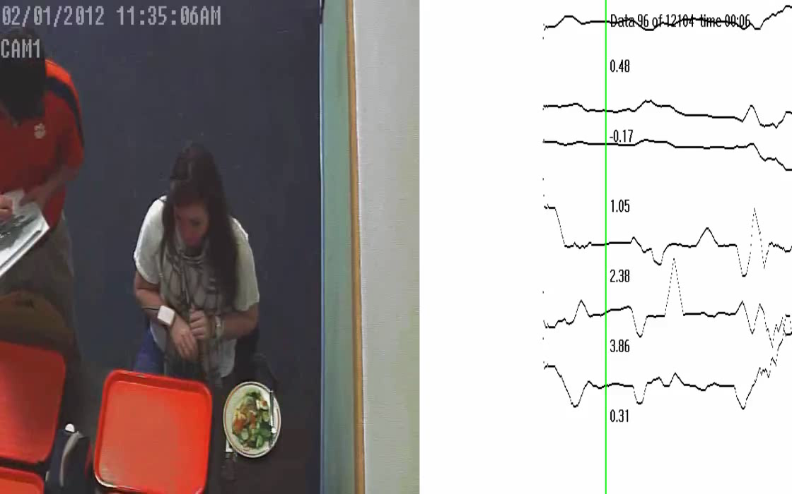
Cafeteria Demo

Slide 14
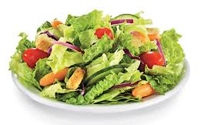
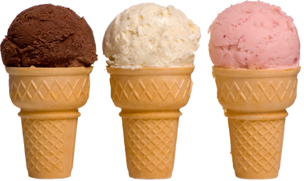
Bite Counting Accuracy
most accurate food:
salad bar (87%)
least accurate food:
ice cream cone (37%)
Accuracy increases as seconds per bite slows
(age, gender, ethnicity)
Accuracy modestly correlates with total wrist motion
(head-toward-plate vs hand-towards-mouth motion)
Y. Shen, J. Salley, E. Muth and A. Hoover, "Assessing the Accuracy of a Wrist Motion Tracking Method for Counting Bites across Demographic and Food Variables", in IEEE Journal of Biomedical and Health Informatics, vol. 21 no. 3, March 2017, pp. 599-606.

Slide 15
Outline
Motivation, related work
Tracking wrist motion to count bites
Relating bites to calories
Using bite counting for weight loss
Research opportunities

Slide 16
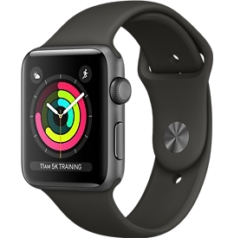


Embedded System Design
Stores time-stamped log of meals (bite count)
On/off button
Lab model
Watch model
Free app

Slide 17
Bite-to-Calorie Correlation
each point = 1 meal
2 weeks data (~50 meals), 1 person

Slide 18
Correlation Test
83 subjects wore for 2 weeks, 3246 total meals
each plot = 1 person
0.4 correlation
0.7 correlation
J. Scisco, E. Muth and A. Hoover, "Examining the Utility of a Bite-Count Based Measure of Eating Activity in Free-Living Humans", in Journal of the Academy of Nutrition and Dietetics, vol. 114 no. 3, April 2014, pp. 464-469.

Slide 19
Correlation Comparison
Physical activity monitors ¹
Energy expenditure
Our device
Energy intake
76% ≥ 0.4
¹ Westerterp & Plasqui, 2007, "Physical Activity Assessment with Accelerometers: An Evaluation against Doubly Labeled Water", in Obesity, vol 15, pp 2371-2379.

Slide 20
Converting Bites to Calories
kpb = kilocalories per bite
Formula based on height (h), weight (w), age (a)
kpb (male) = 0.2455 h + 0.0449 w − 0.2478 a
kpb (female) = 0.1342 h + 0.0290 w − 0.0534 a
Formula fit using 83-people 2-week data set
Tested on 276 meals cafeteria data set
J. Salley, A. Hoover, M. Wilson and E. Muth, "A Comparison Between Human and Bite-Based Methods of Estimating Caloric Intake", in Journal of the Academy of Nutrition and Dietetics, vol. 116 no. 10, Oct 2016, pp. 1568-1577.

Slide 21
Calories in Cafeteria Meals

Slide 22
Outline
Motivation, related work
Tracking wrist motion to count bites
Relating bites to calories
Using bite counting for weight loss
Research opportunities

Slide 23
Adding to the toolset
Tool | Food diary, 24h recall, FFQ (classic tools) | Bite counter (wearables)
Usage | Probe (e.g. once/month) | Continuous
Measures | Nutrition, Food selections | Daily/weekly patterns, Real-time feedback

Slide 24
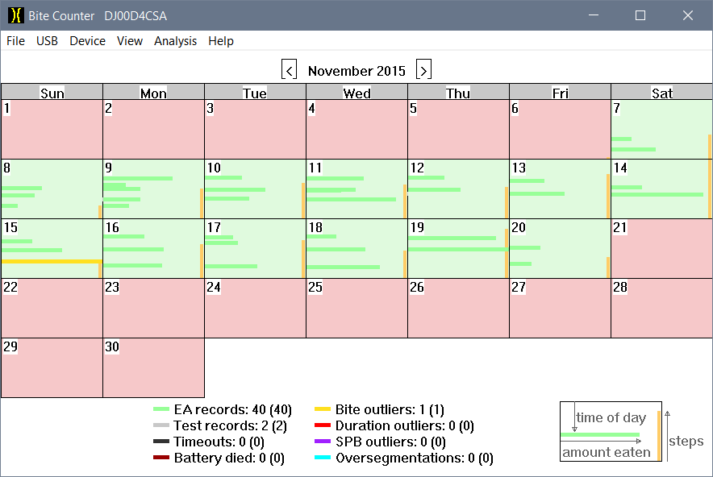
Software
Monthly view

Slide 25
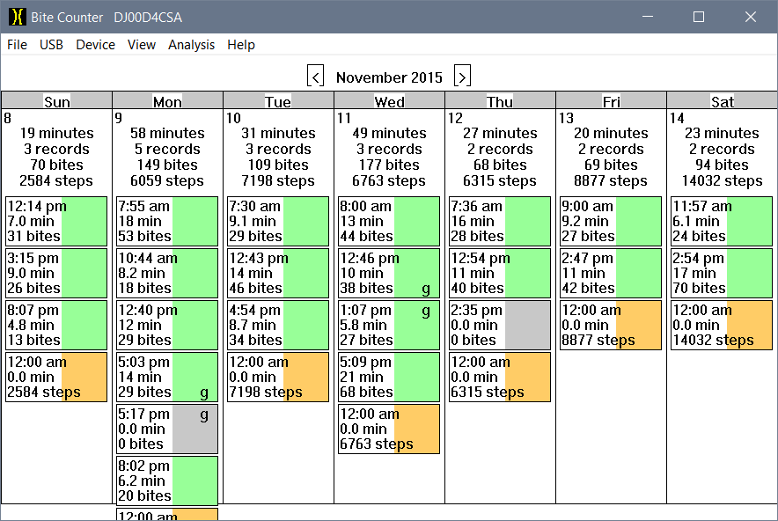
Software
Weekly view

Slide 26


Weight Loss Studies
On average, people used device 21% of the time
(45% days, ~50% intake/day)
USC: 26 week study
MUSC: 16 week study

Slide 27
Outline
Motivation, related work
Tracking wrist motion to count bites
Relating bites to calories
Using bite counting for weight loss
Research opportunities

Slide 28

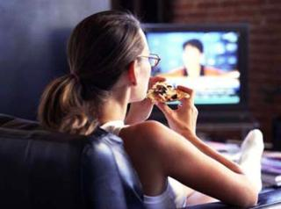
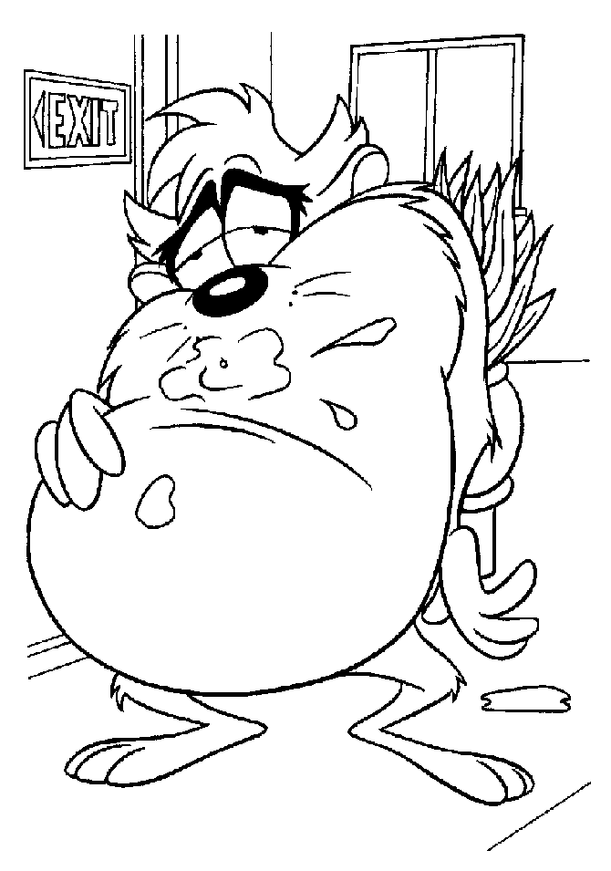
Applications
  Weight loss/maintenance
  Objective, automated monitoring
  Cognitive workload
  Offload energy intake monitoring
  Real-time feedback
  The device can give cues to stop eating
G. Turner-McGrievy, et. al., "Byte by Bite: Use of a mobile Bite Counter and weekly behavioral challenges to promote weight loss", in Smart Health, April 2017.
D. Weathers, J. Siemens and S. Kopp, "Tracking food intake as bites: Effects on cognitive resources, eating enjoyment, and self control", in Appetite, vol. 111 no. 1, April 2017, pp. 23-31.
J Scisco, E Muth, Y Dong, A Hoover, “Slowing bite-rate reduces energy intake: an application of the bite counter device”, J of the American Dietetic Association 111 (8), 1231-1235.

Slide 29

Young Investigators
Collaborators, projects
  Brie Turner-McGrievy, Associate Professor, University of South Carolina
    NIH grant R21CA187929, increasing dietary self-monitoring
  Carly Goldstein, Assistant Professor, Brown University
    NIH grant 5K23HL136845, individually tailored weight loss intervention
  Stephanie Goldstein, Post Doc, Brown University
    NIH grant 1F32HL143954, ecological momentary assessment
  David St-Jules, Assistant Professor, New York University
    American Heart Association grant, continuous glucose monitoring
    NYU internal grant, add wrist motion tracking to above project

Slide 30
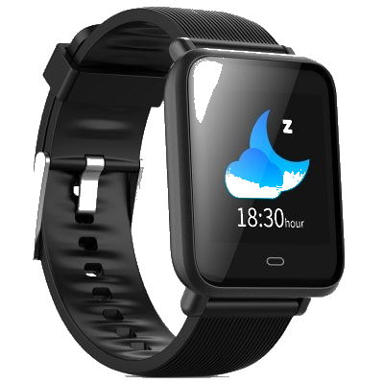

Available
Stores time-stamped log of meals (bite count)
Watch model
Free app
Free app

Slide 31
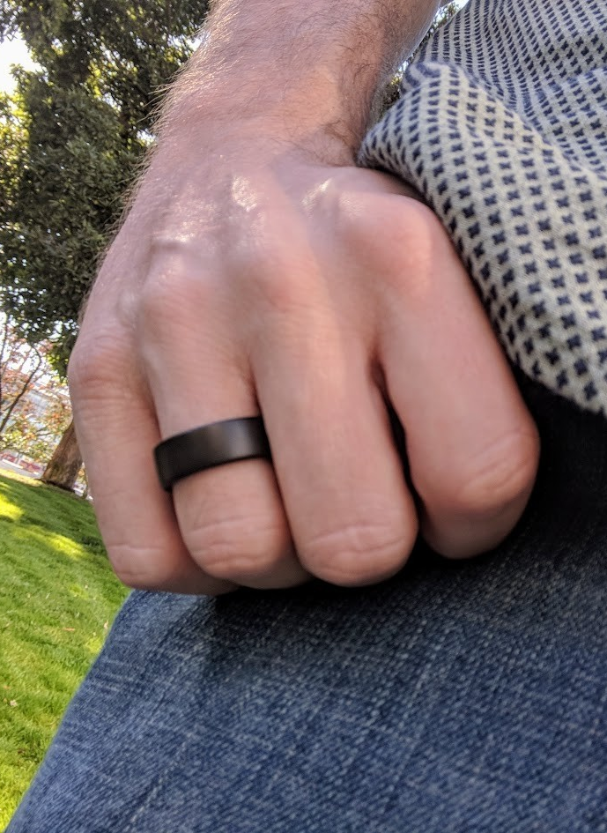
Ring version? Coming 2020
==
Tracking roll axis at finger equivalent to wrist
B. Lin and A. Hoover, "A Comparison of Finger and Wrist Motion Tracking to Detect Bites during Food Consumption", in IEEE Conference on Body Sensor Networks, May 2019.

Slide 32
Acknowledgments
Collaborators
  Adam Hoover, Electrical & Computer Engineering Department, Clemson University
  Eric Muth, Psychology Department, Clemson University
  Diana Thomas, West Point Military Academy
  Brie Turner-McGrievy, University of South Carolina
  Corby Martin, Pennington Biomedical Research Center, LSU
  Pat O’Neil, Weight Management Center, Medical University of South Carolina
  Kathleen Melanson, University of Rhode Island
  Students: Surya Sharma, Yiru Shen, Ryan Mattfeld, Basil Lin, James Jolly, Yujie Dong, Jenna Scisco, Raul Ramos-Garcia, James Salley, Mike Wilson, Ziqing Huang, Soheila Eskandari, Phil Jasper, Amelia Kinsella, Jose Reyes, Meredith Drennan, Xueting Yu, Michael Wooten, Megan Becvarik
Funding
  NIH NIDDK STTR 1R41DK091141-01A1, 2R42DK091141-02
  NIH NHLBI R01 HL118181-01A1
  NIH NCI R21 CA187929-01A1
  South Carolina Launch
  South Carolina Clinical and Translational Institute

Slide 33
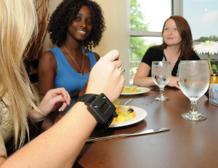
Questions?
For more info: www.cecas.clemson.edu/~ahoover

