Slide 1
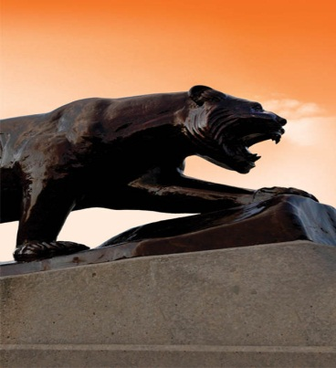

Improving Accuracy in Ultra-Wideband Indoor Position Tracking Through
Noise Modeling and Augmentation
Ph.D. Dissertation Exam
Salil P. Banerjee
Committee Members:
Dr. Adam Hoover (Advisor)
Dr. John Gowdy
Dr. Richard Brooks
Dr. Eric Muth
11/26/2012
Department of Electrical and Computer Engineering

Slide 2
Outline
Motivation
Background
Sensor Set Switching Noise
Augmentation
Conclusions and Future Work
Notes:
I will begin with the motivation, the background, followed by the problem and finally ongoing work.

Slide 3
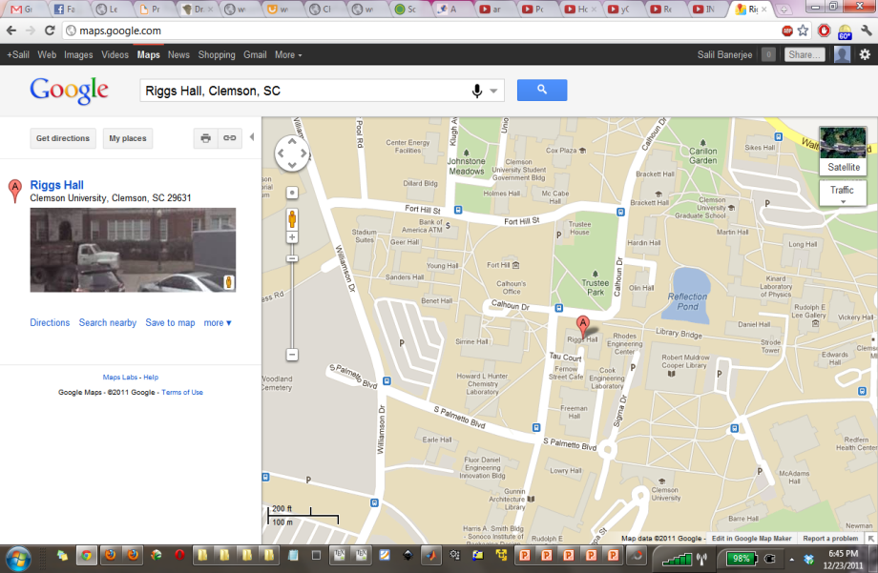
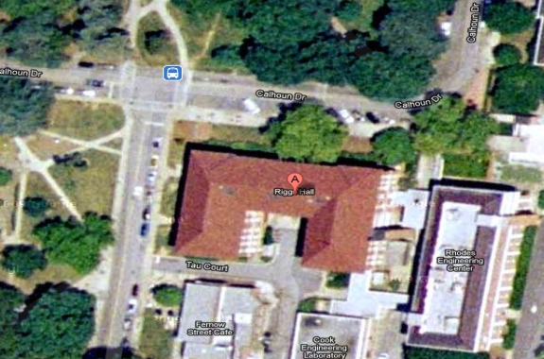
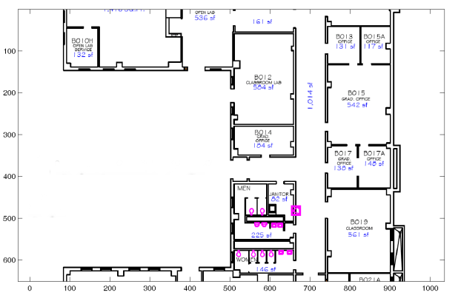
Where am I?
Am I near the building?
Am I in the building?
Sensor Network Lab
Where exactly in the room am I?
Restrooms
Notes:
For any navigation based application, it is important to know one’s current location.
Once we have an idea of where we are, we want to know it with ever increasing precision.
Using modern radio-navigation aids such as the GPS, one can get an approximate idea where one is, for example Have I reached near the building?
Using additional signal information such as from cellular signals and Wifi one can get a better idea of one’s location – Am I in the building or on the road adjacent to the building?
Using Local positioning systems one can get an approximate idea of where one is within a building.
However, our goal is to answer where exactly are we inside a room?
In other words we want to answer the question of achieving centimeter level accuracy.

Slide 4
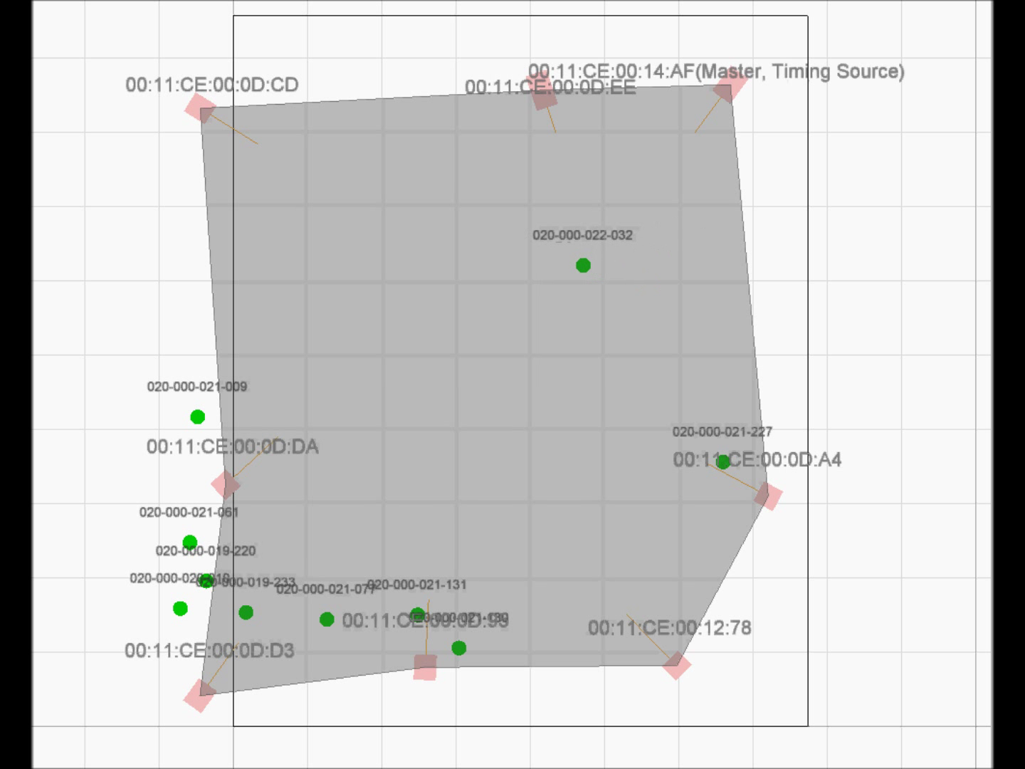
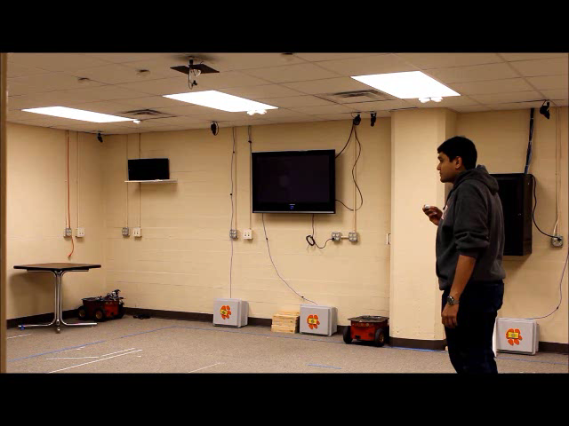
Video showing indoor tracking
Notes:
This video shows an example of raw UWB indoor tracking.
As you can observe that even though the tracking takes place in a room where sensors are almost LOS, there is noise in the measurements
Moreover, the noise also depends on where we are in the room.

Slide 5
Outline
Motivation
Background
Sensor Set Switching Noise
Augmentation
Conclusions and Future Work

Slide 6
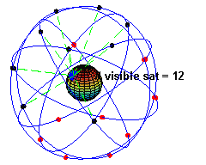
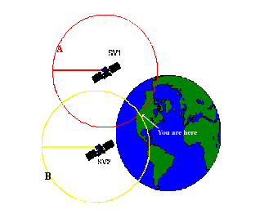

Global Navigation Satellite System (GNSS)
(Ref.: El-Rabbany, Grewal et.al. )
GPS is one of several Global Navigation Satellite Systems (GNSS)
Constellation of satellites – 24 (21 active, 3 replacement)
First deployed in 1970, basic accuracy was 100m
  Developed for air and water vehicle navigation, battlespace awareness
Components include space segment, control segment, user segment
  Different errors or noises occur in various parts of the system
Notes:
We describe the Global Navigation Satellite System since we use similar principles in a Local Positioning System
We are inspired by the development of GNSS and its improvement in accuracy by noise modeling and augmentations
Others being GLONASS by Russia, Galileo by European Union and Beidou by China.
The satellites have been arranged in such a manner that at any point in time there are at least 4 satellites overhead
However, with improvement in accuracy the applications have expanded to civilian vehicle navigation and automated farming

Slide 7
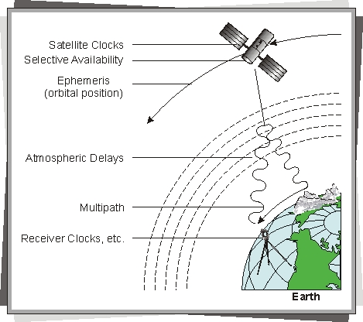
Noise modeling
Error | Typical Value
Orbit/ Ephemeris | 1-5 meters
Clock | 0-4 meters
Ionosphere | 0-30 meters
Troposphere | 0-30 meters
Multipath | 1-3 meters
Receiver | 0-10 meters
Notes:
Researchers have identified and modeled noise sources in a GNSS and reduced their impact by using filters
The table on left shows the various errors in a GNSS and their typical values
Orbital errors are caused due to inaccuracies in modeling the motion of the satellite
Clock errors are caused due to imprecise clocks. A drift of 1ms can lead to a positional error of 300 km
GNSS signals experience delay as they travel through ionosphere and troposphere due to a change in the permittivity in these layers as compared to free space
In cities and mountainous areas signals reflect from surfaces causing multipath errors
Receiver errors are due to improper positioning of antennas and imprecise clocks on receivers

Slide 8
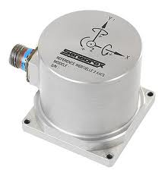
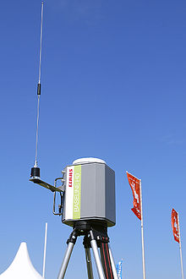
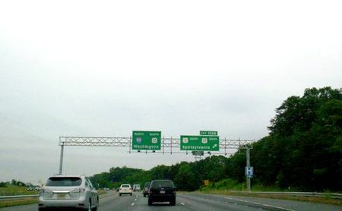
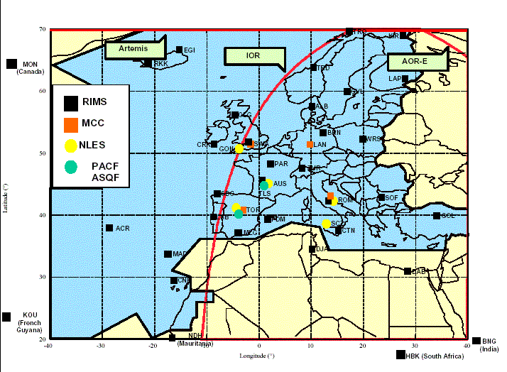
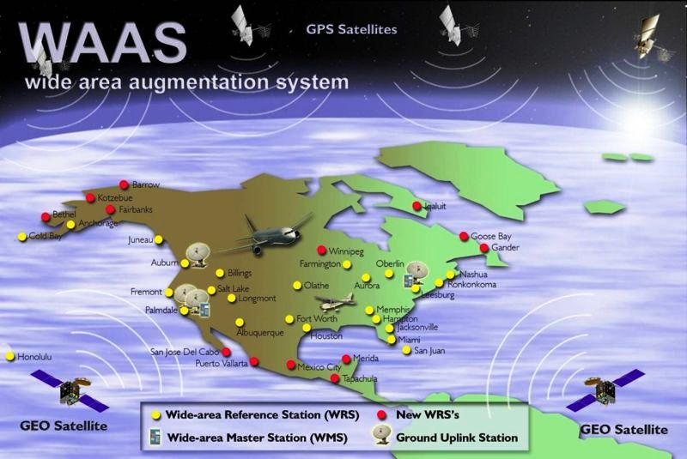
Augmentation
Calculated
Position
After
augmentation
DGPS (Differential GPS)
Maps
INS (Inertial Navigation System)/
IMU (Inertial Measurement Unit)
EGNOS (European Geostationary
Navigation Overlay Service)
WAAS (Wide Area Augmentation System)
Notes:
Researchers have used three different approaches to augment raw GPS data
The first methods is using additional distance measurement such as in Differential GPS where an earthbound receiver whose position has been carefully surveyed provides an additional distance measurement
Examples of such systems are EGNOS in EU and WAAS over North America
The second method is use of maps. In this case the raw GPS measurement is snapped to the closest road
The third method is use of additional hardware such as IMU and odometers

Slide 9
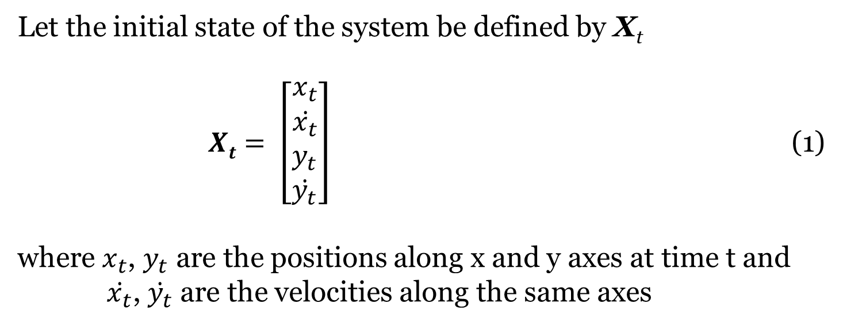
Filtering – State variables
Let the initial state of the system be defined by X_{t}
$Xt= \left[\begin{aligned}x_{t} \\ \dot{x_{t}} \\ y_{t} \\ \dot{y_{t}}\end{aligned}\right]$ (1)
where $x_{t}$, $y_{t}$ are the positions along x and y axes at time t and
$\dot{x_{t}}\text{,} \dot{y_{t}}$ are the velocities along the same axes
Notes:
Filtering is a technique to remove the noise in the signal while retaining the information
It is used to provide estimates of future values, smooth noisy signals and also to perform fusion between signals
State variables are parameters used to describe the behavior of the model
For tracking in 2d we consider variables….

Slide 10
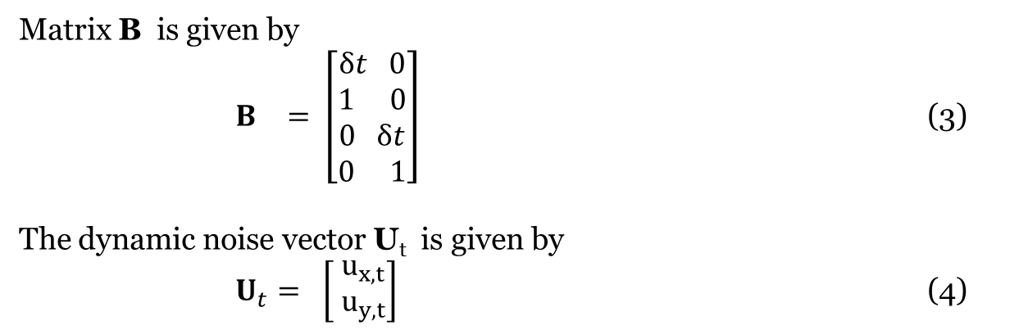
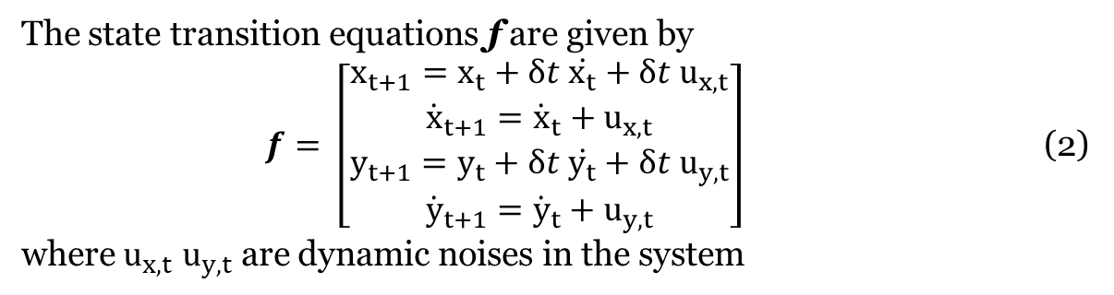
Filtering – Motion model, linear constant velocity
The state transition equations in matrix notation is given by
X_{t} = ФX_{t-1} + B U_{t}
The state transition equations f are given by
$f= \left[\begin{aligned}x_{t+1}=x_{t}+δt \dot{x_{t}}+δt{ u}_{x,t} \\ {\dot{x}}_{t+1}={\dot{x}}_{t}+{ u}_{x,t} \\ y_{t+1}=y_{t}+δt \dot{y_{t}}+δt{ u}_{y,t} \\ {\dot{y}}_{t+1}={\dot{y}}_{t}+{ u}_{y,t}\end{aligned}\right]$ (2)
where $u_{x,t}$ $u_{y,t}$ are dynamic noises in the system
Matrix B is given by
$B_{}= \left[\begin{aligned}δt 0 \\ 1 0 \\ 0 δt \\ 0 1\end{aligned}\right]$ (3)
The dynamic noise vector U_{t} is given by
$U_{t}= \left[\begin{matrix}{ u}_{x,t} \\ { u}_{y,t}\end{matrix}\right]$ (4)
Notes:
The state transition equations are a set of equations that describe the range
of expected behaviors of the thing being tracked

Slide 11

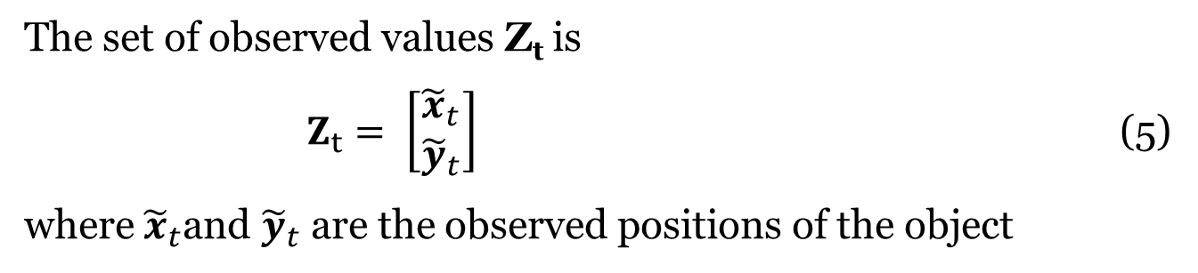
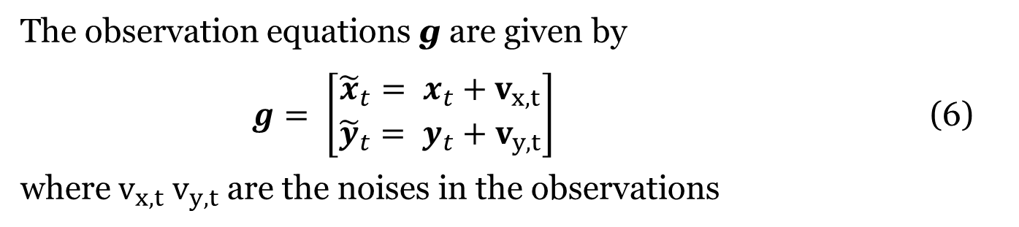
Filtering - Observation model
The set of observed values Z_{t} is
$Z_{t}= \left[\begin{aligned}{\tilde{x}}_{t} \\ {\tilde{y}}_{t}\end{aligned}\right]$ (5)
where ${\tilde{x}}_{t}$and ${\tilde{y}}_{t}$ are the observed positions of the object
The observation equations g are given by
$g= \left[\begin{aligned}{\tilde{x}}_{t}= x_{t}+{ v}_{x,t} \\ {\tilde{y}}_{t}= y_{t}+{ v}_{y,t}\end{aligned}\right]$ (6)
where $v_{x,t}$ $v_{y,t}$ are the noises in the observations
The measurement noise vector N_{t} is given by
$N_{t}= \left[\begin{matrix}{ v}_{x,t} \\ { v}_{y,t}\end{matrix}\right]$
Notes:
Sensors provide observations (measurements) of the object being tracked. The
observation equations are a set of equations that describe the expected range of observations
given the current state of the thing being tracking
Here we assume that there is a zero mean Gaussian noise in the observations

Slide 12
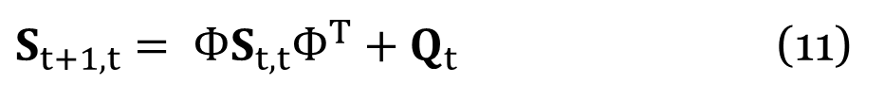
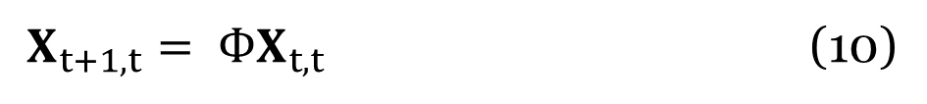

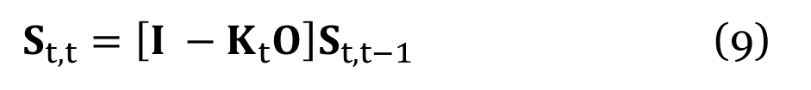
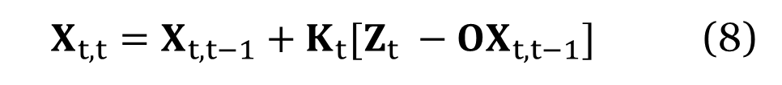
Kalman Filter
Linear motion models
Gaussian noises
Low computational complexity
Calculate Kalman gain
$$K_{t}=S_{t,t−1}O^{T}{\left[OS_{t,t−1}O^{T}+R\right]}^{−1} (7)$$
Update state
$X_{t,t}=X_{t,t−1}+K_{t}[Z_{t} −OX_{t,t−1}]$ (8)
Update covariance
$S_{t,t}=\left[I −K_{t}O\right]S_{t,t−1}$ (9)
Predict state
$X_{t+1,t}= ФX_{t,t}$ (10)
Predict covariance
$S_{t+1,t}= ФS_{t,t}Ф^{T}+Q_{t}$ (11)
Notes:
One of the most popular techniques for filtering linear motion models with gaussian noises
Iterate through the five equations

Slide 13
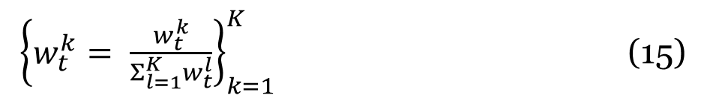

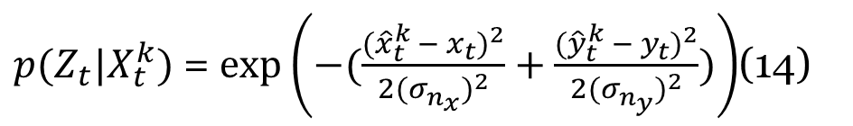

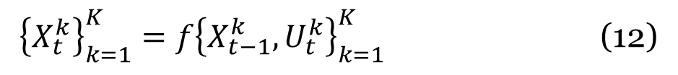
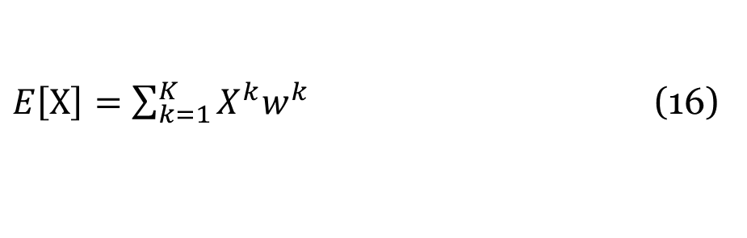
Basic particle filter
Any motion model
Any type of noise
Higher computational complexity
Consider
$χ= \left\{X_{t}^{k},w_{t}^{k}\right\}$, k=1,2, …, 1000
Transition particles
${\left\{X_{t}^{k}\right\}}_{k=1}^{K}=f{\left\{X_{t−1}^{k},U_{t}^{k}\right\}}_{k=1}^{K}$ (12)
Update weights
$w_{t}^{k}=w_{t−1}^{k}$ $p\left(Z_{t} | X_{t}^{k}\right)$ (13)
$p(Z_{t}|X_{t}^{k})$ = $exp⁡\left(−(\frac{({\hat{x}}_{t}^{k} − x_{t})^{2}}{{2(σ_{n_{x}}^{})}^{2}}+\frac{({\hat{y}}_{t}^{k} − y_{t})^{2}}{{2(σ_{n_{y}}^{})}^{2}})\right)$(14)
${\left\{w_{t}^{k}= \frac{w_{t}^{k}}{Σ_{l=1}^{K}w_{t}^{l}}\right\}}_{k=1}^{K}$ (15)
Normalize weights
Compute output
$E\left[X\right]=\sum_{k=1}^{K}{X^{k}w^{k}}$ (16)
Resample if necessary
Notes:
A probabilistic filtering technique
By selecting the proposal distribution equal to the prior distribution, we can update weights using equation 13

Slide 14
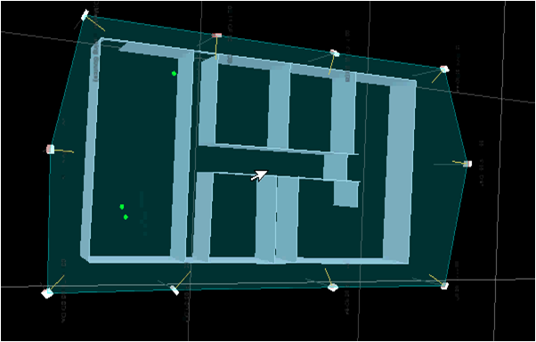

Indoor tracking using Ultra-wideband
same idea
  However …
    Scale changes (Earth versus building)
    Transmitters/receivers are switched
    TOA vs TDOA (timing over shorter distance)
    Non-line-of-sight is the rule rather than the exception

Slide 15
Outline
Motivation
Background
Sensor Set Switching Noise
Augmentation
Conclusions and Future Work

Slide 16
Related Work
Noise modeling
Prototypes
  Fontana (2003) – Developed an early localization system
  Guoping and Rao (2005) – Developed localization system to reduce ranging errors
Isolating noise sources
  Zetik et al. (2004) – Studied effects of multipath, synchronization, antenna effects and peak detection
  Mahfouz et al. (2008) – Studied multipath, synchronization, antenna effects, peak detection and sensor placement issues
Simulations
  Jing et al. (2010) - Studied impact of signal propagation through building materials
  Shen et al. (2010) - Proposed techniques to mitigate the effect of NLOS
Notes:
There are three approaches taken by researchers to model noise in an indoor UWB based positioning system
Prototypes, Isolation of noise sources and Simulations
Fontana developed one of the early FCC approved localization systems. He conducted indoor and outdoor tests to determine the range of the system. He observed that indoor clutter has an impact on the tracking accuracies.
Guoping and Rao also developed a low cost localization system and combined it with a correlation detector and ADCs to detect LOS signals and reduce errors caused due to TDOA
Zetik et. al. isolated each of these noise sources. Using passive and active approaches to 2d and 3d localization they achieved an accuracy of 30 cm.
Similarly Mahfouz et al. also conducted experiments in a small test area, 1-2 m where they studied … noise sources in isolation. Using LOS signals they achieved a mm level accuracy in 1D, 2D and 3D tracking
Since UWB signals have a large bandwidth which is greater than 500 MHz, the different spectral components behave differently as they pass through various materials. Jing et al theoretically studied the impact of the various spectral components as they pass through typically used building materials
Shen et al compared the mean square errors with the variance of the LOS range estimates. If mse was greater than the LOS estimate then it indicated a NLOS condition and they discarded the sensor providing the NLOS estimate

Slide 17
Indoor tracking using Ultra-wideband
same idea
  However …
    Set of satellites used for trilateration changes frequently

Slide 18
Trilateration
A
B
A
B
C
C
Ideal case
Non-ideal case
Notes:
Before I describe the problem, I would like to explain the principle of trilateration which is used to make a measurement.
First we consider an ideal case where we know the distance of the transmitter from the receiver A.
Now the transmitter can lie anywhere on a circle with a radius equal to the distance to the receiver.
Suppose we have another receiver B and we know the distance to that receiver as well, we can draw another circle from B.
The intersection of the two circles gives us two possible locations of the transmitter.
Using another distance measurement to receiver C we can draw a third circle which intersects the previous circles at a single point, which gives us the location of the transmitter
However, in practical situations, due to errors in measuring the distances the circles do not always intersect at a single point, giving us a region of uncertainty within which the transmitter lies.
The location of the transmitter is then computed using least squares or similar approaches.

Slide 19
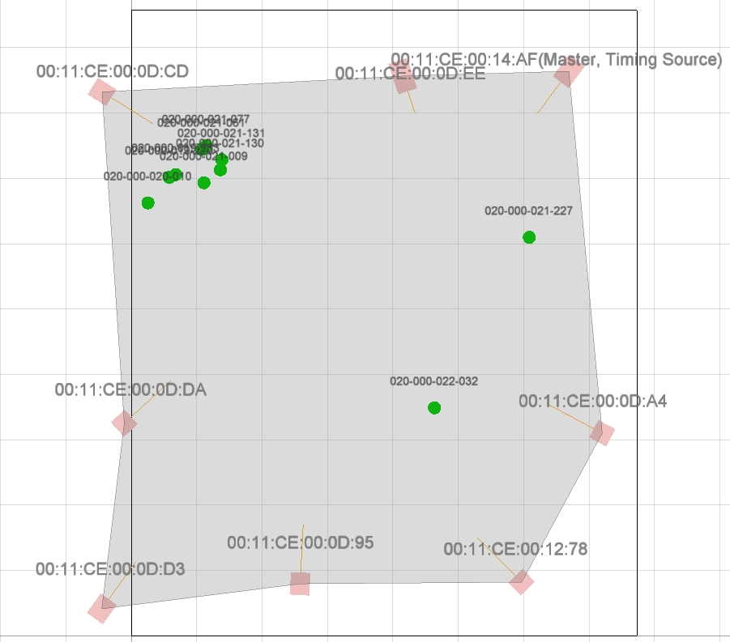
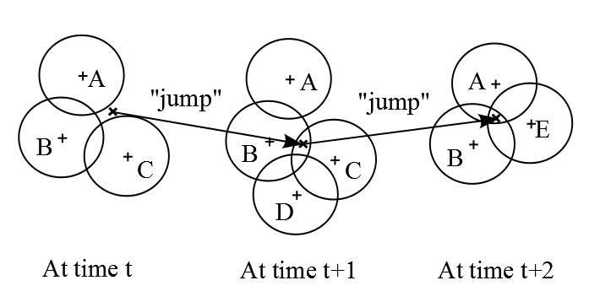
Sensor set switching
In LPS, the sensor sets (“satellites”) switch at a faster rate than in a GNSS. This leads to the addition of a different noise to each measurement, even if the tag is standing still.
Notes:
Although this noise is present in other systems, its impact is much more obvious in Local positioning systems

Slide 20
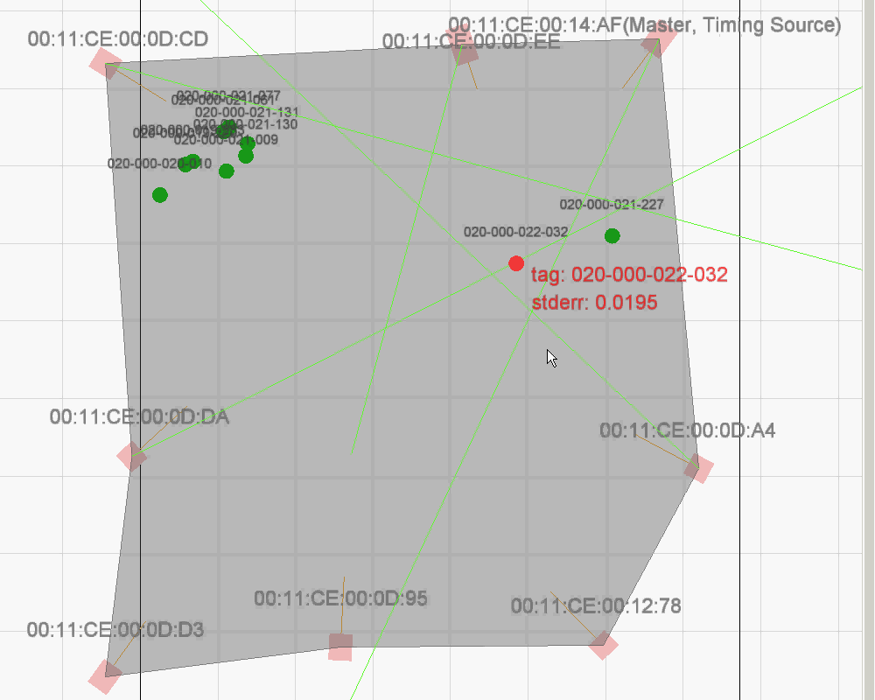
Demo of “jump” noise due to sensor set switching
Notes:
This video shows the noise due to switching sensor sets
Here, the tag has been placed at a fixed location in the room
The red tag shows the tag being tracked and lines show the sensors being used to calculate the measurements
The other green tags show the last known positions of the inactive tags
We can observe that even though the tag is not actually moving, the measurements are jumping due to sensor set switching noise

Slide 21
Objectives
To identify and model the noise due to each sensor set separately
Set A
Set B
Set C
To mitigate the noise using a particle filter

Slide 22
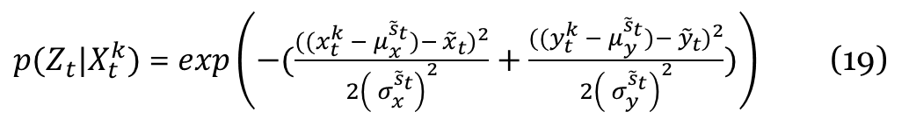
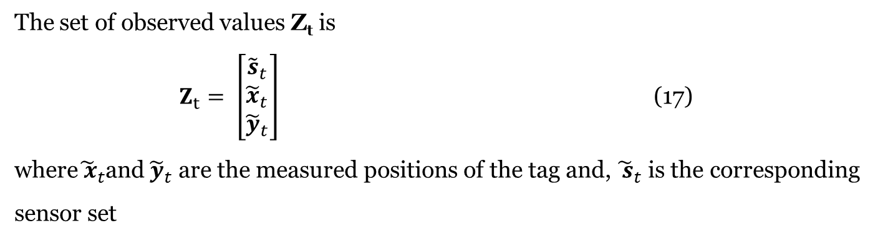
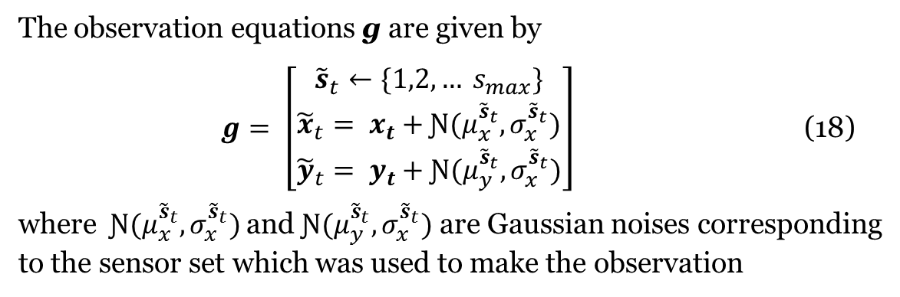
Set noise particle filter
The set of observed values Z_{t} is
$Z_{t}= \left[\begin{aligned}{\tilde{s}}_{t} \\ {\tilde{x}}_{t} \\ {\tilde{y}}_{t}\end{aligned}\right]$ (17)
where${\tilde{ x}}_{t}$and ${\tilde{y}}_{t}$ are the measured positions of the tag and, ${\tilde{ s}}_{t}$ is the corresponding
sensor set
The observation equations g are given by
$g= \left[\begin{aligned}{\tilde{s}}_{t}←\{1,2, … s_{max}\} \\ {\tilde{x}}_{t}= x_{t}+Ɲ(μ_{x}^{{\tilde{s}}_{t}},σ_{x}^{{\tilde{s}}_{t}}) \\ {\tilde{y}}_{t}= y_{t}+Ɲ(μ_{y}^{{\tilde{s}}_{t}},σ_{x}^{{\tilde{s}}_{t}})\end{aligned}\right]$ (18)
where$Ɲ(μ_{x}^{{\tilde{s}}_{t}},σ_{x}^{{\tilde{s}}_{t}})$ and $Ɲ(μ_{y}^{{\tilde{s}}_{t}},σ_{x}^{{\tilde{s}}_{t}})$ are Gaussian noises corresponding
to the sensor set which was used to make the observation
Based upon equation (14), $p(Z_{t}|X_{t}^{k})$ can be written as
$p(Z_{t}|X_{t}^{k})$ = $exp\left(−(\frac{({(x}_{t}^{k} −{ μ}_{x}^{{\tilde{s}}_{t}})− {\tilde{x}}_{t})^{2}}{{2\left({ σ}_{x}^{{\tilde{s}}_{t}}\right)}^{2}}+\frac{({(y}_{t}^{k} −{ μ}_{y}^{{\tilde{s}}_{t}})− {\tilde{y}}_{t})^{2}}{{2\left({ σ}_{y}^{{\tilde{s}}_{t}}\right)}^{2}})\right)$ (19)

Slide 23
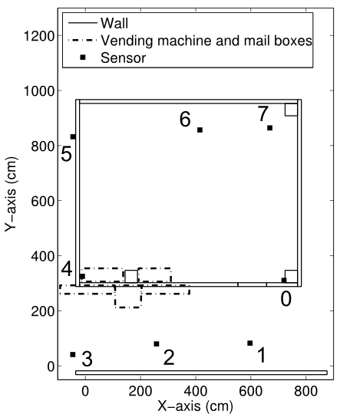
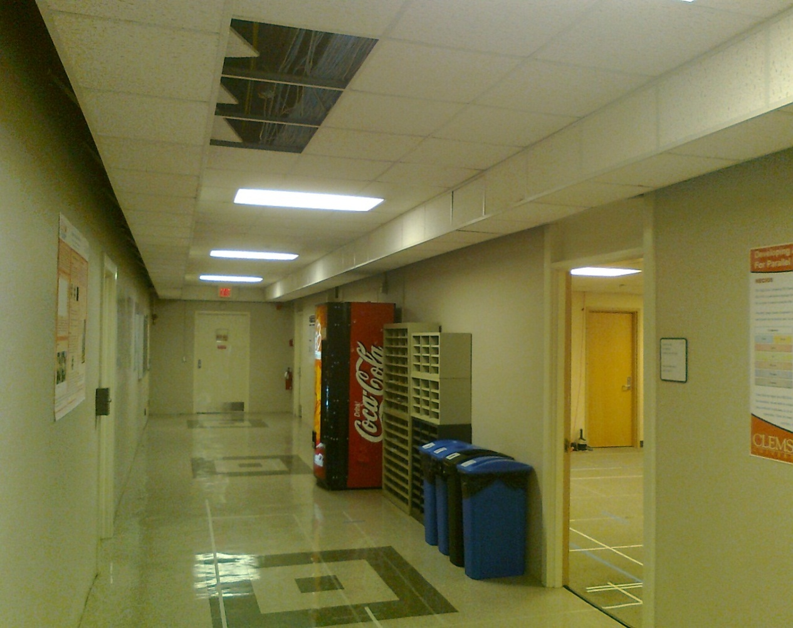
Test facility
UWB Sensor
Stone Wall
Main room of the sensor network lab and part of the hallway
8 sensors were placed around the trackable area
Sensors have been installed above the false ceiling

Slide 24
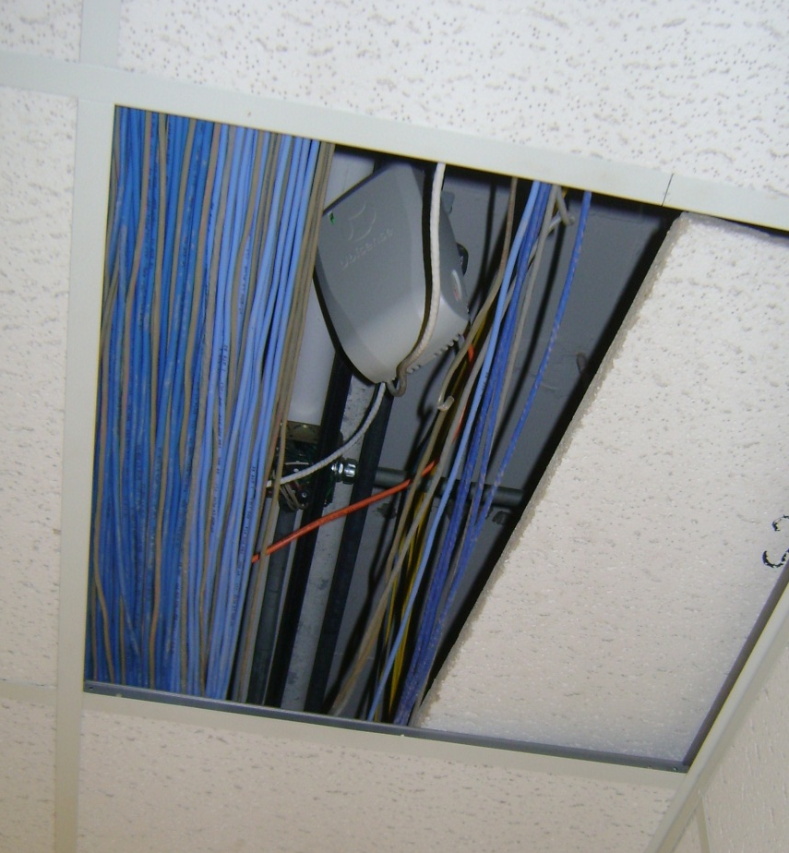
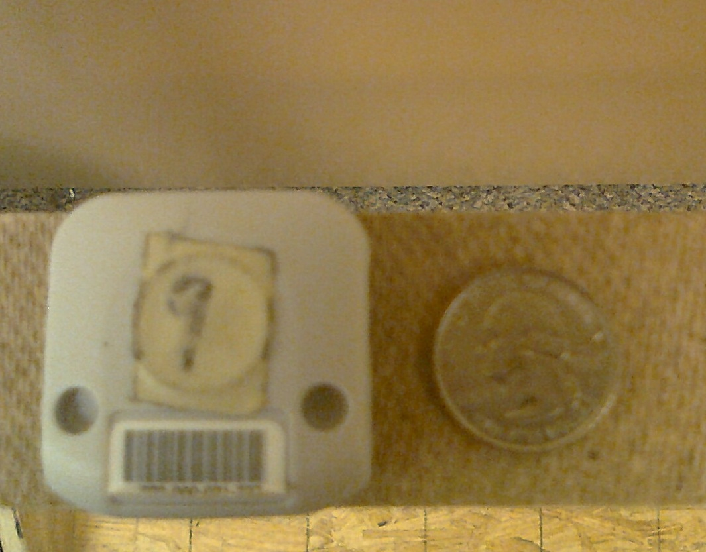
UWB sensor and tag
Sensor
Transmitter tag
UWB tracking system manufactured by Ubisense Inc.
Operating frequency is 6-8 GHz
Notes:
Ubisense a company based in UK

Slide 25
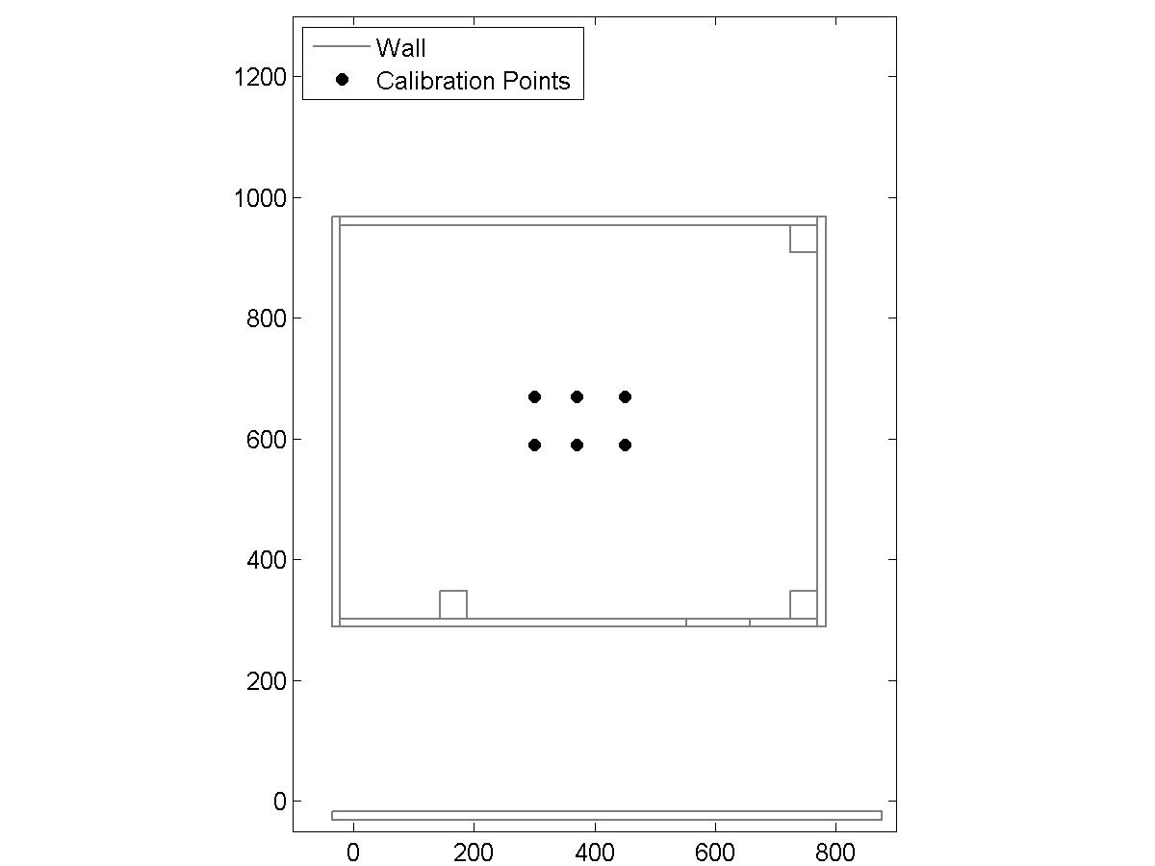
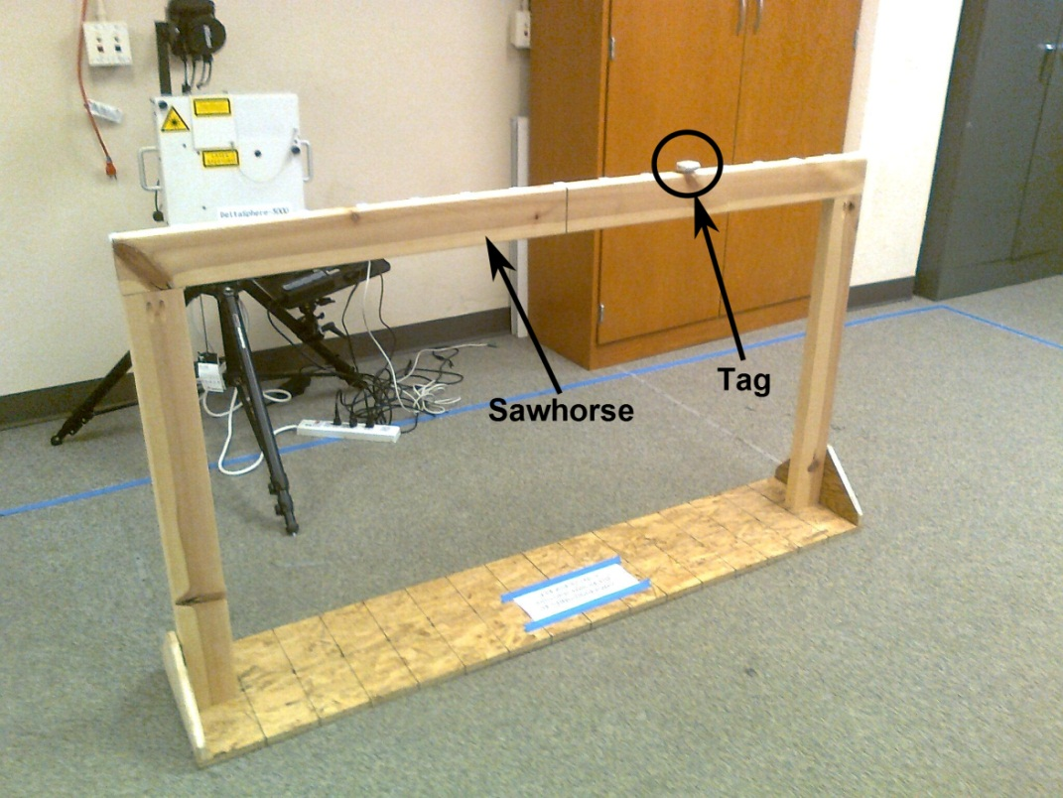
Calibration
Calibration locations
Calibration apparatus
Six calibration locations in the center of the room
1000 measurements were recorded at each location
Notes:
In order to generate a dictionary of sensor sets and their noise models, we consider 6 calibration points in the room.
We consider this area since it is almost LOS to the sensors and to avoid errors due to NLOS and multipath from overshadowing the effect of sensor set switching
At each of these locations we collect 1000 measurements
We use a wooden sawhorse to collect raw measurements.
The base and the top of the sawhorse has been marked at 10 cm intervals which are aligned with the ground truth locations which have been previously marked on the floor
The measurements are accurate upto 1 cm

Slide 26
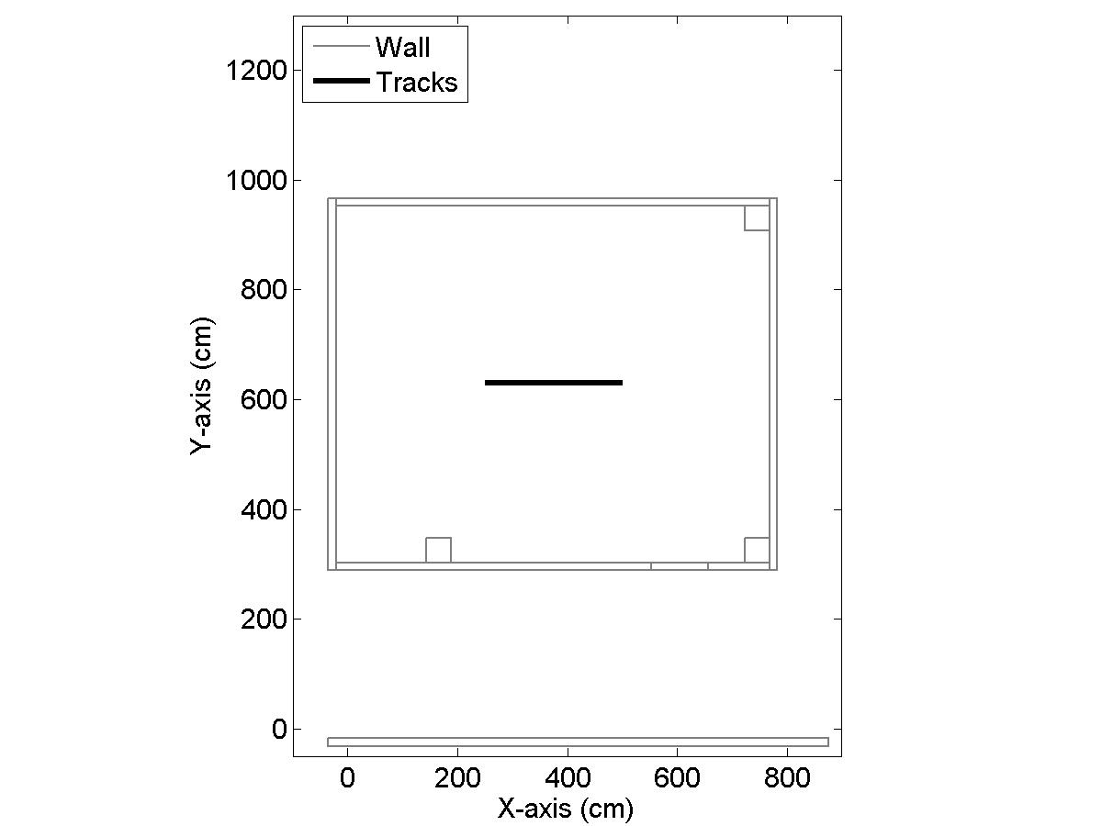
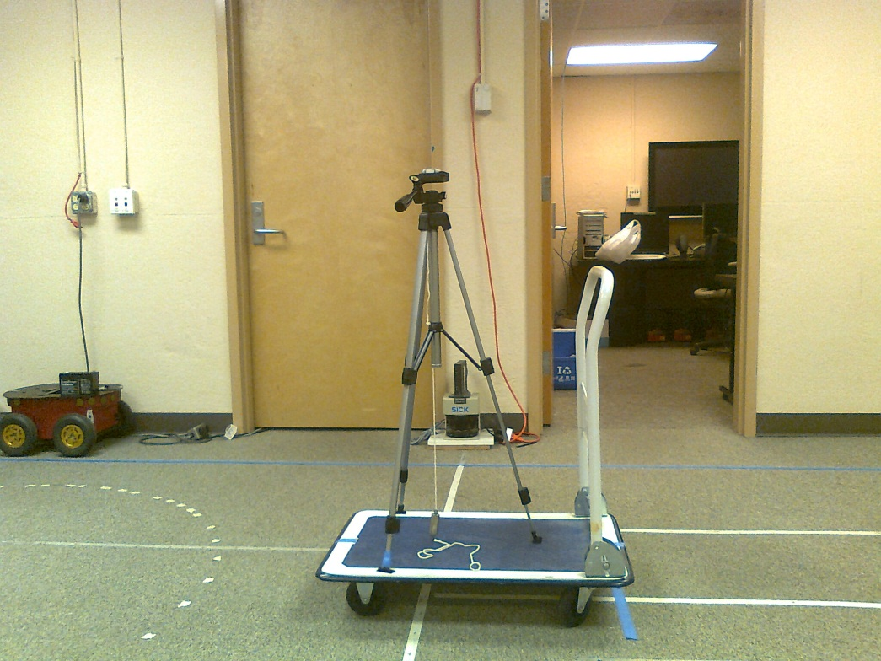
Data collection
Recording location
Recording apparatus
Notes:
Shows the actual position where recordings are collected
The height of the tripod is adjusted to be equal to that of the sawhorse used for the calibration step
The recordings are accurate to upto 1 cm

Slide 27
Range of motions
Recording # | Total Measurements | Speed (cm/s) | Raw Error (cm)
1 | 1521 | 11 | 20
2 | 467 | 35 | 22
3 | 250 | 65 | 23
4 | 164 | 100 | 25
5 | 135 | 120 | 23
7 times back and forth for each recording
Notes:
We consider 5 recordings which have a wide range of motions - from the slow crawl of a robot to the fast pace of a human walk
In each of these recordings, the tripod has been moved back and forth 7 times along the laid out ground truth
The raw error in measurements is around 22-23 cm

Slide 28
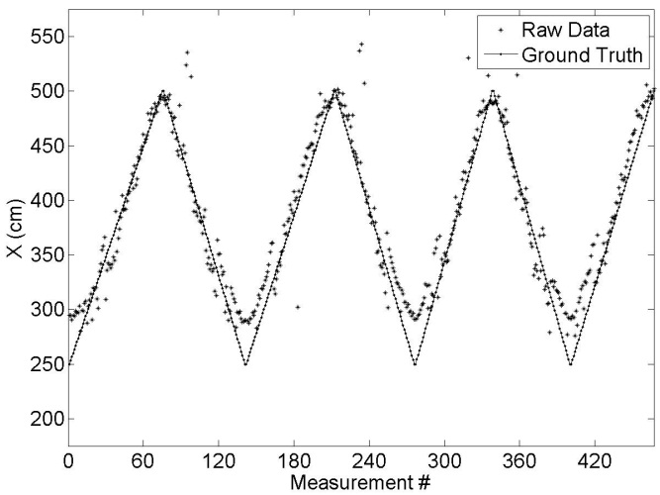
Example raw data
Notes:
In the recordings, motion occurs along the X-axis
In this figure, we show the measurements along the X-axis, where the curves indicate the back and forth motion

Slide 29

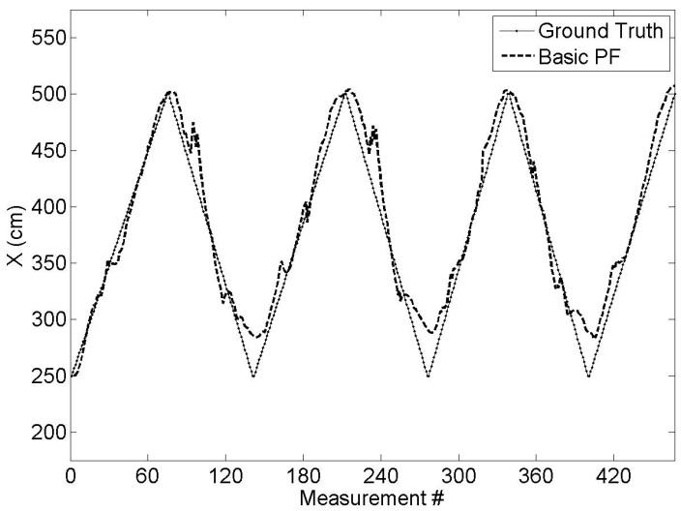

Comparison between basic and switching particle filters
Raw measurements
Basic particle filter
Switching particle filter
Notes:
This figure shows the comparison between basic and sensor set switching particle filters
Both the filters outperform the raw measurements
This can seen in the region corresponding to measurements 180-240 where there are a few outliers in the raw measurements
The basic particle filter performs well and does not react much to the outliers
However, the switching particle filter does not react at all to the outliers and is close to the ground truth

Slide 30
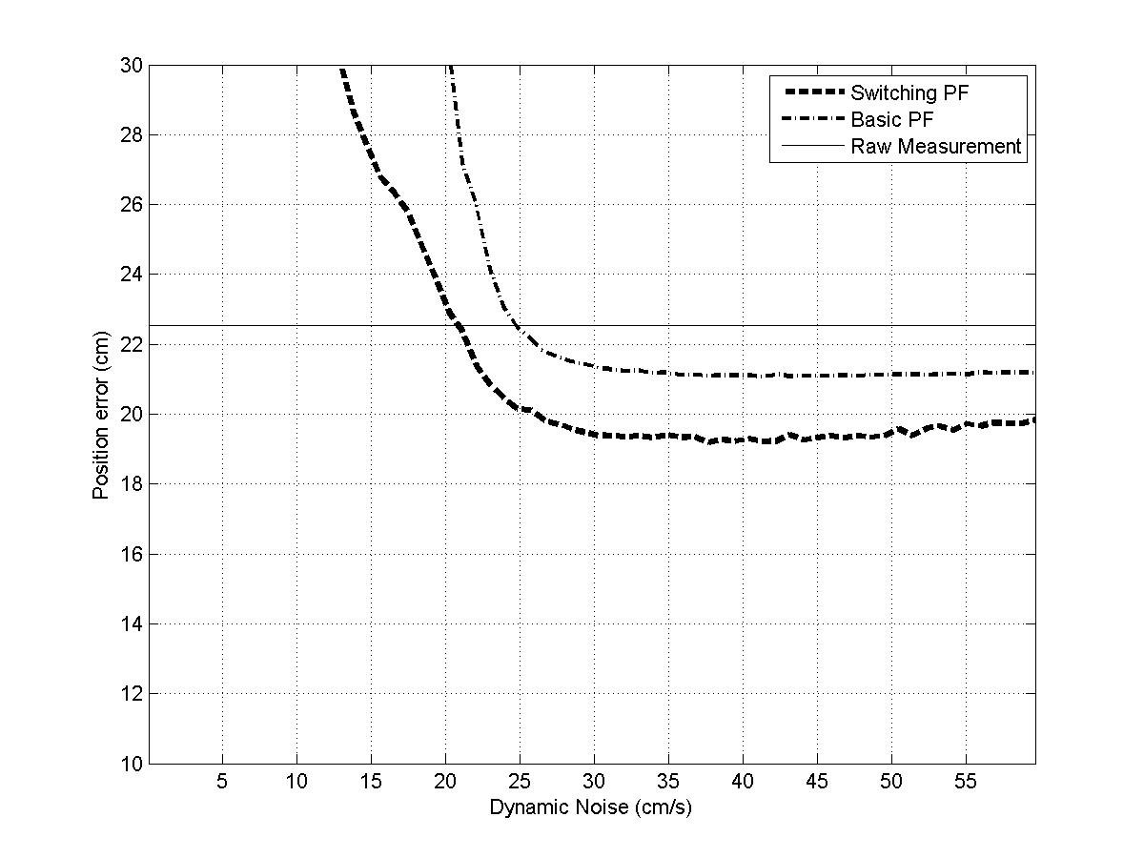
Average error curve for all recordings

Slide 31
Conclusion
Improved accuracies by approximately 15% compared to the raw measurements and 10% compared to the basic particle filtered output
Notes:
We have identified a new noise source due to switching of sensor sets and developed mathematical noise models for them
These noise models have been used in a particle filtering framework to improve the accuracy by approximately 15% as compared to raw measurements and 10% as compared to a basic particle filter

Slide 32
Outline
Motivation
Background
Sensor Set Switching Noise
Augmentation
Conclusions and Future Work
Notes:
The second part of the work is related to augmenting UWB measurements

Slide 33
Previous Work
Augmentation
UWB + IMU
  Jourdan et al. (2005) - Combined measurements to correct biases due to NLOS and incorrect beacon modeling
  Pittet et al. (2008) - Combined measurements to reduce errors caused due to multipath, NLOS, channel modeling and outliers
  Corrales et al. (2008) - Combined measurements to track human operators interacting with robots
UWB + Odometer + Compass
  Cheok et al. (2010) - Combined measurements from UWB, odometers and a digital compass to track a mobile robot
Our work – Combine UWB with LADAR/camera measurements
Notes:
Researchers have used IMU and odometers to augment UWB measurements
Jourdan et al. combined IMU and UWB measurements. The IMU provides attitude and acceleration measurements which are used to correct range biases in UWB and discard outliers
Pittel et al conducted experiments in classroom built of steel walls approximately 12 by 12 m in dimension where the UWB and IMU measurements were combined using EKF. In this case also IMU was used to correct range biases in UWB and eliminate outliers
Corrales et al combined 18 IMUs with UWB using Kalman filter in a system which involved tracking a person interacting with a robotic arm
Cheok et al combined UWB with wheel speed encoders and digital compass. The odometer and compass provided correction measurements and helped eliminate outliers

Slide 34
Indoor tracking using Ultra-wideband
same idea
Can accuracy be improved by using differential signals?
Notes:
Since indoor positioning is similar to GPS, we can ask the question whether accuracy of UWB based LPS be improved using differential signals?

Slide 35
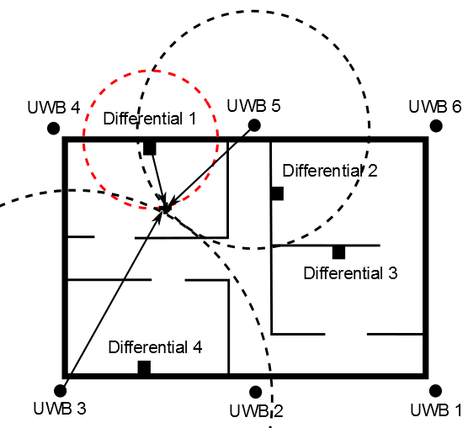
Augmenting UWB with differential sensor
UWB is NLOS
Lower precision
Differential sensor is LOS
Higher precision
LADAR and camera as differential sensors
Differential LPS
Notes:
This figure shows an example of differential LPS.
The 6 UWB sensors are placed across a facility and are NLOS.
Therefore, they provide a rough estimate of where the object is and the precision is lower
In this case a differential sensor is placed in each room to provide an additional distance measurement.
Since the differential sensors are placed LOS the measurements have higher precision
In our experiments we consider two differential sensors to augment UWB - LADAR and camera

Slide 36
Data Fusion
Aided sensor
  UWB is an aided sensor
  Target assists with its tracking
  ID is provided by target
Unaided sensor
  LADAR and camera are unaided sensors
  Segmentation needed
  Data association is a problem as number of people increase
Notes:
For data fusion we consider two categories of sensors for target tracking systems – aided and unaided
An aided sensor is one where the target actively assists with its tracking by carrying an object that broadcasts its location
An unaided sensor is one where the sensor does not receive any such information

Slide 37
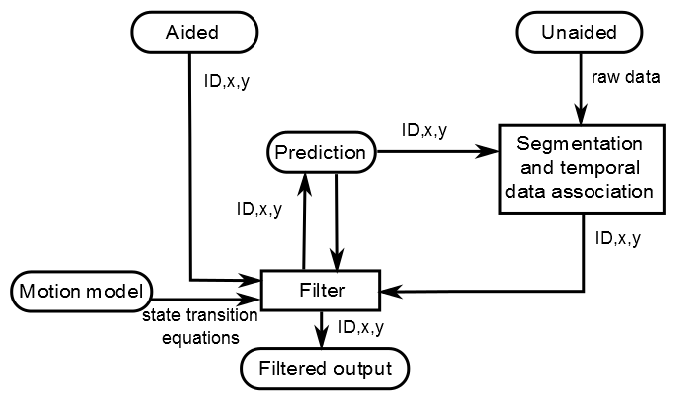
Framework
Notes:
This figure shows a block diagram of the fusion framework.
There are three sections in the framework: raw measurements, motion model and the filter
In the first section we receive measurements from the aided and unaided sensors
In case of the aided sensor the ID, and xy positions are known, whereas in the case of the unaided sensor we receive a raw image from which the positions of the objects have to be segmented
Next these positions have to be associated temporally or using information from other sensors
The motion model can be chosen based on the expected behavior of the motion of the object being tracked
The filter receives measurements from the sensors and estimates from the motion model and uses them recursively to generate filtered outputs
The filter uses the IDs, x and y to segment the raw unaided sensor measurements

Slide 38
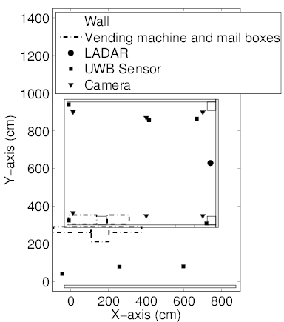
Test facility
Main room of the sensor network lab
8 UWB sensors
1 LADAR
6 cameras
Notes:
LADAR scans from top to bottom counter-clockwise

Slide 39
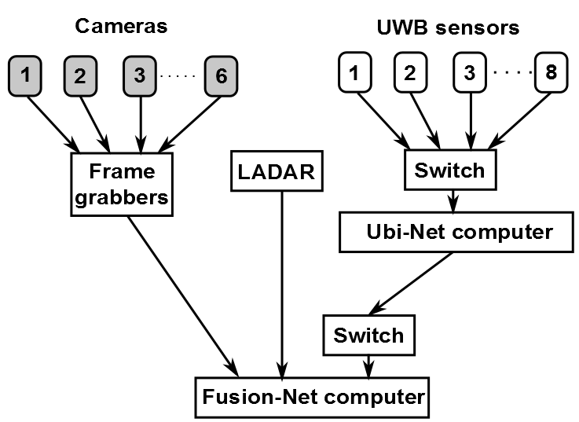
Block diagram of sensor connection

Slide 40
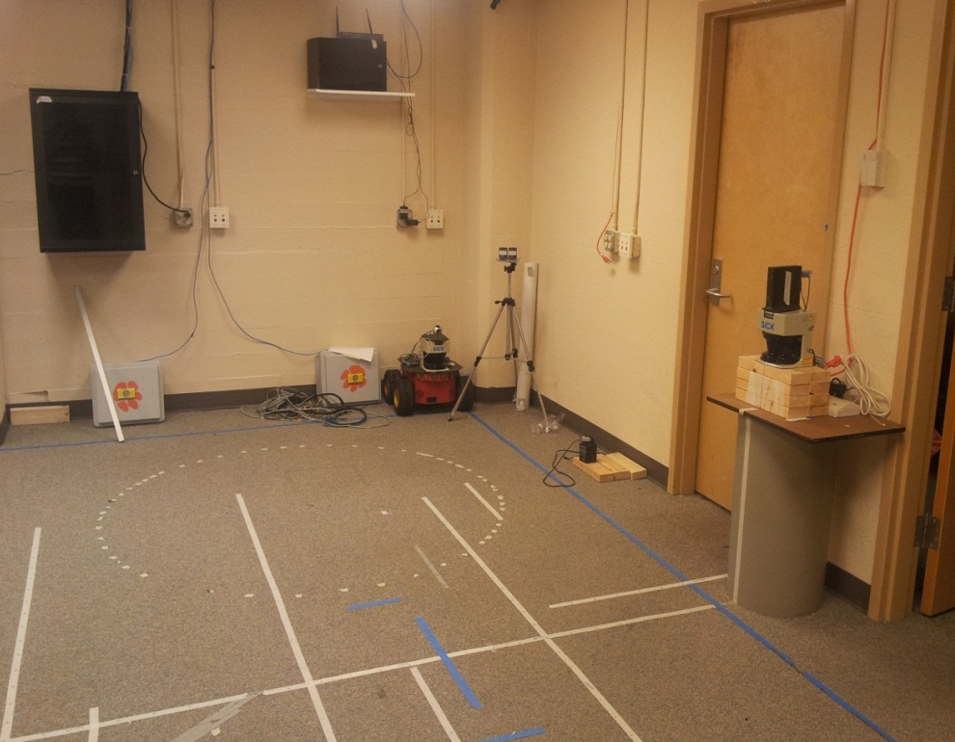

LADAR (Laser Detection and Ranging)
LADAR
SICK Laser LMS291-S05
Provides 180◦angular coverage
Range 0-30 m
Operates at 2.5 Hz
Notes:
Figure on left shows the actual location of a LADAR in the sensor network lab.
We use a …..
A LADAR provides distance measurements
As seen in figure on top right, when there are no objects in view we get the same distance for all angles
However, when an object is in view we get a lesser distance measurement at the angles corresponding to the position of the object
The distance-angle measurements are converted to x,y positions in the UWB coordinate frame

Slide 41

Camera
Camera
Creates an occupancy map
Uses blob detection
Cameras operate at 30 Hz
Generates occupancy map at roughly 20 Hz
Notes:
The cameras use the intensity values from the grayscale images to create an occupancy map
Then blob detection algorithm is used to detect objects in the room
The x,y positions in the image space are mapped to x,y positions in the UWB coordinate space

Slide 42

Demo of tracking using aided and unaided sensors
0
180
LADAR
Notes:
This video demonstrates tracking and raw measurements obtained from UWB, LADAR and camera
There is one person moving and 2 static objects in the room
The colored circles show the positions from the UWB
The gray blobs correspond to raw measurements from the camera network while the yellow squares show the distance measurements corresponding to each angle from 0-180
When the moving person is close to the objects the LADAR measurements are occluded and can detect only 1 object
Similarly for the camera we have only 1 big blob corresponding to two people
However, for UWB we have 3 unique position estimates

Slide 43

Revisiting Kalman Filter
Calculate Kalman gain
$$K_{t}=S_{t,t−1}O^{T}{\left[OS_{t,t−1}O^{T}+R\right]}^{−1} (7)$$
Update state
$X_{t,t}=X_{t,t−1}+K_{t}[Z_{t} −OX_{t,t−1}]$ (8)
Update covariance
$S_{t,t}=\left[I −K_{t}O\right]S_{t,t−1}$ (9)
Predict state
$X_{t+1,t}= ФX_{t,t}$ (10)
Predict covariance
$S_{t+1,t}= ФS_{t,t}Ф^{T}+Q_{t}$ (11)
Notes:
Iterate through the five equations

Slide 44



Timing behavior of asynchronous measurements received from multiple sensors
For UWB and LADAR fusion
$$Z,O,R= \left\{\begin{aligned}Z_{u},O_{u},R_{u} if UWB is present \\ Z_{l},O_{l},R_{l} if LADAR is present \\ Z_{ul},O_{ul},R_{ul} if both are present\end{aligned}\right.$$
For UWB and camera fusion
$$Z,O,R= \left\{\begin{aligned}Z_{u},O_{u},R_{u} if UWB is present \\ Z_{c},O_{c},R_{c} if camera is present \\ Z_{uc},O_{uc},R_{uc} if both are present\end{aligned}\right.$$
Notes:
There are three different cases

Slide 45



Switching observation model Kalman filter
When measurements are received from UWB, equation (5) can be written as
$Z_{u}= \left[\begin{matrix}{\tilde{x}}_{t}^{u} \\ {\tilde{y}}_{t}^{u}\end{matrix}\right]$ (19)
where ${\tilde{x}}_{t}^{u},{\tilde{y}}_{t}^{u}$ are the raw measurements
The observation equations g shown in equation (6) is given by
$g= \left[\begin{matrix}{\tilde{x}}_{t}^{u}=x_{t}^{u}+Ɲ(0,σ_{n_{x}^{u}}^{}) \\ {\tilde{y}}_{t}^{u}=y_{t}^{u}+Ɲ(0,σ_{n_{y}^{u}}^{})\end{matrix}\right]$ (20)
where $Ɲ\left(0,σ_{n_{x}^{u}}^{}\right)and Ɲ\left(0,σ_{n_{y}^{u}}^{}\right)$ are Gaussian measurement noises
Here O_{u} and R_{u} matrices in equations (7)-(9) are substituted by
$O_{u}= \left[\begin{matrix}1 & 0 & \begin{matrix}0 & 0\end{matrix} \\ 0 & 0 & \begin{matrix}1 & 0\end{matrix}\end{matrix}\right]$ and $R_{u}= \left[\begin{matrix}σ_{n_{x}^{u}}^{2} & σ_{n_{x}^{u},n_{y}^{u}}^{} \\ σ_{n_{x}^{u},n_{y}^{u}}^{} & σ_{n_{y}^{u}}^{2}\end{matrix}\right]$
Notes:
Based on previous work, the standard deviation in the measurements for UWB was found to be roughly 40 cm

Slide 46



Switching observation model Kalman filter
When measurements are received from LADAR, equation (5) can be written as
$Z_{l}= \left[\begin{matrix}{\tilde{x}}_{t}^{l} \\ {\tilde{y}}_{t}^{l}\end{matrix}\right]$ (21)
where ${\tilde{x}}_{t}^{l},{\tilde{y}}_{t}^{l}$ are the raw measurements
The observation equations g shown in equation (6) is given by
$g= \left[\begin{matrix}{\tilde{x}}_{t}^{l}=x_{t}^{l}+Ɲ(0,σ_{n_{x}^{l}}^{}) \\ {\tilde{y}}_{t}^{l}=y_{t}^{l}+Ɲ(0,σ_{n_{y}^{l}}^{})\end{matrix}\right]$ (22)
where $Ɲ\left(0,σ_{n_{x}^{l}}^{}\right)and Ɲ\left(0,σ_{n_{y}^{l}}^{}\right)$ are Gaussian measurement noises
Here O and R matrices in equations (7)-(9) are substituted by
$O_{l}= \left[\begin{matrix}1 & 0 & \begin{matrix}0 & 0\end{matrix} \\ 0 & 0 & \begin{matrix}1 & 0\end{matrix}\end{matrix}\right]$ and $R_{l}= \left[\begin{matrix}σ_{n_{x}^{l}}^{2} & σ_{n_{x}^{l},n_{y}^{l}}^{} \\ σ_{n_{x}^{l},n_{y}^{l}}^{} & σ_{n_{y}^{l}}^{2}\end{matrix}\right]$
Notes:
Based on experiments, the standard deviation in the observations for the LADAR was 0.2 cm

Slide 47



Switching observation model Kalman filter
When measurements are received from camera, equation (5) can be written as
$Z_{c}= \left[\begin{matrix}{\tilde{x}}_{t}^{c} \\ {\tilde{y}}_{t}^{c}\end{matrix}\right]$ (23)
where ${\tilde{x}}_{t}^{c},{\tilde{y}}_{t}^{c}$ are the raw measurements
The observation equations g shown in equation (6) is given by
$g= \left[\begin{matrix}{\tilde{x}}_{t}^{c}=x_{t}^{c}+Ɲ(0,σ_{n_{x}^{c}}^{}) \\ {\tilde{y}}_{t}^{c}=y_{t}^{c}+Ɲ(0,σ_{n_{y}^{c}}^{})\end{matrix}\right]$ (24)
where $Ɲ\left(0,σ_{n_{x}^{c}}^{}\right)and Ɲ\left(0,σ_{n_{y}^{c}}^{}\right)$ are Gaussian measurement noises
Here O and R matrices in equations (7)-(9) are substituted by
$O_{c}= \left[\begin{matrix}1 & 0 & \begin{matrix}0 & 0\end{matrix} \\ 0 & 0 & \begin{matrix}1 & 0\end{matrix}\end{matrix}\right]$ and $R_{c}= \left[\begin{matrix}σ_{n_{x}^{c}}^{2} & σ_{n_{x}^{c},n_{y}^{c}}^{} \\ σ_{n_{x}^{c},n_{y}^{c}}^{} & σ_{n_{y}^{c}}^{2}\end{matrix}\right]$
Notes:
Based on experiments, the standard deviation in the observations for the camera was 0.2 cm

Slide 48


Switching observation model Kalman filter
When measurements from both UWB and LADAR sensors are received simultaneously, equation (5) is augmented as follows
$Z_{ul}= \left[\begin{aligned}{\tilde{x}}_{t}^{u} \\ {\tilde{y}}_{t}^{u} \\ {\tilde{x}}_{t}^{l} \\ {\tilde{y}}_{t}^{l}\end{aligned}\right]$ (25)
where ${\tilde{x}}_{t}^{u},{\tilde{y}}_{t}^{u}$and ${\tilde{x}}_{t}^{l},{\tilde{y}}_{t}^{l}$ are the raw measurements
The observation equations g are given by
$g= \left[\begin{aligned}{\tilde{x}}_{t}^{u}=x_{t}^{u}+Ɲ(0,σ_{n_{x}^{u}}^{}) \\ {\tilde{y}}_{t}^{u}=y_{t}^{u}+Ɲ(0,σ_{n_{y}^{u}}^{}) \\ {\tilde{x}}_{t}^{l}=x_{t}^{l}+Ɲ(0,σ_{n_{x}^{l}}^{}) \\ {\tilde{y}}_{t}^{l}=y_{t}^{l}+Ɲ(0,σ_{n_{y}^{l}}^{})\end{aligned}\right]$ (26)

Slide 49

Switching observation model Kalman filter
Here O and R matrices in equations (7)-(9) are substituted by
$O_{ul}= \left[\begin{matrix}1 & 0 & \begin{matrix}0 & 0\end{matrix} \\ 0 & 0 & \begin{matrix}1 & 0\end{matrix} \\ \begin{matrix}1 \\ 0\end{matrix} & \begin{matrix}0 \\ 0\end{matrix} & \begin{matrix}\begin{matrix}0 & 0\end{matrix} \\ \begin{matrix}1 & 0\end{matrix}\end{matrix}\end{matrix}\right]$ and
$$R_{ul}= \left[\begin{matrix}σ_{n_{x}^{u}}^{2} & σ_{n_{x}^{u},n_{y}^{u}}^{} & 0 & 0 \\ σ_{n_{x}^{u},n_{y}^{u}}^{} & σ_{n_{y}^{u}}^{2} & 0 & 0 \\ 0 & 0 & σ_{n_{x}^{l}}^{2} & { σ}_{n_{x}^{l},n_{y}^{l}}^{} \\ 0 & 0 & σ_{n_{x}^{l},n_{y}^{l}}^{} & σ_{n_{y}^{l}}^{2}\end{matrix}\right]$$

Slide 50


Switching observation model Kalman filter
When measurements from both UWB and camera sensors are received simultaneously, equation (5) is augmented as follows
$Z_{uc}= \left[\begin{aligned}{\tilde{x}}_{t}^{u} \\ {\tilde{y}}_{t}^{u} \\ {\tilde{x}}_{t}^{c} \\ {\tilde{y}}_{t}^{c}\end{aligned}\right]$ (27)
where ${\tilde{x}}_{t}^{u},{\tilde{y}}_{t}^{u}$and ${\tilde{x}}_{t}^{c},{\tilde{y}}_{t}^{c}$ are the raw measurements
The observation equations g are given by
$g= \left[\begin{aligned}{\tilde{x}}_{t}^{u}=x_{t}^{u}+Ɲ(0,σ_{n_{x}^{u}}^{}) \\ {\tilde{y}}_{t}^{u}=y_{t}^{u}+Ɲ(0,σ_{n_{y}^{u}}^{}) \\ {\tilde{x}}_{t}^{c}=x_{t}^{c}+Ɲ(0,σ_{n_{x}^{c}}^{}) \\ {\tilde{y}}_{t}^{c}=y_{t}^{c}+Ɲ(0,σ_{n_{y}^{c}}^{})\end{aligned}\right]$ (28)

Slide 51

Switching observation model Kalman filter
Here O and R matrices in equations (7)-(9) are substituted by
$O_{uc}= \left[\begin{matrix}1 & 0 & \begin{matrix}0 & 0\end{matrix} \\ 0 & 0 & \begin{matrix}1 & 0\end{matrix} \\ \begin{matrix}1 \\ 0\end{matrix} & \begin{matrix}0 \\ 0\end{matrix} & \begin{matrix}\begin{matrix}0 & 0\end{matrix} \\ \begin{matrix}1 & 0\end{matrix}\end{matrix}\end{matrix}\right]$ and
$$R_{uc}= \left[\begin{matrix}σ_{n_{x}^{u}}^{2} & σ_{n_{x}^{u},n_{y}^{u}}^{} & 0 & 0 \\ σ_{n_{x}^{u},n_{y}^{u}}^{} & σ_{n_{y}^{u}}^{2} & 0 & 0 \\ 0 & 0 & σ_{n_{x}^{c}}^{2} & { σ}_{n_{x}^{c},n_{y}^{c}}^{} \\ 0 & 0 & σ_{n_{x}^{c},n_{y}^{c}}^{} & σ_{n_{y}^{c}}^{2}\end{matrix}\right]$$

Slide 52


Data Collection
# of people in room | # of recordings
1 | 10
2 | 10
3 | 10
4 | 5
5 | 5
6 | 5
7 | 5
8 | 5
Assumptions
Placement of tag on helmet approximates center of body
People walk with a constant velocity ($≤$ 30 cm/s)
Linear tracks for easier evaluation

Slide 53

Sample video of data collection
Notes:
8 people walking around the room along the laid down paths
We can observe people walking slowly trying to maintain their center of gravity along the path

Slide 54




Errors
Mismatch (mme)
Miss (m)
False positive (f_{p})
Notes:
There are three types of errors that can be observed when tracking multiple objects
Mismatch explain
Miss – explain
False positive – explain, Here threshold is chosen to be 100 cm which is almost 3 sigma of UWB
Example of these errors

Slide 55

Augmenting UWB with LADAR
1 person
Notes:
This figure illustrates the spatial and temporal performance when augmenting UWB with LADAR
Explain the X, y axis for all the plots
The plots (a) through (c) show the temporal representation of the errors for each track.
Y-axis is the Euclidean error while the x-axis is the time
Below is spatial representation of the tracking
UWB looks better spatially, however if we observe it temporally it has more errors compared to LADAR
The fused output is closer to LADAR since it injects more precise measurements and its noise model has a lower standard deviation

Slide 56

Augmenting UWB with LADAR
3 people
Notes:
Some missing measurements from LADAr . Some false positives along track 2 for UWB
However there are sufficient ladar measurements to improve the fused output
Not only are the missing measurements handled by the fusion, but the false positives due to UWB are also reduced

Slide 57

Augmenting UWB with LADAR
6 people
Notes:
More missing data
LADAR mismatch errors present
Show false positives
The fusion handles better for the magenta and blue tracks
Since so much missing data for the green LADAR the fused output basically follows the UWB
The fused temporal plots show how whenever there are LADAR measurements available the fused results snap close to it thereby causing the spiky results

Slide 58

Augmenting UWB with LADAR
8 people
Notes:
Lot of missing data, 2 mostly complete tracks and 3 half tracks for LADAR
Not sufficient LADAR measurements to improve the UWB’s precision
Improves for red and black since have more LADAR meas available
Therefore avg fused precision is closer to UWB

Slide 59


Error metrics
CLEAR workshop
MOT metrics proposed by Bernardin et al. 2006, 2008
Measures accuracy and precision
The accuracy of multi-object tracking is given by
$$MOTA=1 − \frac{\sum_{t}{(m_{t}+f_{pt}+mme_{t})}}{\sum_{t}{g_{t}}}$$
The precision of multi-object tracking is given by
$$MOTP=\frac{\sum_{i,t}{d_{t}^{i}}}{\sum_{t}{c_{t}}}$$
Notes:
Need for a metric to evaluate the performance of an algorithm for MOT
CHIL (computers in the human interaction loop) and VACE (video analysis and content extraction) were early workshops that attempted to develop a spatio-temporal metric to take into account the mismatches, misses and false positives
CLEAR brought the efforts of CHIL and VACE together to develop such a metric
In our work we use the MOT metric to evaluate the performance of MOT
Two metrics
Explain each of the parameters

Slide 60


MOT metrics UWB and LADAR
Accuracy
Precision
Notes:
Due to increase in missing data caused by occlusions the MOTA of LADAR reduces as the number of people increases
Fused results are close to 100%
Precision

Slide 61

Augmenting UWB with camera
1 person
Notes:
Closer to camera measurement since the meas noise of cam is less than the UWB

Slide 62

Augmenting UWB with camera
3 people
Notes:
Track 2 we can observe that the camera meas is less precise
Fused results are closer to camera since we consider it to be more precise

Slide 63

Augmenting UWB with camera
6 people
Notes:
Some missing data for track 2
Some mismatches near magenta regions and blue and black
Fused output again leans towards the imprecise camera
The mismatch between tracks 2 and 3 can also been shown from errors in camera in plot (a)

Slide 64

Augmenting UWB with camera
8 people
Notes:
Again similar results for camera
Less precise and fused is also closer to cam
The spiky results show that the fusion tends towards the more precise measurements occasionally

Slide 65


MOT metrics UWB and Camera
Accuracy
Precision
Notes:
Not a whole lot of missing information for camera compared to the number of measurements available
Therefore the mOTa is close to 100%
Precision stable for UWB
Improvement for 1 person
And then precision of camera gets worse

Slide 66

Conclusion
Motivated by the idea of differential GNSS
Using LADAR augmentation improved MOTA for 1-8 people in a room, and improved MOTP for 1-6 people by as much as 40% at 1 person.
Using camera augmentation improved MOTA for 1-8 people in a room and improved MOTP for 1 person by 15%, but decreased MOTP for 3+ people
Sensors | 1-2 people | 3-6 people | 7-8 people
UWB | $\sim$31 cm | $\sim$31 cm | $\sim$31 cm
LADAR | $\sim$ 17 cm | 20 – 30 cm | 30 – 35 cm
Camera | 23 – 27 cm | 30 – 37 cm | $\sim$37 cm
UWB+LADAR | $\sim$ 16 cm | 17 – 27 cm | $\sim$30 cm
UWB+Camera | 22 – 27 cm | 30 – 32 cm | $\sim$32 cm

Slide 67
Outline
Motivation
Background
Sensor Set Switching Noise
Augmentation
Conclusions and Future Work

Slide 68
Conclusions and Future Work
Identified and explored the effect of noise due to switching sensor sets
Augmented UWB using two types of unaided sensors - LADAR and camera
In future, other noise sources in UWB LPS such as the impact of NLOS and antenna orientation should be explored
Other types of differential sensors need to be explored such as RFID, Bluetooth or Zigbee
Aided/unaided data fusion may be applied to other problems besides indoor differential LPS
Notes:
Developed a particle filter to handle the noise
From the results we saw that the differential framework can handle a limited number of people. The LADAR can improve the precision better than camera and can also handle a larger number of people.
This technique is useful in applications requiring high precision positioning with a few people in the room.
We have developed a general framework that can be used to handle any sensor and applied to other problems

Slide 69
Questions?

Slide 70
Outline
Motivation
Background
Sensor Set Switching Noise
Augmentation
  Previous work
  The Problem
  Methods
  Results
  Conclusion
Conclusions
Notes:
The ongoing work is related to augmenting UWB measurements

Slide 71


Switching observation model Kalman filter
For UWB and LADAR fusion
$$Z,O,R= \left\{\begin{aligned}Z_{u},O_{u},R_{u} if UWB is present \\ Z_{l},O_{l},R_{l} if LADAR is present \\ Z_{ul},O_{ul},R_{ul} if both are present\end{aligned}\right.$$
For UWB and camera fusion
$$Z,O,R= \left\{\begin{aligned}Z_{u},O_{u},R_{u} if UWB is present \\ Z_{c},O_{c},R_{c} if camera is present \\ Z_{uc},O_{uc},R_{uc} if both are present\end{aligned}\right.$$

Slide 72






Local Positioning Systems (LPS)
Ultrasound
(single room, <1 m)
WLAN
(several rooms, 1-30 m)
RFID
(several rooms, very close proximity)
Camera
(single room, <1 m)
Bluetooth
(several rooms, <10 m)
UWB
(whole building, <1 m)
Notes:
Need figure from that paper

Slide 73

Ultra-wideband (UWB) technology
FCC authorized unlicensed use of UWB in 2002
Range limited to 10 meters
Uses short pulses instead of modulated signal
Has a bandwidth >500 MHz
High channel capacity
Does not interfere with existing narrowband systems

Slide 74




UWB Applications
Communication
Through-wall Imaging
Search and Rescue
Indoor Position Tracking
Medical Imaging

Slide 75
Trilateration
A
B
A
B
C
C
B
A
C
Notes:
GPS example
Trilateration

Slide 76
UWB noise sources
Non-line-of-sight (NLOS)
Multipath
Synchronization
Antenna effects
Peak detection
Sensor placement
Sensor set switching
Notes:
GPS example
Trilateration

Slide 77
Particle filtering
A sequential Monte Carlo methodology
The advantage – can use any distribution function
The problem – distribution functions are often intractable
The solution – approximate the distribution function using a
set of particles

Slide 78



Particle filtering and golf
Consider the golf course is a par-30 hole (approximately 2500 m)
Let the initial state of the system be defined by X
$X= \left[\begin{aligned}x_{t} \\ \dot{x_{t}} \\ y_{t} \\ \dot{y_{t}}\end{aligned}\right]$
where, $x_{t}$, $y_{t}$ are the positions along x and y axes at time t and
$\dot{x_{t}}\text{,} \dot{y_{t}}$ are the velocities along the same axes
The state transition equations ‘f’ are given by
$f= \left[\begin{aligned}x_{t+1}=x_{t}+T\dot{x_{t}} \\ {\dot{x}}_{t+1}={\dot{x}}_{t}+Ɲ(0,σ_{d}) \\ y_{t+1}=y_{t}+T\dot{y_{t}} \\ {\dot{y}}_{t+1}={\dot{y}}_{t}+Ɲ(0,σ_{d})\end{aligned}\right]$
where, $Ɲ(0,σ_{d})$ is a continuous zero-mean Gaussian dynamic noise in the system
Player given 10 attempts to hit a ball from the same location
Assuming the player to be good, the probabilities of the ball ending up in the “green” are higher than in the trees or sand trap

Slide 79




Particle filtering and golf
Observation noise due to partial occlusion, distance of ball from club, other factors
Given a measurement, what’s the probable location of the ball?
$$p\left(x_{t} | y_{t}\right)= \frac{p\left(x_{t} | x_{t−1}\right)p\left(y_{t} | x_{t}\right)}{p\left(y_{t} | y_{t−1}\right)}p\left(x_{t−1} | y_{t−1}\right)$$
Since the transition from $p\left(x_{t} | y_{t}\right)$ to $p\left(x_{t−1} | y_{t−1}\right)$ is
often intractable, we use a set of particles to approximate the distribution
Mathematically we can denote the set of
particles as, $χ= \left\{X_{t}^{k},w_{t}^{k}\right\}$

Slide 80
Cooperative vs. Uncooperative sensors
Cooperative sensors
  Approximate position is known
  Less accurate
  Example – UWB
Uncooperative sensors
  Position unknown
  More accurate when position is known
  Example – LADAR

Slide 81
Outline
Motivation
Background
Sensor Set Switching Noise
  The Problem
  Methods
  Results
  Conclusion
Ongoing work

Slide 82

Raw measurements at a location
Notes:
We have place the tag at a fixed location and collected 1000 measurements
From the raw measurements we can observe that there are at least 3-4 distinct clusters

Slide 83





Development of noise models
Sensor set 1 – 76540
Sensor set 2 - 75420
Sensor set 3 – 65410
Sensor set 4 - 76541
Notes:
This figure shows the floorplan of the test facility and the placement of sensors
Numbers 0-7 indicate the numbers of the sensors
In our positioning system, we consider a sensor set to be a collection of 5 sensors
This figure shows 4 sensor sets and the corresponding measurements
The noise model of each of these sensor sets is given by the following noise model
Here the mu corresponds to the average of mean shift from the ground truth and the sigma corresponds to the standard deviation in the measurements
In the figure on right, the lengths of the ellipses correspond to 3 standard deviations

Slide 84

Sensor sets
Notes:
This figure shows the histogram of the unique sensor sets at the location shown in the previous slide
From the total number of possible combinations, we identified 11 unique sensor sets where the 1st sensor set corresponds to sensors which are almost LOS to the tag.
In order to generate a noise model for a sensor set, we consider only those which have greater than or equal to 30 measurements

Slide 85




Demo of basic particle filter

Slide 86

Video demo of basic particle filter
Notes:
After a few iterations we can observe that some particles go very far from the filtered output
At this point these particles have very low weights and are resampled near the higher weighted particles
This method is known as select with replacement

Slide 87
UWB system operation
Timing cable
Power over Ethernet cable
Receiver
Receiver
(master)
Switch
Transmitter
Computer
Receiver
Receiver
Notes:
Here the sensors are connected in a daisy chained fashion with the master sensor proving the timing information
The sensors receive power over the ethernet and are connected to a central switch which is connected to a computer where the location engine software provides measurements

Slide 88

Tuning dynamic noise
The state transition equations ‘f’ are given by
$f= \left[\begin{aligned}x_{t+1}=x_{t}+T\dot{x_{t}} \\ {\dot{x}}_{t+1}={\dot{x}}_{t}+Ɲ(0,σ_{d}) \\ y_{t+1}=y_{t}+T\dot{y_{t}} \\ {\dot{y}}_{t+1}={\dot{y}}_{t}+Ɲ(0,σ_{d})\end{aligned}\right]$ (2)
where, $Ɲ(0,σ_{d})$ is a continuous zero-mean Gaussian dynamic noise
in the system
dynamic noise
Lower values of $σ_{d}$ -> dynamics weighted higher -> more smoothing
Higher values of $σ_{d}$ -> measurements weighted higher -> less smoothing
Notes:
Coming back to the state transition equations, we have added dynamic noise to the velocities
Changing the value of dynamic noise has an impact on the filtered output
For low values of sigma_d, the dynamics are weighted higher which leads to smoother outputs, but the outputs lag the actual motion of the track
If sigma_d is increased to a very high value, the measurements are weighted higher leading to less smoother outputs, ultimately reaching a point where the outputs play connect the dots with the measurements.

Slide 89





Tuning dynamic noise – example
Raw measurements
σ_{d} = 0.55 cm/s
σ_{d} = 2.3 cm/s
σ_{d} = 2.8 cm/s
σ_{d} = 3.7 cm/s
σ_{d} = 55.0 cm/s

Slide 90

Tuning dynamic noise - error curve
Notes:
Here we can observe the filtered outputs over a range of dynamic noise.
For this recording the best outputs occur for a dynamic range of 5-10 cm/s

Slide 91

How to combine these?
Notes:
UWB reduces the search space and can be used to drive the LADAR segmentation
The measurements can then be combined to improve the tracking accuracy

Slide 92

Synchronized UWB and LADAR
UWB error = 35 cm
LADAR error = 14 cm

Slide 93
To do
UWB measurements to guide tracking and solve data association problem in LADARs
Develop a particle filtering framework to combine UWB and LADAR measurements

Slide 94
Conclusion
Identified and explored the effect of noise due to switching between different sensor sets in a multi-sensor local positioning system
Developed mathematical noise models for the sensor sets from sparse data collection
Developed a particle filter that can handle noise model switching
Improved accuracies by approximately 15% compared to the raw measurements and 10% compared to the basic particle filtered output
Notes:
We have identified a new noise source due to switching of sensor sets and developed mathematical noise models for them
These noise models have been used in a particle filtering framework to improve the accuracy by approximately 15% as compared to raw measurements and 10% as compared to a basic particle filter

