Slide 1
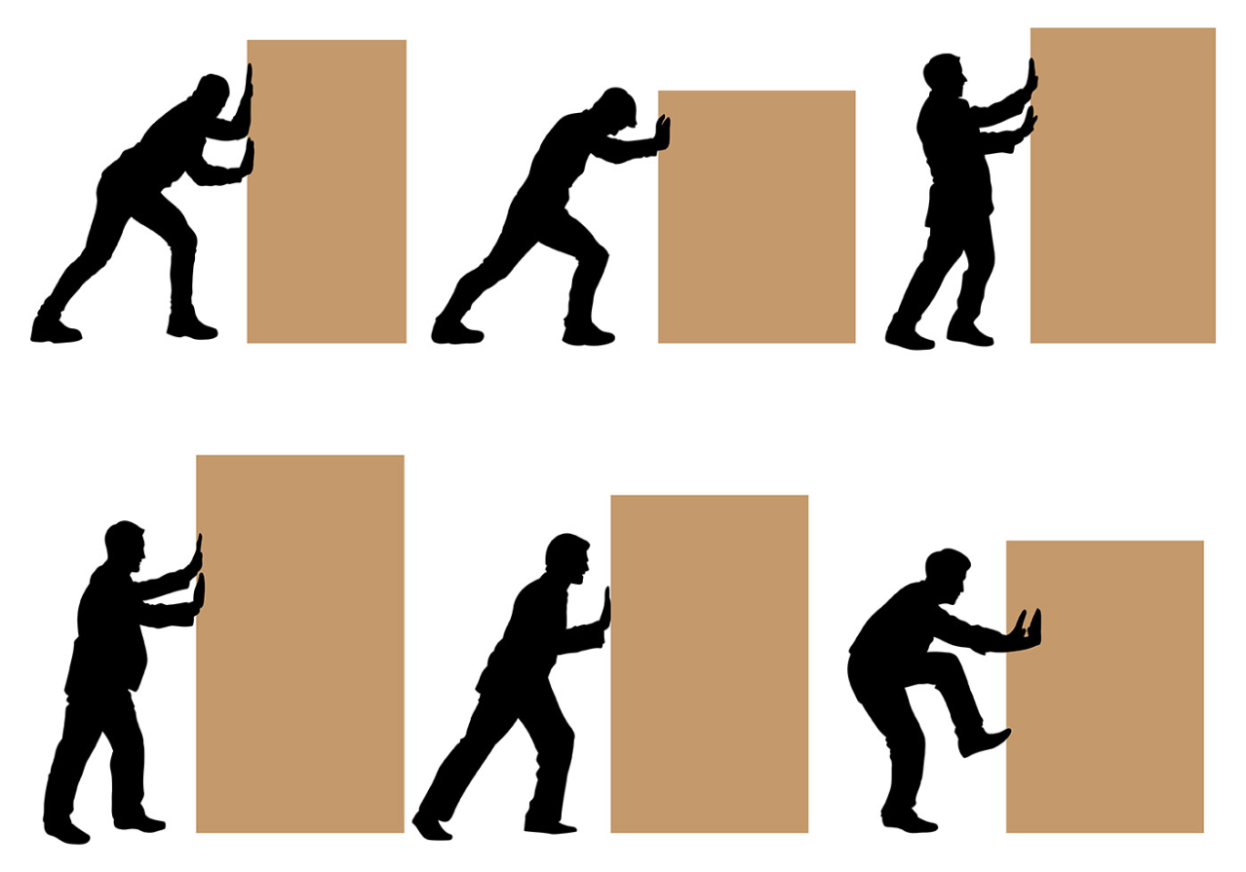
Real-time scheduling, resource blocking
Adam Hoover

Slide 2
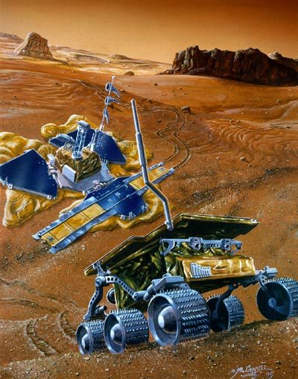
Outline
Direct vs push-through blocking
Calculating max blocking
RMA with blocking
Lab #8
Aperiodic tasks
Mars Pathfinder

Slide 3
Direct vs push-through blocking
direct = higher priority task waiting on lower priority task using needed resource
push-through = medium priority task delayed by priority inheritance of lower priority task
direct
push-through
task | priority
A | highest
B | high
C | medium
D | low
E | lower
F | lowest
task | priority
A | highest
B | high
C | medium
D | low
E | lower
F | lowest
waiting on resource
waiting
on resource
waiting on E
priority boosted to level A

Slide 4
Calculating max blocking
task | priority | time using resource | max blocking (direct) | max blocking (push-through) | max blocking
A | highest | 10 | 30 | 0 | 30
B | high | -- | 0 | 30 | 30
C | medium | 30 | 20 | 20 | 20
D | low | -- | 0 | 20 | 20
E | lowest | 20 | 0 | 0 | 0
max blocking = max(direct, push-through) per task

Slide 5
Example
task | priority | time using resource | max blocking (direct) | max blocking (push-through) | max blocking
A | highest | 42
B | higher | --
C | high | 34
D | medium | 17
E | low | --
F | lower | 25
G | lowest | 15
34
0
34
0
34
34
25
25
25
25
25
25
0
25
25
15
15
15
0
0
0

Slide 6
Calculating total max blocking
task | priority | time using R1 | max blocking R1 | time using R2 | max blocking R2 | total max blocking
A | highest | 10 | 30 | 40 | 15 | 45
B | high | -- | 30 | -- | 15 | 45
C | medium | 30 | 0 | 15 | 0 | 0
first, calculate max blocking per resource independently
sum across resources to get total max blocking

Slide 7
RMA with resource blocking
A set of tasks is schedulable if:
$$∀$$
i=1…n
let k=1…i
$$\left\lfloor \frac{T_{i}}{T_{k}}\right\rfloor$$
let l=1…
total max blocking
$$\sum_{j=1}^{i−1}{\left((R_{j}+O)\left\lceil \frac{lT_{k}}{T_{j}}\right\rceil \right)}+R_{i}+B_{i}≤lT_{k}$$
for some (k,l)

Slide 8
Example
$$∀$$
i=1…n
task | priority | R | T | B
A | high | 5 | 10 | 2
B | medium | 8 | 25 | 2
C | low | 9 | 60 | 0
let k=1…i
$$\left\lfloor \frac{T_{i}}{T_{k}}\right\rfloor$$
let l=1…
for some (k,l)
assume overhead = 0
$$\sum_{j=1}^{i−1}{\left((R_{j}+O)\left\lceil \frac{lT_{k}}{T_{j}}\right\rceil \right)}+R_{i}+B_{i}≤lT_{k}$$
i=1
let k=1…1
let l=1…floor(10/10)=1
(k,l) = (1,1)
$$5+2≤1∙10$$
7<= 10 ? yes, task A schedulable

Slide 9
Example
$$∀$$
i=1…n
task | priority | R | T | B
A | high | 5 | 10 | 2
B | medium | 8 | 25 | 2
C | low | 9 | 60 | 0
let k=1…i
$$\left\lfloor \frac{T_{i}}{T_{k}}\right\rfloor$$
let l=1…
for some (k,l)
assume overhead = 0
$$\sum_{j=1}^{i−1}{\left((R_{j}+O)\left\lceil \frac{lT_{k}}{T_{j}}\right\rceil \right)}+R_{i}+B_{i}≤lT_{k}$$
i=2
let k=1…2
let l=1…floor(25/10)=2
$$5\left\lceil \frac{1∙10}{10}\right\rceil +8+2≤1∙10$$
(k,l) = (1,1)
15 <= 10 ? no
$$5\left\lceil \frac{2∙10}{10}\right\rceil +8+2≤2∙10$$
(k,l) = (1,2)
20 <= 20 ? yes, tasks A&B schedulable

Slide 10
Example
$$∀$$
i=1…n
task | priority | R | T | B
A | high | 5 | 10 | 2
B | medium | 8 | 25 | 2
C | low | 9 | 60 | 0
let k=1…i
$$\left\lfloor \frac{T_{i}}{T_{k}}\right\rfloor$$
let l=1…
for some (k,l)
assume overhead = 0
$$\sum_{j=1}^{i−1}{\left((R_{j}+O)\left\lceil \frac{lT_{k}}{T_{j}}\right\rceil \right)}+R_{i}+B_{i}≤lT_{k}$$
i=3
let k=1…3
let l=1…floor(60/10)=6
$$5\left\lceil \frac{1∙10}{10}\right\rceil +8\left\lceil \frac{1∙10}{25}\right\rceil +9+0≤1∙10$$
(k,l) = (1,1)
5+8+9 <= 10 ? no
$$5\left\lceil \frac{2∙10}{10}\right\rceil +8\left\lceil \frac{2∙10}{25}\right\rceil +9+0≤2∙10$$
(k,l) = (1,2)
10+8+9 <= 20 ? no

Slide 11
Example
$$∀$$
i=1…n
task | priority | R | T | B
A | high | 5 | 10 | 2
B | medium | 8 | 25 | 2
C | low | 9 | 60 | 0
let k=1…i
$$\left\lfloor \frac{T_{i}}{T_{k}}\right\rfloor$$
let l=1…
for some (k,l)
assume overhead = 0
$$\sum_{j=1}^{i−1}{\left((R_{j}+O)\left\lceil \frac{lT_{k}}{T_{j}}\right\rceil \right)}+R_{i}+B_{i}≤lT_{k}$$
i=3
let k=1…3
let l=1…floor(60/10)=6
$$5\left\lceil \frac{3∙10}{10}\right\rceil +8\left\lceil \frac{3∙10}{25}\right\rceil +9+0≤3∙10$$
(k,l) = (1,3)
15+16+9 <= 30 ? no
$$5\left\lceil \frac{4∙10}{10}\right\rceil +8\left\lceil \frac{4∙10}{25}\right\rceil +9+0≤4∙10$$
(k,l) = (1,4)
20+16+9 <= 40 ? no

Slide 12
Example
$$∀$$
i=1…n
task | priority | R | T | B
A | high | 5 | 10 | 2
B | medium | 8 | 25 | 2
C | low | 9 | 60 | 0
let k=1…i
$$\left\lfloor \frac{T_{i}}{T_{k}}\right\rfloor$$
let l=1…
for some (k,l)
assume overhead = 0
$$\sum_{j=1}^{i−1}{\left((R_{j}+O)\left\lceil \frac{lT_{k}}{T_{j}}\right\rceil \right)}+R_{i}+B_{i}≤lT_{k}$$
i=3
let k=1…3
let l=1…floor(60/10)=6
$$5\left\lceil \frac{5∙10}{10}\right\rceil +8\left\lceil \frac{5∙10}{25}\right\rceil +9+0≤5∙10$$
(k,l) = (1,5)
25+16+9 <= 50 ? yes
tasks A,B,C schedulable
this system is schedulable

Slide 13
Aperiodic tasks
Aperiodic task = event that happens irregularly (not on fixed interval)
Can be handled several ways:
Polling = check for event on regular interval; schedule check periodically
Deferred = queue events when they occur; schedule event handler periodically
Sporadic server = queue events when they occur; handle events during times when no periodic tasks are running
These methods all depend on max event rate, queue capacity, and server event handling rate
time

Slide 14
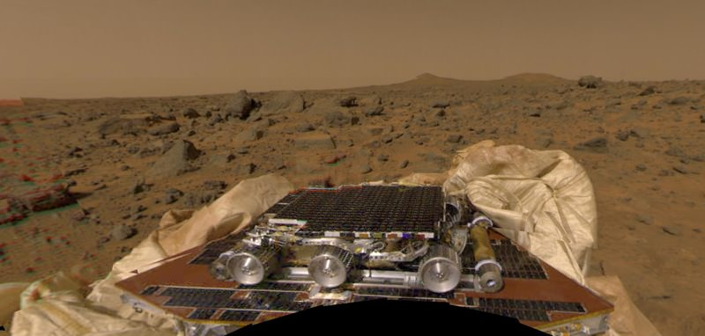
Mars pathfinder
NASA’s first robotic rover successfully landed on mars (video)
Mainstream news unaware that during Earth->Mars transit, the spacecraft was rebooting every few minutes and nobody could figure out why
Task traces and Earth-side simulations revealed a priority inversion
New task table uploaded to spacecraft, rebooted, everything worked
Real-time scheduling entered mainstream engineering

