Slide 1
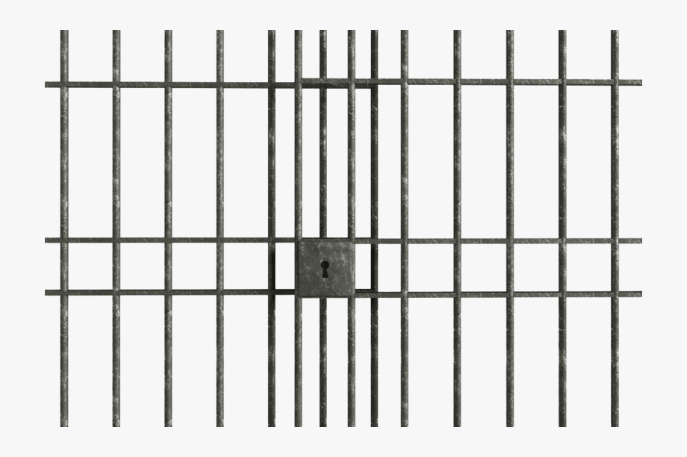
United States v. Microsoft Corporation
Adam Hoover

Slide 2
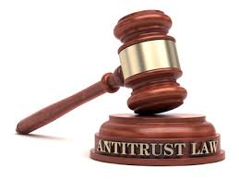
Outline
Standard Oil
Anti-trust laws (United States)
Court cases, remedies
Monopolies
Network externals (technology)
Microsoft
Google, Facebook, Amazon

Slide 3
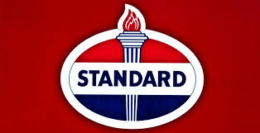
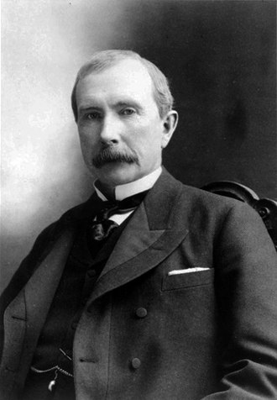
Standard Oil
Founded 1870 by J.D. Rockefeller in Ohio
Primary product was kerosene, used for heat and lighting

Slide 4
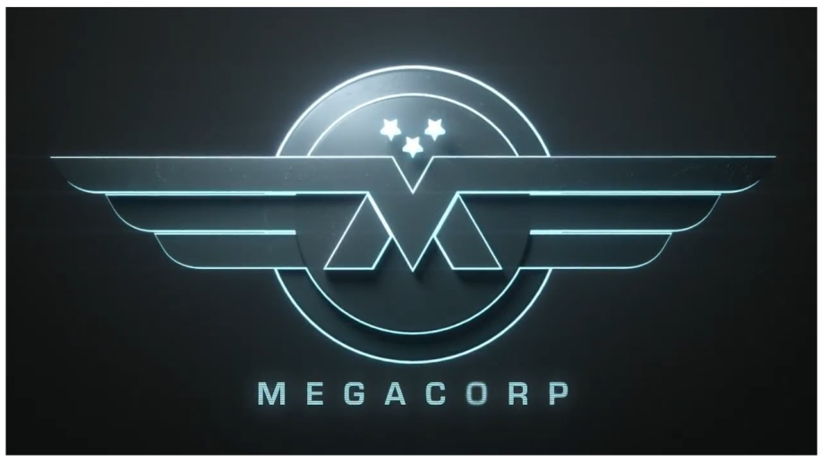
Standard Oil
How did Standard Oil become a “megacorp”?
Business practices:
Efficiency
Kerosene yields gasoline as a byproduct
Most manufacturers dumped it in rivers
Standard Oil used it to power their machines
Horizontal integration
Bought manufacturers in neighboring counties, then states
Sometimes shut down companies after purchase
Pressured other companies through price/volume
Vertical integration
Made deals with railroad companies to transport product
Locked railroads into monopoly deals

Slide 5
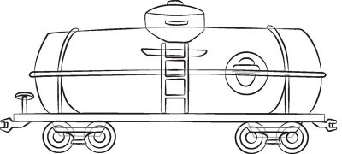
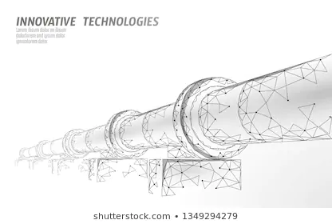
Standard Oil (fable?)
Rival company pumped oil through pipeline
Pipelines have to cross land owned by railroad companies
Rockefeller told railroad company to not allow pipeline in their land
Rival company used barrels to cross railroad and reenter pipeline
Rockefeller ordered empty trains parked in the way

Slide 6
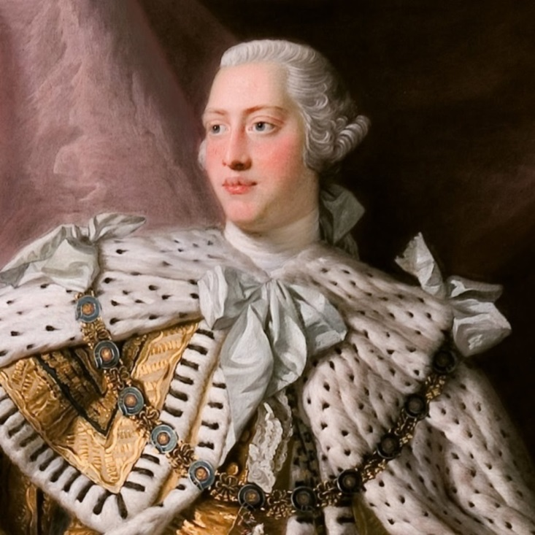
Wealth vs Royalty
Wealth = control, in business, politics and society
USA applauds gain of wealth to a point
King George III, England, 1738-1820
Royal family wealth today = $88 billion
JD Rockefeller, USA, 1839-1937
$400 billion (adjusted), 2% of US GDP

Slide 7
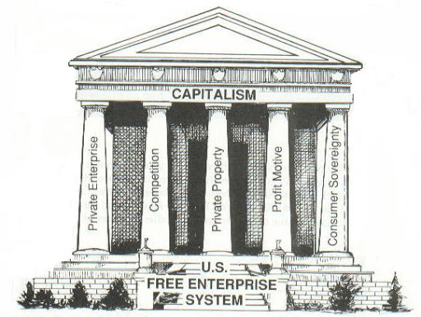
Free enterprise
Free enterprise requires a free market, aka “level playing field”
Consumers ultimately decide which businesses win or lose

Slide 8
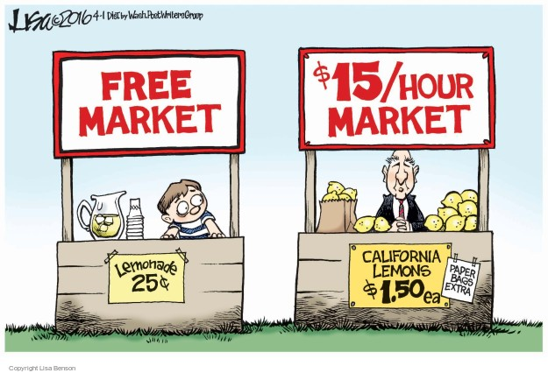
Fair market
Vendors can advertise, offer sales, and take actions to induce trade
fair …. unfair
Vendors cannot threaten or lie about competitors (false advertising)
Government’s job is to watch the market and ensure fairness

Slide 9
Government vs Standard Oil
State governments started passing laws limiting company ownership
Rockefeller invented “trust company” – company owning another company
1890 US Congress passed the Sherman Antitrust Act
Illegal to conduct practices that “restrain trade”
Example: conspiracy to control market (competitors colluding)
US government brings suit against company, must prove illegal acts
Remedy…
How do you put a company in jail?
Cannot “kill”, company providing important service to society
Break company up
Supervise compliance with free market practices (fines)

Slide 10
Breakup of Standard Oil
In 2020 still in list of top 10 richest companies in the world

Slide 11
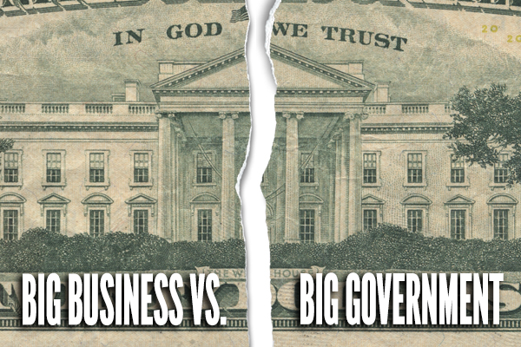
The battle continues…
1914 US Congress passed the Clayton Antitrust Act
Enumerated additional illegal practices:
Price discrimination between multiple buyers
Exclusive dealings that lessen competition
Product tying that lessens competition
Ownership in competitor companies
Mergers and acquisitions that lessen competition

Slide 12
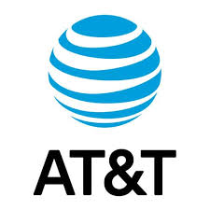
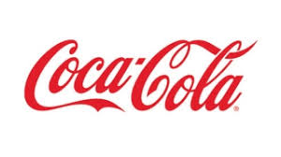
Companies prosecuted
1969, IBM -> voluntarily separated hardware/software sales
1982, AT&T -> “Baby Bell” companies (e.g. Bell South)
1987, Coca Cola and Pepsi -> price fixing (fines)
2014, NCAA -> still in progress
2020, Google, Amazon, Facebook all being watched closely

Slide 13
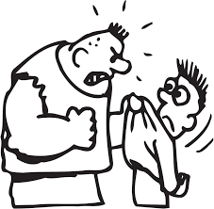
Monopolies
“Natural” monopoly is okay
For some services it saves redundant infrastructure costs
Utilities: electricity, garbage collection, water, internet(?)
Government provides assistance managing monopoly
Monopoly “leveraging” is not okay
Cannot use an existing monopoly to bully into another market
E.g. electric company cannot demand you buy milk from them to get service

Slide 14
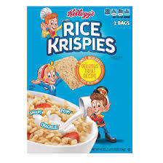
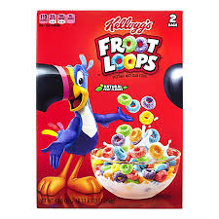
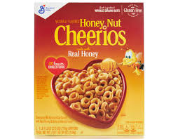
Product competition
Does the best product always win?
Historically, yes!
Example: A poor-tasting cereal is unlikely to gain customers

Slide 15
Network externals
Does the best technology always win?
Almost never
Examples:
1980, Beta vs VHS, video recording
MS Word vs other word processors
Network externals = value of product tied to how many people using it
Does not matter for widgets (stuff) but matters very much for technology
Very controversial idea, circa 1995, when Microsoft was prosecuted

Slide 16
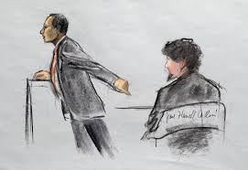
Prosecution of Microsoft
First, government had to prove existing monopoly (Windows O/S)
High barrier to entry in market (for new competing O/S)
Ability to raise prices at will
Second, the government enumerated anti-competitive practices:
Used O/S monopoly to leverage into web browser market
Tied browser to O/S, customer must buy both or neither
Required OEMs (Gateway, Dell, Compaq) to display Microsoft logo on boot
Browser incompatibility (forked HTML and related languages)
AOL decided to develop pages that only worked in Microsoft browser
Vaporware (announce product before it exists to prevent competition)

Slide 17
Microsoft’s defense
Claimed web browser integral feature of O/S
Tried to demonstrate that removing web browser caused O/S to break
Demo hilariously failed
Argued that web browser was “free”
Ignoring development costs
Made same claims with media player (music, video)
2000, Judge Jackson found Microsoft guilty
Recommended breakup into O/S and other software
2001, appellate court overturned, instituted fines and oversight (O/S API)
2005-6, EU levied massive fines in similar case

Slide 18
Lessons learned
Technologies not well-understood in politics, business, law
For example, what is an O/S?
Network externals = best product does not win in technology
First-to-market is critical
Information economy causing similar types of questions
Google, Amazon, Facebook among others

Slide 19
Big Tech in 2020’s
Facebook/Meta (2021 US FTC case)
Horizontal anti-competitiveness:
Bought Instagram for $1B in 2013
Bought WhatsApp for $19B in 2015
Amazon (2023 US FTC case)
Several practices to stifle competition in on-line market
Google/Alphabet (2017 - and others - EU cases)
Online advertising “tech stack” (80% of their income)
Maps, email, calendar, office tools, FitBit
As of 2024, EU has fined them 8.25 billion euros for breach of antitrust laws (still under appeal)
Apple (2024 US DoJ case)
Blocking/excluding/suppressing cross-platform smartphone apps
Hindering competition in smartwatch market

