Slide 1
Device Drivers
Adam Hoover

Slide 2
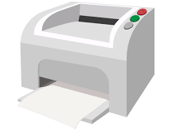
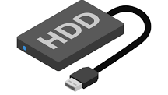
Hardware interface
application
device driver
Interface between applications and hardware
hardware

Slide 3
Software development
application
standardized interface across different hardware
application developer does not need to worry about hardware details
device driver developer (manufacturer) insulates hardware
device driver
device driver
device driver

Slide 4
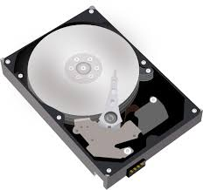
Design philosophy
all hardware treated like files
each piece of hardware gets its own filename
hardware accessed using file-like functions (open, read, etc.)
/dev/usb1
/dev/hda
/dev/lp

Slide 5
Device driver functions
device driver developer writes a set of functions:
struct file_operations driver_fops = {
read(),
open(),
close(),
write(),
seek(),
…
}
structure of function pointers
provided to O/S
application:
driver:
O/S
FILE *fpt;
fpt=fopen(“/dev/hda”, “r”);
driver_fops->open()

Slide 6
Device driver functions
struct file_operations driver_fops = {
read(), /* data transfer */
open(), /* setup */
close(), /* cleanup */
mmap(), /* provide access to driver memory */
ioctl(), /* control */
write(), /* data transfer */
seek(),
…
}
device driver developer can put any code in any function
typically open/close handle setup/cleanup
typically read/write handle data transfer
ioctl (i/o control) is “handyman” for everything else

Slide 7
O/S file management
normal file (ls -al):
-rw-r--r-- ahoover cuuser 6796 Sep 2 2019 index.html
permissions
(user, group, all)
(read, write, exec)
owner
file size
(bytes)
last
mod
date
filename
group
device files (ls -al):
brw-rw---- root disk 8, 0 Aug 24 2019 sda
brw-rw---- root disk 8, 1 Aug 24 2019 sda1
brw-rw---- root disk 8, 16 Aug 24 2019 sdb
brw-rw---- root disk 8, 17 Aug 24 2019 sdb1
crw-rw---- root disk 21, 0 Aug 24 2019 sg0
crw-rw---- root disk 21, 1 Aug 24 2019 sg1
driver file
b => block
c => character
major number
which set of functions to use
minor number
manage multiple copies

Slide 8
Creating a device file
To make a device filename, run the “mknod” command:
mknod –m660 /dev/sg0 c 21 0
b => block
c => character
major
number
minor
number
permissions
crw-rw---- root disk 21, 0 Aug 24 2019 sg0
Device filenames can be removed using the standard “rm” command

Slide 9
Providing driver code to O/S
Driver code can be compiled into the kernel:
make bzImage
kgcc kernel.c
…
kgcc driver.c
…
/boot/vmlinuz.img
The kernel file will contain the functions within “driver.c”
and be ready to use them upon booting.

Slide 10
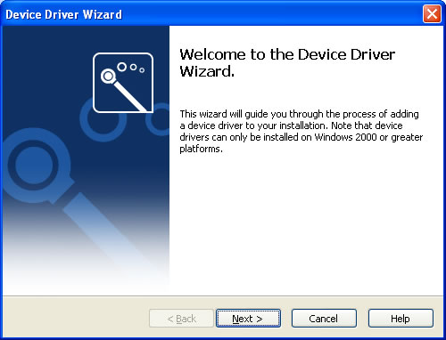
Dynamically add driver to O/S
Driver code can be dynamically linked into the kernel:
gcc driver.c
driver.o
insmod driver.o
(dynamically linked)
The kernel can be updated with new code using the “insmod” command.
This can be done while the kernel is currently running.

Slide 11
O/S module management
Driver developer writes functions for module insertion and removal:
insmod driver.o
module_init()
(setup, informs O/S
of major number)
rmmod driver.o
module_exit()
(cleanup, removal)
lsmod
(see list of all modules currently linked and in use)
These functions are included in the driver.c file.

Slide 12
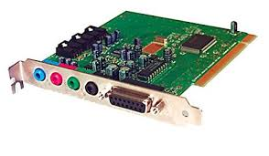
Writing the driver
struct file_operations driver_fops = {
read(), /* up to you */
open(), /* up to you */
close(), /* up to you */
mmap(), /* up to you */
ioctl(), /* up to you */
write(), /* up to you */
seek(), /* … */
…
}
different for every piece of hardware
usually a mix of C and assembly
read spec sheet (manual) from manufacturer
provide useful interface to application developers

Slide 13
When everything works correctly…
Users and application developers all benefit from good device drivers.

