Slide 1
Camera Calibration
Adam Hoover

Slide 2
Outline
Coordinate systems
Intrinsic vs extrinsic parameters
Pinhole model
Radial lens distortion
CCD parameters
Tsai’s model
Calibration process
MATLAB toolbox
Riggs Sensor Network Lab

Slide 3
Coordinate Systems
X_{w}
X
camera image plane
Y
Z
Z_{w}
Y_{w}
We seek to map points (X_{w} Y_{w} Z_{w}) in the world coordinate to points (X Y Z) in the camera coordinate system

Slide 4
Camera Parameters (Extrinsic)
X
R
T
Z
Y
Extrinsic parameters describe camera location
Position
Orientation
translation vector (Tx Ty Tz)
rotation matrix (Rx Ry Rz)

Slide 5
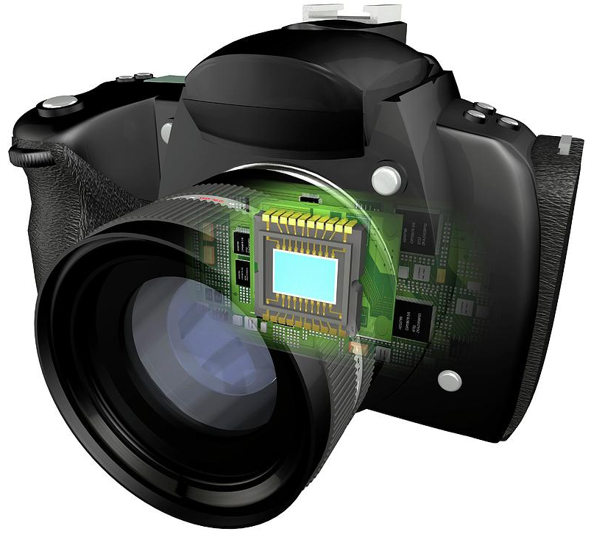
Camera Parameters (Intrinsic)
focal point
CCD
lens
light rays
Intrinsic parameters describe physics of how camera senses the world
Lens can bend the light rays to increase field-of-view
Focal length imaginary point where light rays converge
CCD sensing element

Slide 6
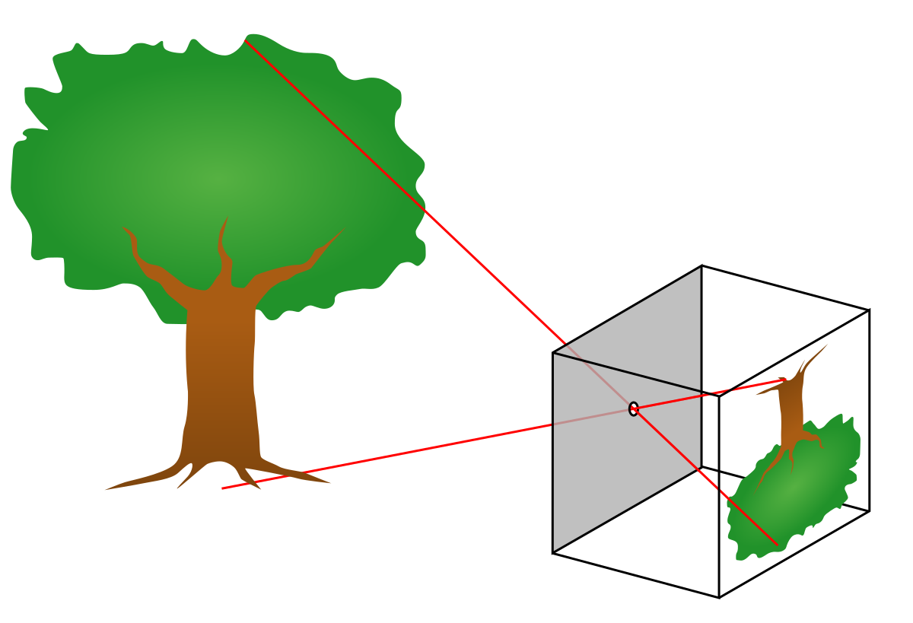
Pinhole Camera (no lens)
All cameras see inverted data. The image is typically flipped during A/D.
A pinhole camera has a field-of-view proportional to its image size.
The light rays are all sensed along straight lines.

Slide 7
Lensed Camera
A lens bends the light rays. They can bend inward or outward.
The field-of-view of is expanded (wide angle) or contracted (zoom) by the lens.
The focal length f manipulates the image size.

Slide 8
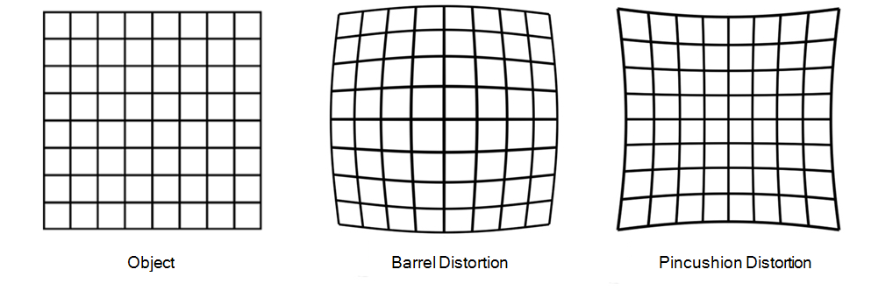
Lens Parameters
x_{u}
x_{d}
Distortion at each pixel calculated as:
$x_{d}=x_{u}/(1+k_{1}r^{2}+k_{2}r^{4}+…)$ $y_{d}=y_{u}/(1+k_{1}r^{2}+k_{2}r^{4}+…)$
where $r=\sqrt{x_{u}^{2}+y_{u}^{2}}$
although k terms can be infinite, in practice only 1-2 terms are used

Slide 9
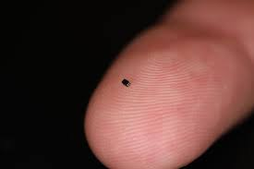
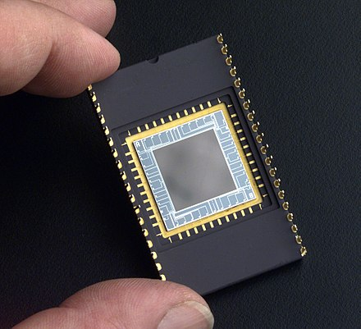
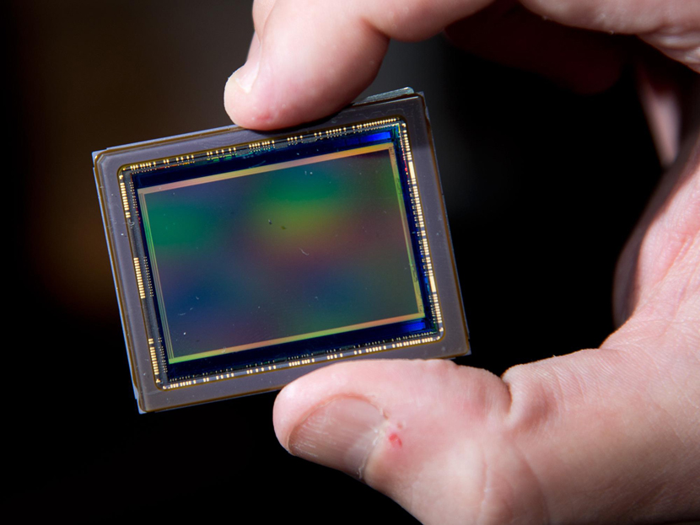
CCD sensor
CCD sensors can vary in size (sensing area).

Slide 10
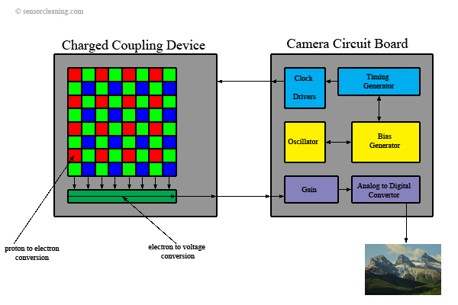
CCD package
A CCD is an analog sensor, but is commonly packaged with A/D circuitry.

Slide 11
CCD parameters
Nx
dx
CCD parameters include:
Nx,Ny # sensor elements
dx,dy distance between elements
sx XY scale factor (if non-square)
Cx,Cy offset between lens and CCD
(front view)
center of CCD
center of lens
offset
(side view)

Slide 12
Tsai’s Camera Model
X_{w}
X
Parameters:
Tx,Rx camera position/orientation
f focal length
k₁,k₂ lens distortion
sx XY scale factor (imperfections)
Cx,Cy offset between lens and CCD
Y
Z
Z_{w}
Y_{w}
We use the extrinsic and intrinsic parameters to map points (X_{w} Y_{w} Z_{w}) in the world coordinate system to points (X Y Z) in the camera coordinate system.
Other models use less (pinhole) or more parameters depending on the application and precision needed in the mapping.

Slide 13
Coordinate System Mapping
X_{w}
X
camera image plane
Y
Z
Z_{w}
Y_{w}
Step 1: world coordinates to camera coordinates
$\left[\begin{matrix}X \\ Y \\ Z\end{matrix}\right]=R\left[\begin{matrix}X_{w} \\ Y_{w} \\ Z_{w}\end{matrix}\right]$+T

Slide 14
Coordinate System Mapping
X_{w}
(side view)
X
(X_{u}, Z_{u})
(X, Z)
Y
Z
f
image plane
Z_{w}
$$\frac{X}{X_{u}}=\frac{Z}{f}$$
Y_{w}
Step 2: camera coordinates to ideal (undistorted) image coordinates
$$X_{u}=f\frac{X}{Z}$$
$$Y_{u}=f\frac{Y}{Z}$$
No “Z” in the image plane

Slide 15
Coordinate System Mapping
x_{u}
x_{d}
Step 3: ideal image coordinates to distorted (by lens) coordinates
$X_{d}=X_{u}/(1+k_{1}r^{2}+k_{2}r^{4})$ $Y_{d}=Y_{u}/(1+k_{1}r^{2}+k_{2}r^{4})$
where $r=\sqrt{X_{u}^{2}+X_{u}^{2}}$

Slide 16
Coordinate System Mapping
Nx
dx
center of CCD
center of lens
offset
(side view)
(front view)
Step 4: distorted image coordinates to pixel coordinates
$X_{p}=s_{x}\frac{N_{px}}{N_{x}}\frac{1}{dx}X_{d}+C_{x}$ $Y_{p}=\frac{N_{py}}{N_{y}}\frac{1}{dy}Y_{d}+C_{y}$
where (N_{px} N_{py}) are number of pixels in the digital image
Upscaling (N_{x} N_{y}) to a larger (N_{px} N_{py}) creates the illusion of a larger image

Slide 17
Calibration
X_{w}
X
Y
Z
Z_{w}
(0,3)
Y_{w}
calibration target
(0,0)
4.8 cm
(7,0)
origin of target coordinate system
Calibration uses a calibration target temporarily placed in the field-of-view.
The target has known dimensions and known world coordinates.
The target is constructed to simplify its segmentation during image processing.

Slide 18
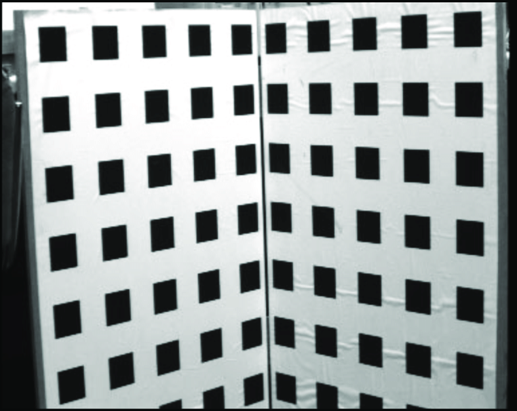
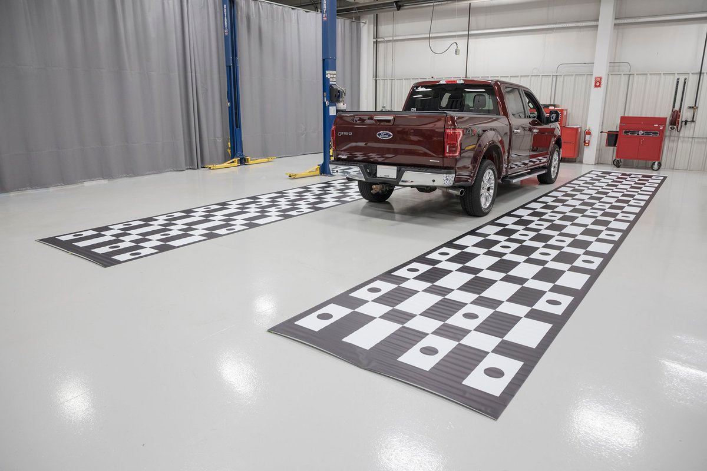
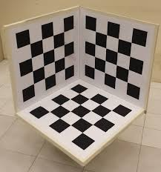
Targets
Checkerboard patterns are common because they are easy to segment.
1D patterns are sufficient, but 2D and 3D patterns can improve accuracy.
Filling the field-of-view improves estimates of lens distortion.

Slide 19
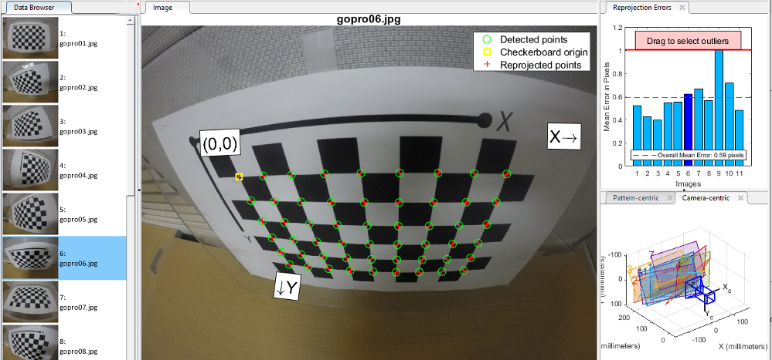
Image Processing
col,row = (703, 242)
x,y = (5.5, 0.5)
col,row = (356, 617)
x,y = (2.5, 5.5)
We need image (col, row) to world (x, y) coordinate mappings.
Image processing can find these (semi-)automatically.
Assymetry on the target grid can help define the axes.

Slide 20
Solving for Parameters
Input: list of image-to-world mappings
(col, row) (x, y)
(242,112) (0.5, 0.5)
(283, 116) (1.5, 0.5)
(331, 125) (2.5, 0.5)
… …
Set of equations describing camera model
Output: parameter values
Tx,Rx camera position/orientation
f focal length
k₁,k₂ lens distortion
sx XY scale factor (imperfections)
Cx,Cy offset between lens and CCD
Equation solutions can be linear or nonlinear depending on model complexity.
Minimum number of mappings depends on number of model parameters.
In general, five or more mappings are bare minimum.

Slide 21
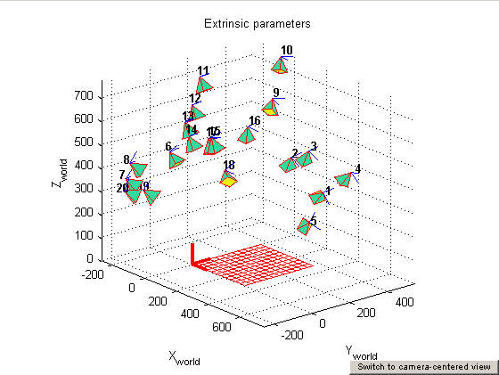
Visualizing Camera Model
Camera positions/orientations can be visualized relative to target.
This assumes the target did not move (the camera(s) moved).
Serves as a sanity check to detect errors during calibration process.

Slide 22
MATLAB
Install the Computer Vision Toolbox.
Instructions for using the calibrator app.

Slide 23
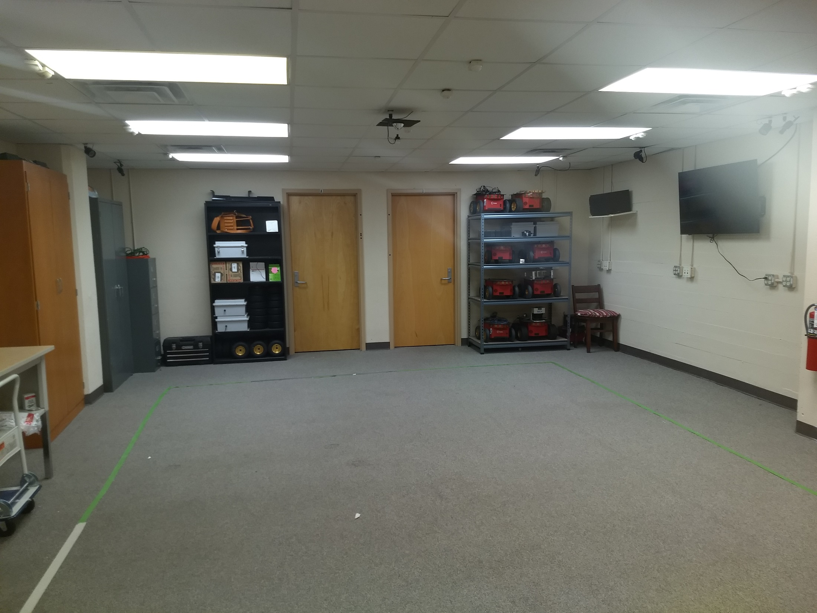
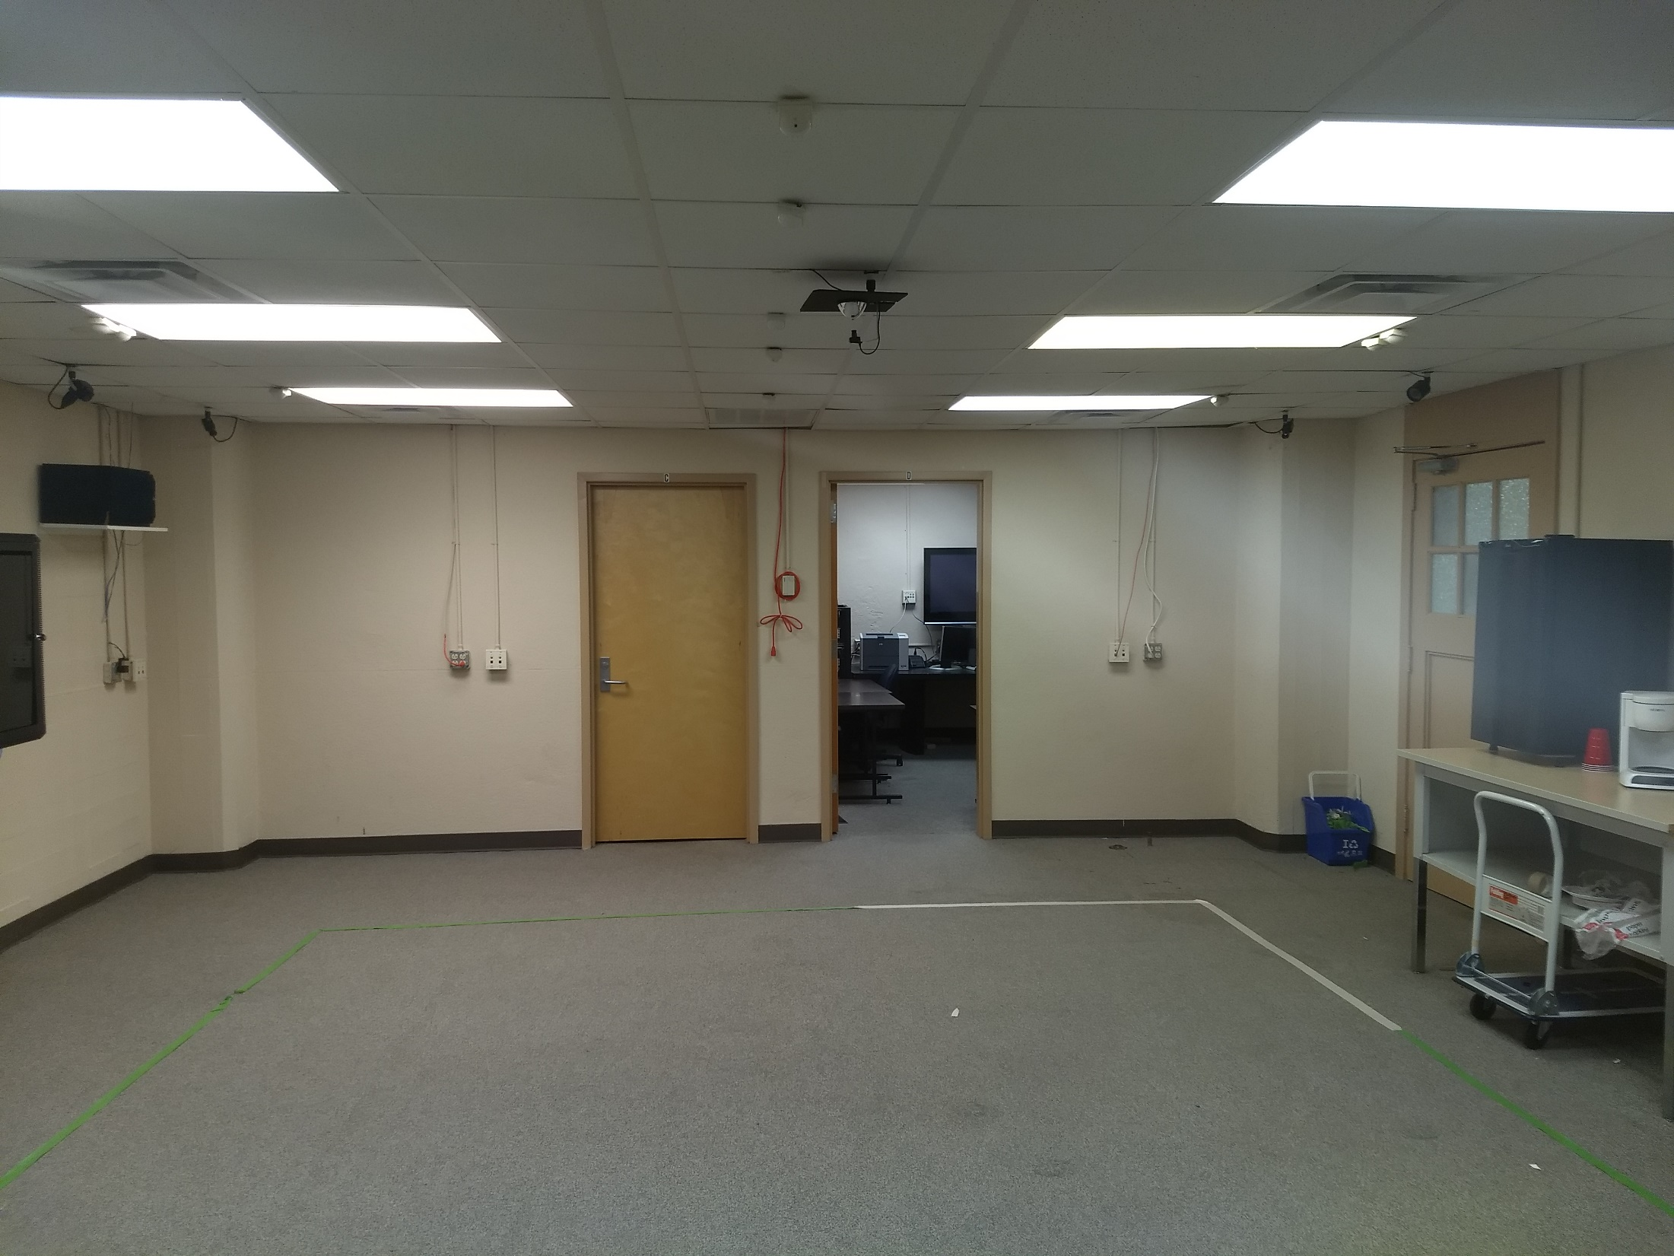
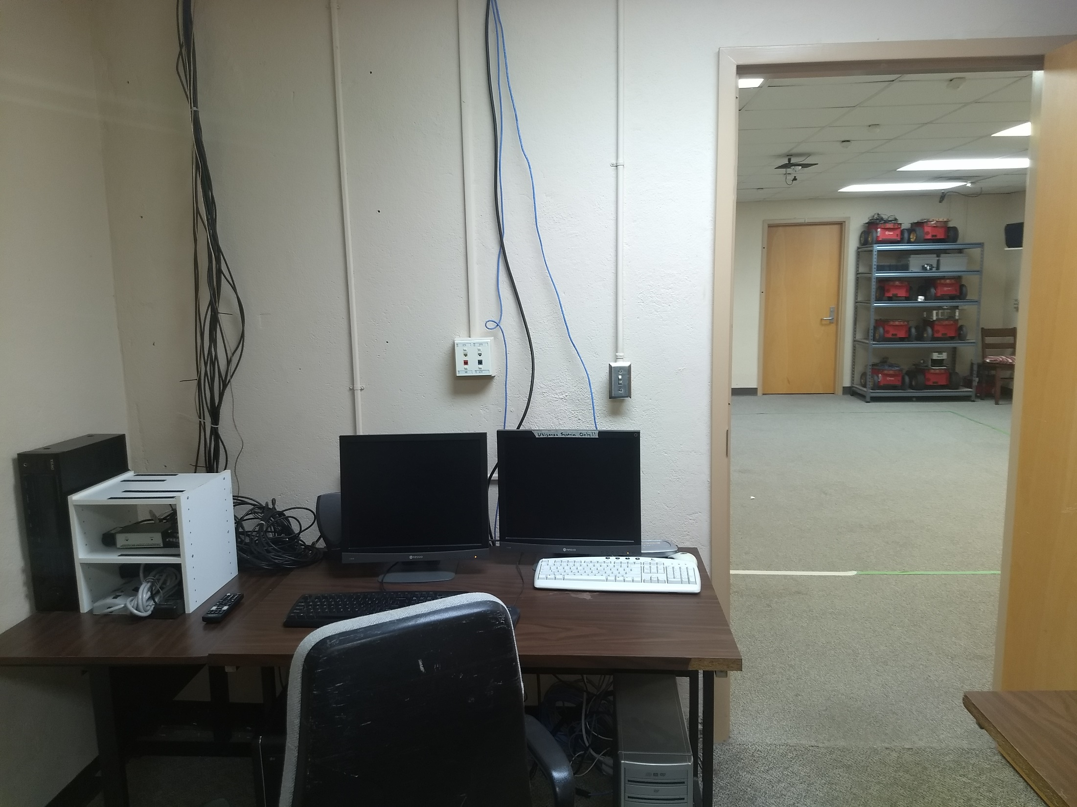
Riggs Sensor Network Lab
6 greyscale cameras
Computer and hardware in control room

Slide 24
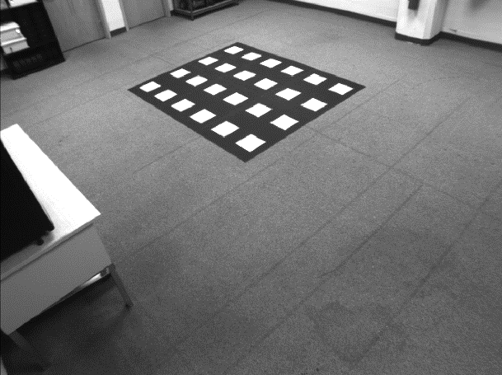
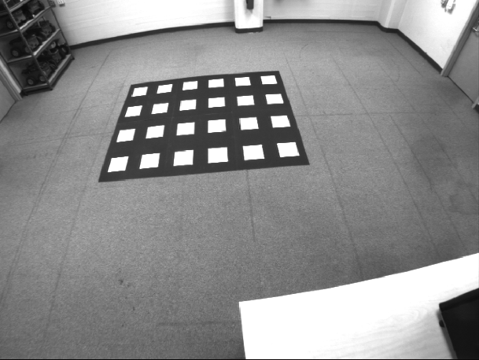
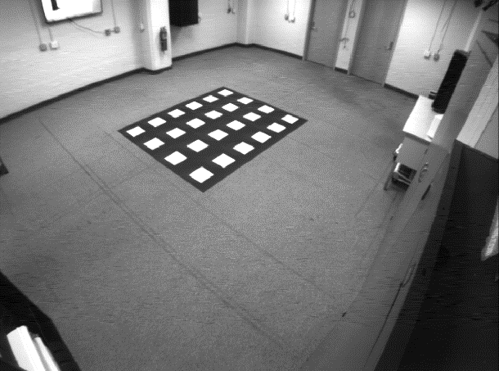
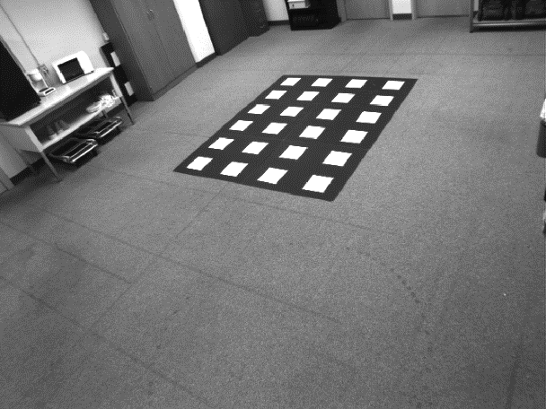
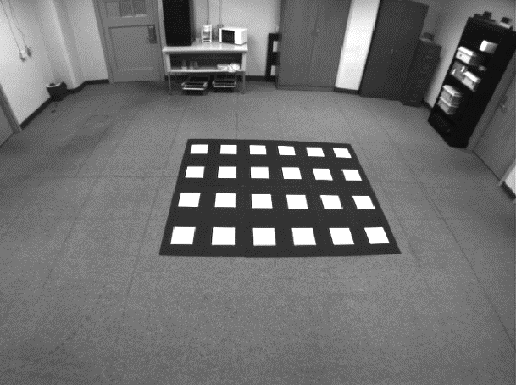
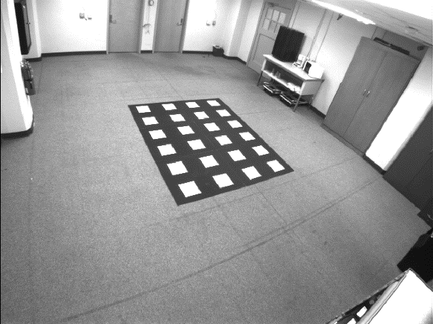
Riggs Sensor Network Lab
Custom calibration targets (poster boards)
Treat gently

Slide 25
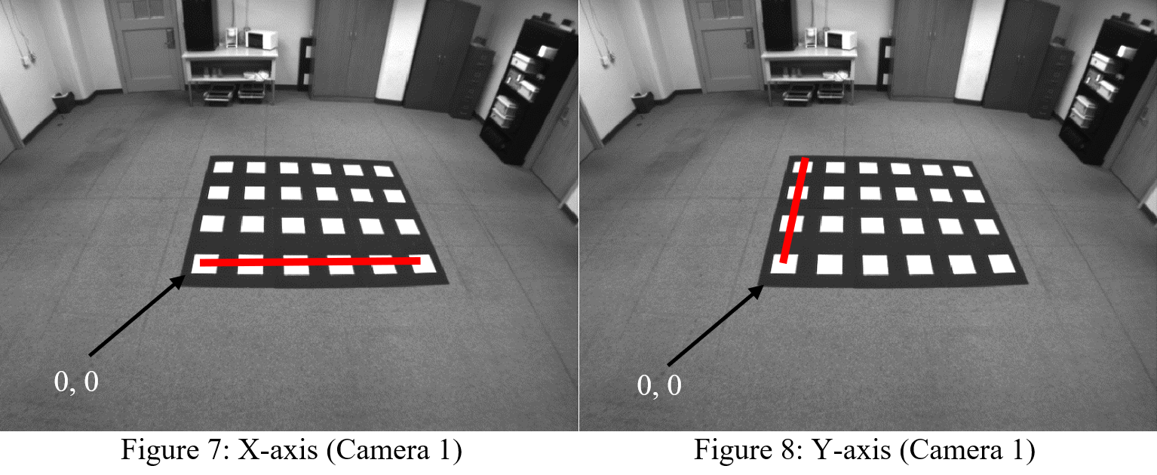
Riggs Sensor Network Lab
Custom software to capture image-to-world mappings and calibrate
Origin and axes identified manually per camera

Slide 26
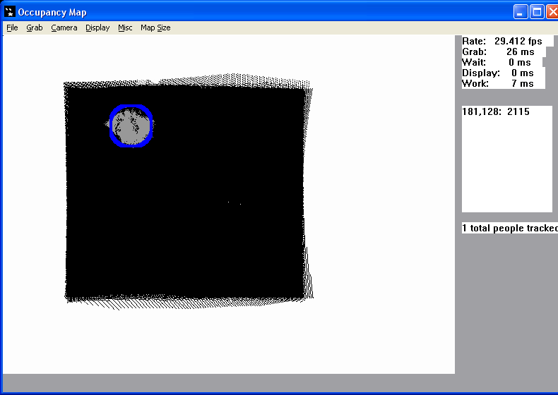
Tracking and Game Demo
Custom software to track people/objects moving around room
“Frog’s Revenge” virtual reality video game

